Slide 1
An introduction into later life considerations and estate planning
QC--490045869

Slide 2


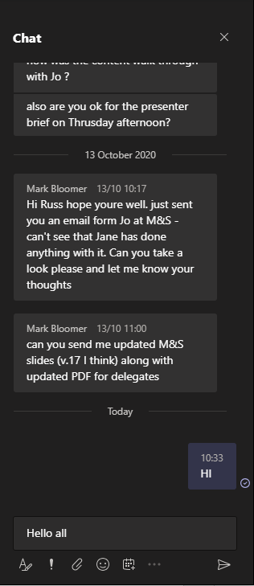

Using the chat box
click the chat box icon
type a message
Hello all…
tap the chat box icon
(it may be at the top of your device’s screen)
410452555

Slide 3
About us
We are a leading financial wellbeing and retirement specialist - helping those in the workplace to improve their financial future.
Established in 2005, we work with hundreds of organisations across both the private and public sector.
Our financial education services are delivered on a bespoke basis.
341377444

Slide 4

Financial education structure
Follow up call
You will be able to ask questions relating to your own circumstances.
Online Seminar
Next steps
Today’s online seminar will cover financial education.
We will identify your next steps and point you in the right direction.
27949402

Slide 5
Agenda
  Long term care
  Estate planning
  Inheritance tax
  Your pension savings on death
  Organising your affairs
  Further information

Slide 6
Long term care
728840750
Notes:
728840750

Slide 7





How much you pay depends on..
The value of your savings, assets and income
The level of help you need
What funding you might be entitled to
Your health
Free NHS Continuing Healthcare
You may qualify if you have mostly healthcare needs rather than social needs
There’s no clear-cut list of health conditions or illnesses that qualify
The assessment is strict - most people do not qualify
To apply, ask your GP or social worker for a NHS Continuing Healthcare assessment
WEALTH at work colours
163474269
Notes:
163474269
Note to presenter:
NHS FUNDED CARE ASSESSMENT:
What is covered?
Normal NHS healthcare – for example, from your GP, health visitor or in hospital – is free.
But NHS continuing healthcare covers extra costs, such as help with washing or dressing, or paying for specialist therapy.
It might also include accommodation if your care is provided in a care home, or support for carers if you’re being looked after at home.
Step 1 – The initial screening
First, you’ll have an initial screening to see if you qualify for funding.
It’s usually carried out in hospital or at home by a nurse, doctor, social worker or other healthcare professional.
They’ll assess your general health and care needs with a simple checklist. It will cover:
mobility
breathing
continence
communication
nutrition – food and drink
skin – including wounds and ulcers
psychological and emotional needs
altered states of consciousness
symptom control through drug therapies and medication
cognition – everyday understanding of what’s going on around you
other significant care needs.
If your health, or the health of someone you care for, is getting worse quickly – ask about a fast track assessment to bypass the initial screening.
Step 2 – The assessment
Even though the assessment process can be complex, most people and families who’ve been through it say the benefits are worth it.
If the initial screening shows you might be able to get free NHS continuing healthcare, you’ll need to have another assessment.
It will be carried out by a team of two or more health and social-care professionals who are involved in your care.
The team will use a Decision Support Tool which is more detailed than the checklist above. They will assess the possibility of ultimate eligibility and will decide if you should be red to the next stage.
They’ll mark each of your care needs as no need, low, moderate, high, severe or priority.

Slide 8



Local council funded care
STEP 1 – CARE NEEDS ASSESSMENT
STEP 2 – FINANCIAL ASSESSMENT
A social worker carries out the assessment
Care isn’t normally free
Needs are checked against nationally agreed criteria
There’s a means tested financial assessment
The council has a duty to provide &/or arrange the care services
This will show you how much you will need to contribute
473142282
Notes:
473142282
For use in England, Scotland & Wales
Getting a local council care needs assessment
Before they can help, your local council must carry out a care needs assessment. It’s free and it’s your legal right to have one.
You shouldn’t be ed an assessment because the local council thinks your needs aren’t great enough or that you won’t qualify for financial help.
The local council will identify your care needs and check that they meet a nationally agreed set of criteria.
If you qualify for help, they have a legal duty to provide or arrange the services you need.
They’ll then carry out a financial assessment to work out if you should pay towards any services you need.
Financial assessment and eligibility
If you qualify for help, your local council will carry out a financial assessment.
This is called a ‘means test’. It helps to work out how much you should pay towards the cost of your care.

Slide 9


Financial assessment – looks at:
YOUR REGULAR
INCOME
YOUR
CAPITAL
  State Pension & benefits
  Savings & Premium Bonds
  Private & occupational pensions
  Investments
  Rental income
  Your home & other property
If you have income as part of a couple, then only your share will be taken into account
  Jointly held assets are generally split equally
714573089
Notes:
714573089

Slide 10
Financial assessment – your home
Any of the following still live there:
    a spouse, partner or civil partner
    a close relative who is over 60 or older or receives disability benefit
    a child you’re legally responsible to support
WEALTH at work colours
You move into care on a temporary basis
You will be receiving care in your own home
£
Your home will be excluded if:
288002785
Notes:
288002785

Slide 11

Deprivation of assets
  Deliberately decreasing your assets to reduce the amount you are charged towards care
£
WEALTH at work colours
Evidence
  Your local council (HSC in Northern Ireland) must show that you have intentionally reduced your assets
£
  Third parties who received the assets could be liable to repay the local council (or HSC)
Source: Department of Health – Care & Support Statutory Guidance
441896711
Notes:
441896711

Slide 12



Capital limits: England
Fully Funded
Partially Funded
You will need to contribute £1 for every £250 of capital above £14,250
Self Funded
Capital of less than:
£14,250
Capital between:
£14,250 - £23,250
Capital of more than:
£23,250
You may still be expected to contribute from your income
Limits apply to residential care and care at home
224808411
Notes:
224808411
Note to lecturer – Display in England

Slide 13



Changes from Oct 2025 - England
£86,000 cap
What’s not included
Revised capital limits
The cap will cover care and support costs
It will be maintained by your local authority
Rent
Food
Utility bills
Top-ups for preferred care provider
Any care costs incurred before October 2025
Fully funded – capital of less than £20,000*
Partially funded – capital between £20,000 & £100,000*
Self funded – capital of £100,000 or more
*You may still need to contribute from your income
88826433
Notes:
Note to lecturer – Display in England
Delayed in the Autumn Statement 2022, from Oct 2023 to Oct 2025

Slide 14





Paying for care costs
Equity release
Can you claim any benefits?
Access money tied up in your property
Downsizing or renting out your home
Search: ‘Age UK benefits calculator’
It may be more cost effective than equity release
DWP
£
Immediate needs annuity
Selling things you own
Provides a regular income in exchange for a lump sum - income is tax-free if paid directly to care provider
Such as art, antiques or collectibles
633080641
Notes:
633080641
Note to lecturer:
Claim the benefits you’re entitled to
Attendance Allowance is money for people aged 65 or over who have care needs.
It could include help outside the home. It does not matter if no one actually gives this help, as long as you can show you need it.
You can have any type of disability or illness, including sight or hearing impairments, or mental health issues such as dementia.
To claim Attendance Allowance you must have needed help with your care needs for at least 6 months. (If you’re terminally ill you can make a claim straight away.)
Attendance Allowance is not means-tested so your income and savings are not taken into account when assessing if you qualify for the benefit.
It is paid tax-free - Claiming Attendance Allowance won’t reduce any other income you receive.
Depending on the situation other benefits may be available. Benefit calculators are available at the following charities websites:
Entitled to (www.entitledto.co.uk)
Turn2us (www.turn2us.org.uk)
Equity release – consider overall cost
When it comes to long-term-care planning, equity release schemes can be useful, but only if you’re looking to fund care in your own home and you do not qualify for local authority support.
However, if you think you’ll soon need to move out into residential care, then equity release probably won’t be suitable.
That’s because equity release arrangements require you to repay the loan in full if you move permanently into a care home.

Slide 15
Estate planning
495410273

Slide 16




Estate planning
  During your life you build up personal wealth, your ‘estate’
  Estate Planning involves protecting your wealth and ensuring it passes to the people you want it to
  It’s an evolving process and may include:
    Gifting money during your lifetime
    Updating beneficiaries on life assurance and pensions
    Setting up a Lasting Power of Attorney
    Creating a Will
2
3
1
Estate Planning
4
954600983

Slide 17




Why is estate planning important?
Intestacy
IHT
LPOA
Health and Funeral
Without a Will, Intestacy Laws decide who gets what
Make the most of the allowances available to you
  Assign someone to look after your money if you lose mental capacity
Detail your health and funeral wishes
427616810

Slide 18
Inheritance tax

Slide 19


Inheritance tax (IHT)
  HMRC apply IHT to your worldwide assets if you are a long-term resident of the UK
  Long-term residents are those UK-resident for over 10 of the last 20 tax years
  You may still count as a long-term resident for up to 10 years after leaving the UK
81349940
Notes:
0

Slide 20





Inheritance tax (IHT)
Residence Nil Rate Band
Transfer unused portion
100,000
100,000
100,000
Nil Rate Band
IHT
Charge
£325,000
£175,000
up to £500k
40%
Applied to any part of an estate that is chargeable to IHT
Only applied to a home that is left to a direct descendant
A couple could potentially pass on up to £1m before IHT becomes due*
*A couple in this context is a spouse or civil partner
741423466
Notes:
IHT is a tax charge applied to an individual’s estate, usually at the point they die

Slide 21
Inheritance tax (IHT) - example
The estate is worth £515,000 after IHT
The estate
£10,000
40% IHT charge
£25,000
Excess subject to IHT
£15,000
Net excess
£450,000
Total nil rate band limit
£175,000
£50,000
Residence nil rate band
£25,000
£325,000
Total £525,000
Nil rate band
The estate is being passed to a direct descendant
927393826
Notes:
A person’s estate is made up of everything they own at the point they die
Highlight that non exempt gifts made in 7 years prior to death are included in the estate.

Slide 22

Your estate
In addition to the nil rate bands, there are a number of other gifts that can be made free from IHT. These include gifts to:
A spouse or civil partner
+
Gifts that are free from IHT regardless of who the recipient is:
  The proceeds of a Life Assurance policy held in trust
  Discretionary payments from a pension on death to any nominated beneficiary
Political parties in the UK
Any registered charity
From 6 April 2027, unspent DC pension pots and lump sum death benefits from a DB plan left to non-spouse/civil partner beneficiaries will be subject to Inheritance Tax.
281704780
Notes:
0

Slide 23
Your pension savings on death

Slide 24
Your DC pension savings
If you have remaining benefits in a defined contribution pension when you die, these are taxed differently to non pension savings.
Inheritance tax does not currently apply to benefits held in a registered pension scheme, however unspent pension pots will be included in your estate from April 2027
If death occurs before age 75, benefits are usually paid to your chosen beneficiary free of income tax*
If death occurs after age 75 benefits are taxed on receipt at the beneficiaries marginal rate of tax
If a member has purchased an annuity, any payment after death will be dependent on whether cover for a partner has been selected and subject to income tax
*Tax would be due if the total pension savings exceeds the lump sum death benefit allowance of £1,073,100.

Slide 25




Annuities
What is payable will depend on the options you selected when you set the annuity up.
Options include:
Joint life
Guaranteed period
Lump sum
Notes:
Be aware that if someone opted for a single life annuity, the payments would usually stop when you die.
If you set the annuity up on a joint life basis, your beneficiary will continue to receive a proportion of the income you were receiving.
There might be further payments if you had a guarantee period and died within the guarantee period. In this case income will continue to your beneficiary until the end of the guarantee period.
A lump sum could also be payable if value protection were included.

Slide 26




Your DB pension savings
If you have a defined benefit pension, any money to be paid to your beneficiaries will be as outlined in the scheme’s rules.
Your pension administrator may pay a dependant’s pension to:
your spouse or civil partner
your children
a financial dependent
Any income paid to a dependant will be taxed as earnings at their marginal rate.
Notes:
Advise attendees to contact their DB pension provider for further information as all schemes are different.
The pension they will get will usually be a percentage of the pension they were getting (or would have got if you die before the pension started being paid).
DB pensions are only usually paid to children if: they are under the age of 23 or if they’re mentally or physically impaired (MoneyHelper)
If the pension payable is fairly small, it might be possible to take it as a lump sum instead

Slide 27




Updating nomination forms
Review the nominations for your pension and life assurance policies
Review chosen beneficiaries for your pension and DIS
Review any legacy pensions from previous employment
Proceeds from both are usually paid free of IHT
235722909
Notes:
9

Slide 28

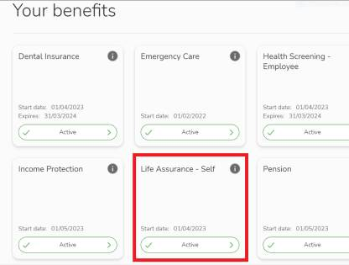
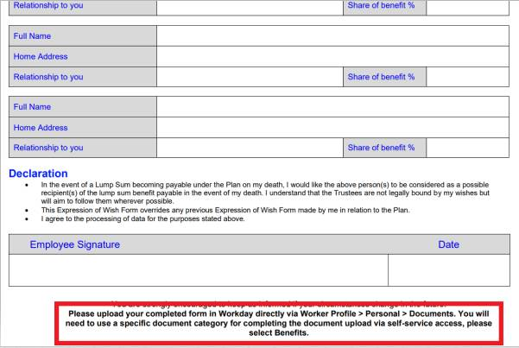
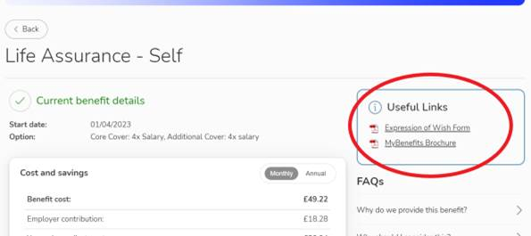
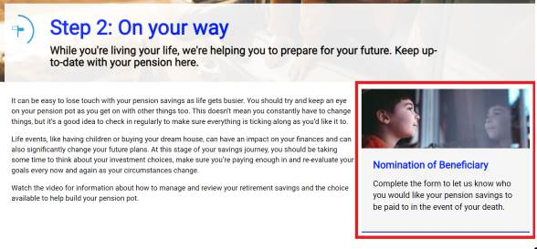
Updating nomination forms
Notes:
Expressions of wish form
People need to go to our MyBenefits system, view their benefits and follow the hi-lighted steps below – once completed they need to upload this to our Workday system as per the last screenshot.
pension expression of wish
Do this on the L&G pension site (4th image)

Slide 29
Organising your affairs

Slide 30






Lasting power of attorney
Paying bills
Where you live
Buying & selling property, paying the rent or mortgage
Property and Financial Affairs
Health and
Care
Medical care & what you should eat
Investing money
Who you should have contact with
208189833
Notes:
FOR USE IN ENGLAND AND WALES ONLY
Presenter Note:
If a lasting power of attorney is not in place the Court of Protection can step in – this can be a lengthy, complicated and expensive process
Remember Advanced Directive - communicate your wishes to trusted parties

Slide 31

Create a “when I go file”
A copy of your Will.
Savings
Pre paid funeral plans
Bank accounts
Loans & Credit cards
STEP
STEP
01
04
Contact details for:
Executor
Solicitor
Financial adviser
Any other professionals
STEP
STEP
A Cancel list:
Standing orders
Direct debits
Memberships
02
05
Providers and account numbers of:
Pensions
Life assurance
Investments
STEP
STEP
06
03
Funeral wishes
902651358
Notes:
8
Presenter notes:
Aim to create a quick-ence guide to everything that will need to be addressed when someone dies to make it easier for surviving family members to sort through. Tell close family / the executor / a partner where this file is.

Slide 32
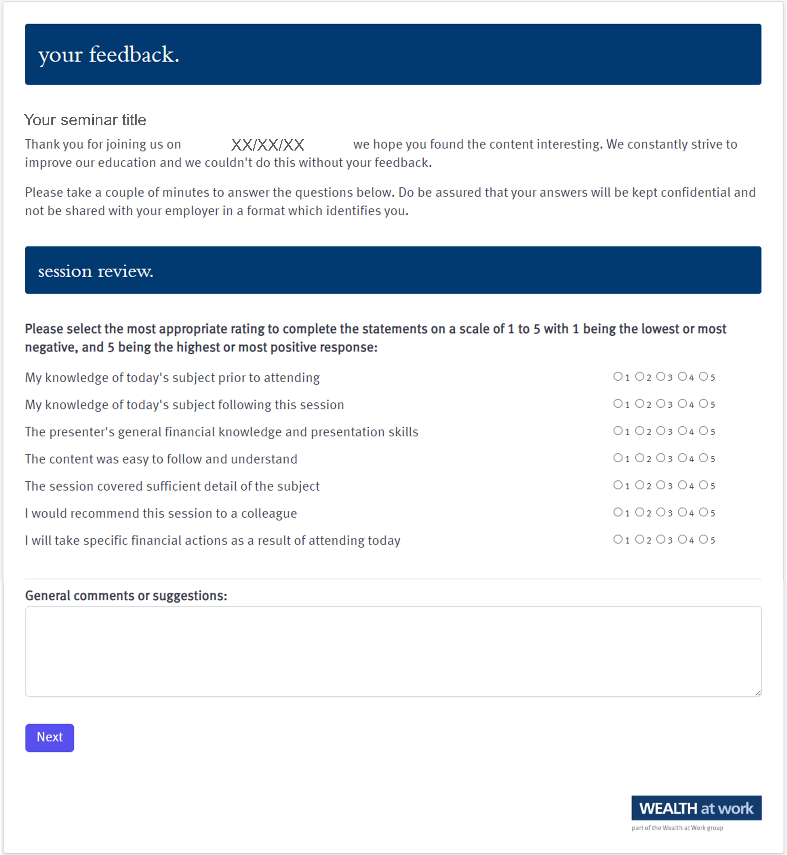
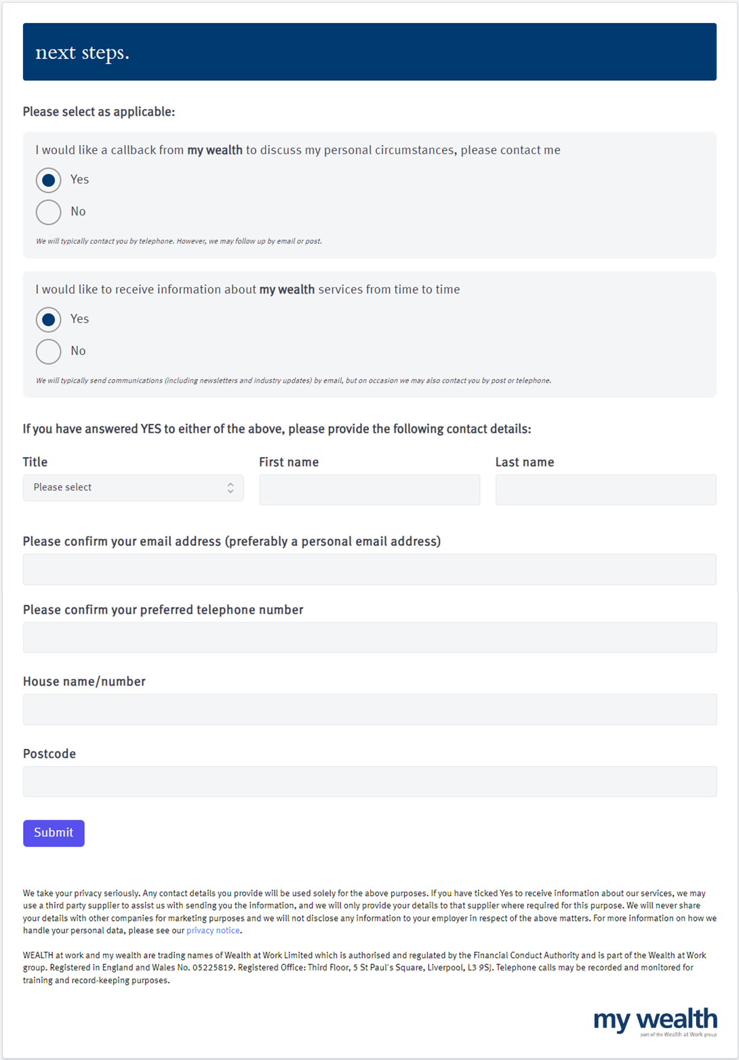
Your feedback
759533470

Slide 33
Next steps
211146986

Slide 34
Next steps
393965084

Slide 35
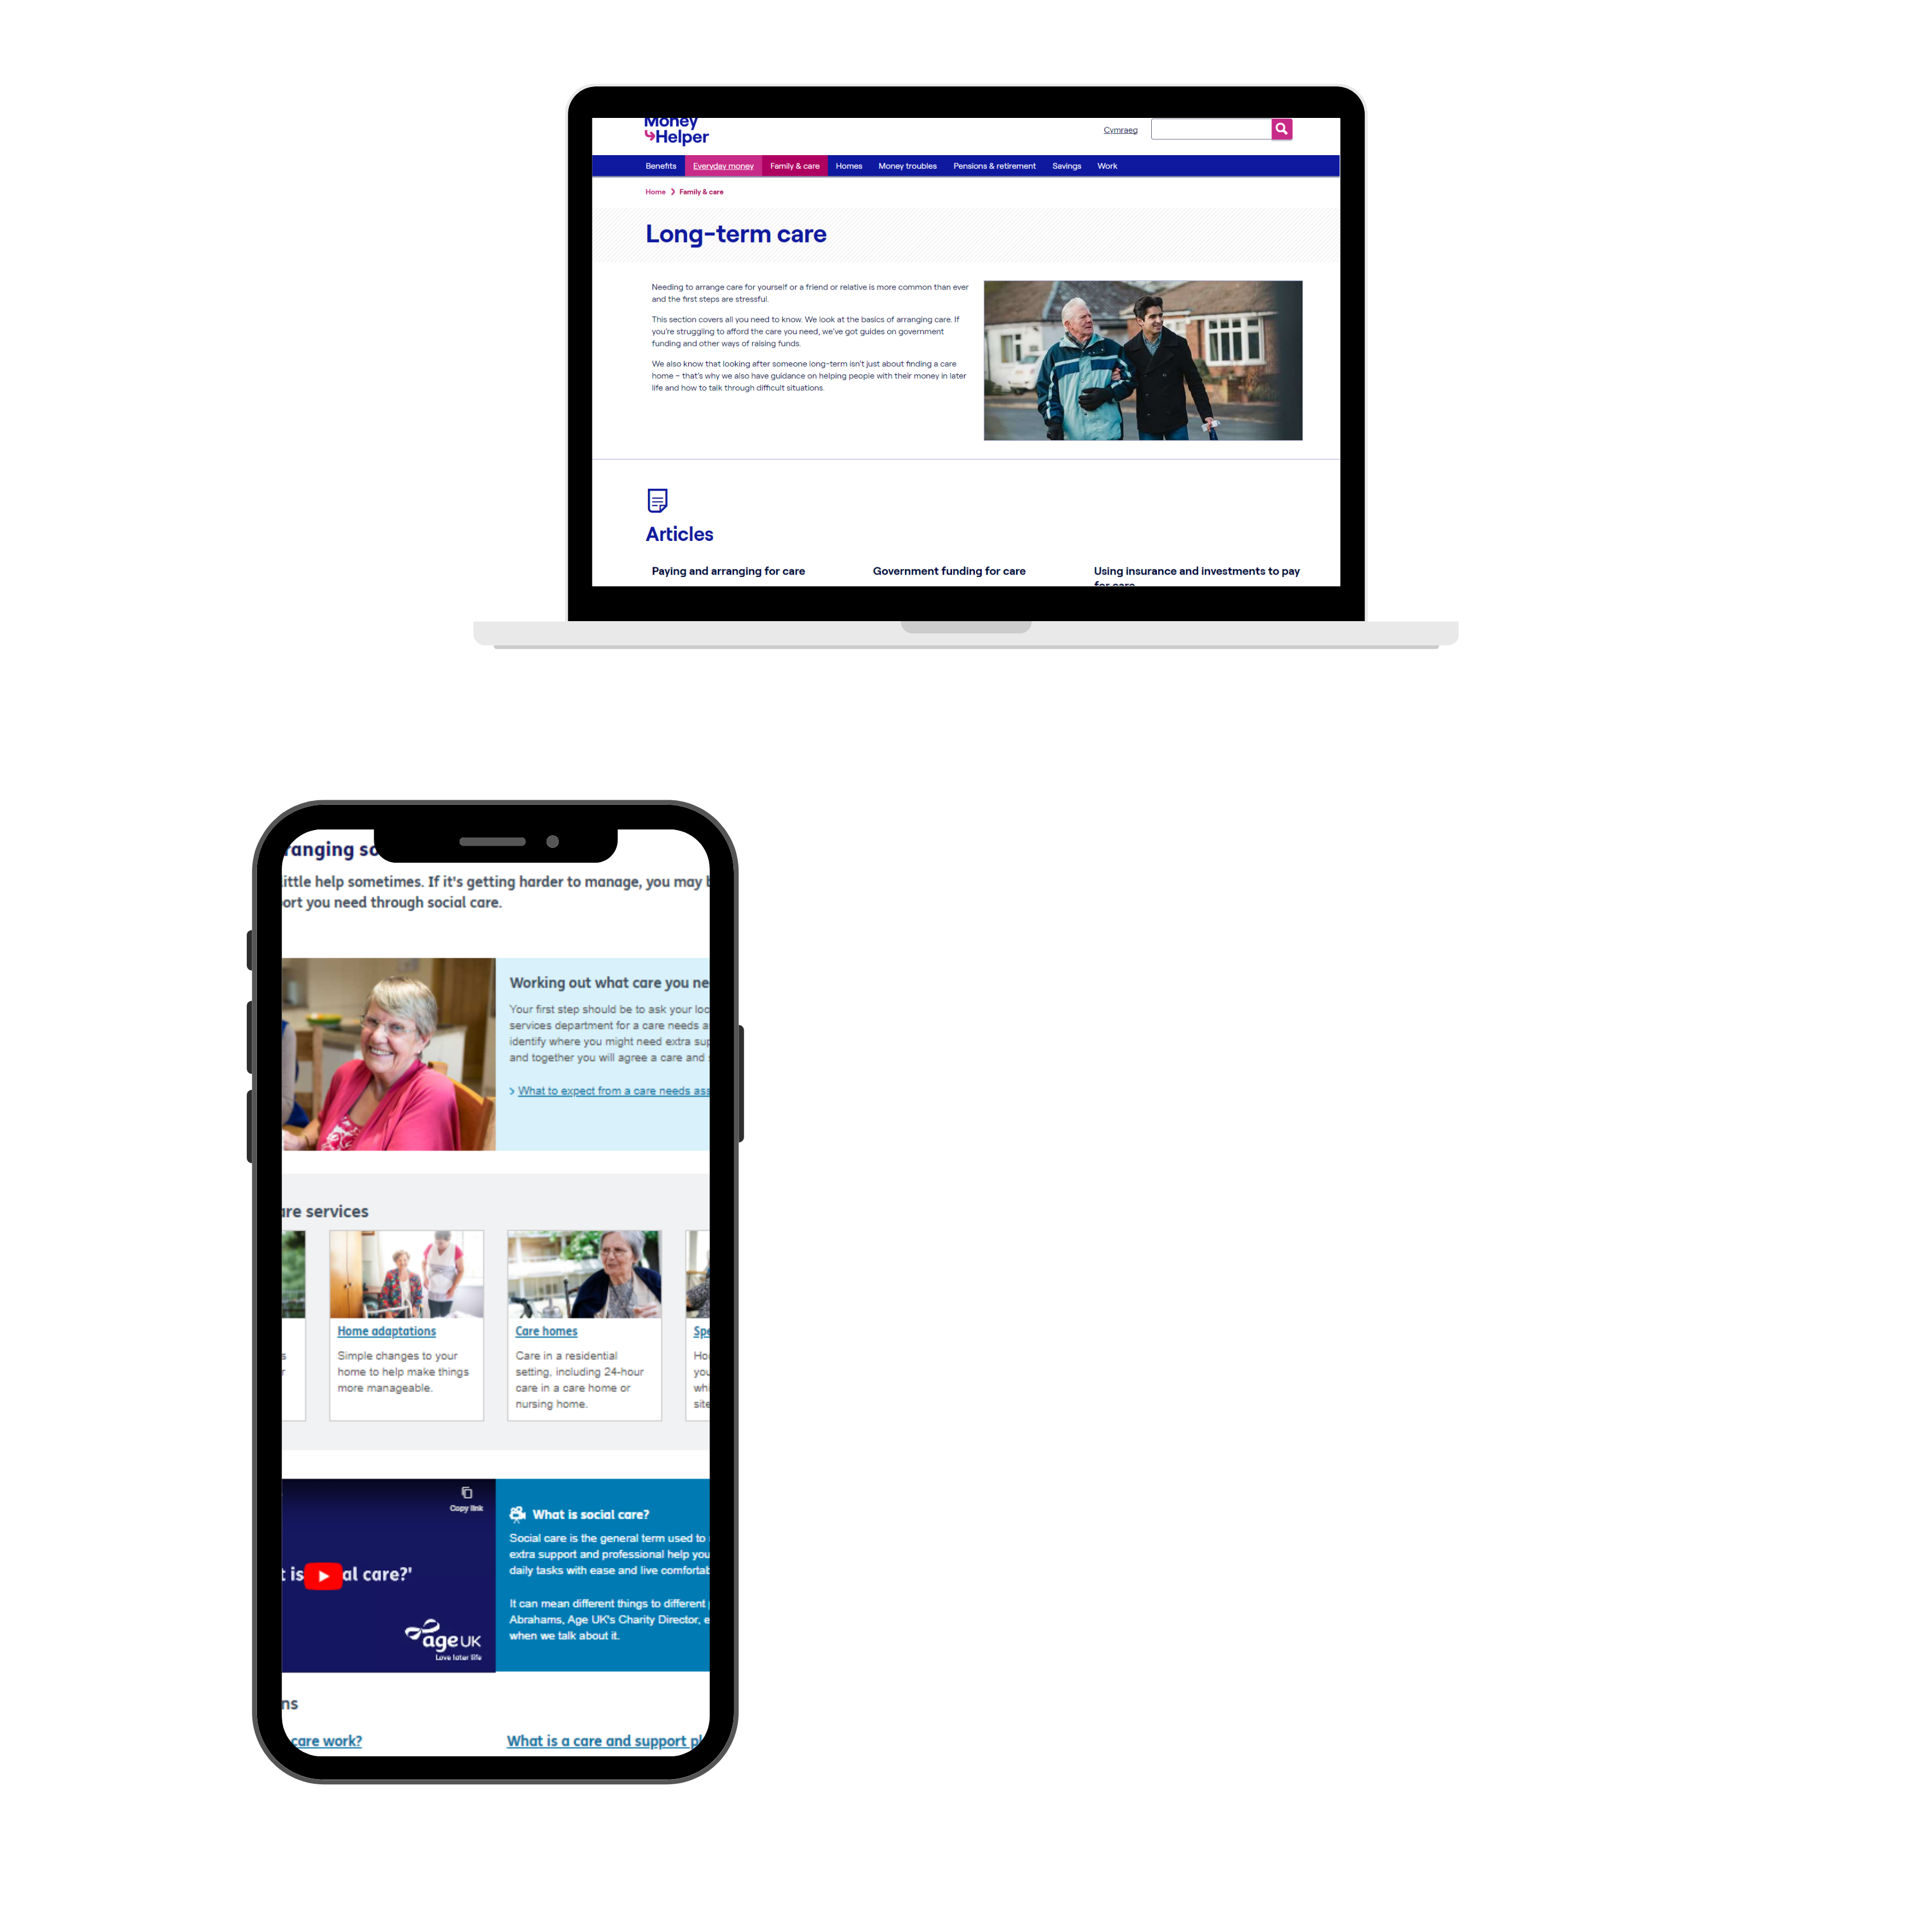
Further information on care
MoneyHelper
www.moneyhelper.org.uk/en/family-and-care/long-term-care
Age UK
England: www.ageuk.org.uk
Scotland: www.ageuk.org.uk/scotland
WEALTH at work colours
Wales: www.ageuk.org.uk/cymru
Northern Ireland: www.ageuk.org.uk/northern-ireland
447291012
Notes:
447291012

Slide 36
Useful contacts
01
      Free Wills Month
        freewillsmonth.org.uk/
02
      Citizens advice – Help with dealing with an estate
citizensadvice.org.uk/family/death-and-wills/
      Residence Nil rate band – further information
03
        gov.uk/guidance/inheritance-tax-residence-nil-rate-band
Intestacy rules
04
        gov.uk/inherits-someone-dies-without-will
  Power of Attorney – further information
05
        moneyhelper.org.uk/en/family-and-care/long-term-care/setting-up-a-power-of-attorney-in-england-and-wales
  Workplace nomination forms
06
        visit scheme websites
Notes:
FOR USE IN ENGLAND AND WALES ONLY

Slide 37
Book onto…
An advanced guide to estate planning
  Inheritance tax
  Making gifts during your lifetime
  Intestacy rules and Will writing
  Trusts
  Further information

Slide 38
Seeking advice
    An adviser will assess your circumstances, objectives and risk profile and provide you with a personal recommendation to meet your objectives.
    All regulated firms are listed on the Financial Services Register, this provides confirmation that the firm is authorised, the specific services they are authorised to provide and details of the advisers who work for them.
    Financial Services Register link:
    https://register.fca.org.uk
252395834

Slide 39

Contact us
We provide a telephone helpline and a regulated investment advice service through my wealth - a trading name of Wealth at Work Limited which is part of the Wealth at Work group.
It helps individuals to understand their personal financial situation especially when selecting their retirement income options.
      Request a callback from the helpline via the feedback form to discuss your personal circumstances with my wealth and agree your next steps and receive regulated investment advice where required
      You can also telephone 0800 028 3200
141862785

Slide 40
Education caveat
All copyright or other intellectual property rights in the material constituting this presentation which has been provided by Wealth at Work Limited remains the property of the Wealth at Work group.
The content of this presentation is provided for illustrative purposes only and is not intended to be used for individual investment or financial planning and does not constitute financial advice.
Whilst every effort is made to ensure the accuracy of information contained in the presentation it cannot be guaranteed. In particular the rules relating to tax can frequently change.
Any references to tax or the operation of tax or tax reliefs are illustrative only and the tax treatment in respect of any individual depends upon the circumstances of each individual.
It is important to recognise that the value of investments related to the stock market (and any resulting benefits such as interest or dividends), can rise or fall and an investor may not get back the amount invested. Past performance data used is for illustrative purposes only and is not necessarily a guide to future performance.
Any hyperlinks or references to third parties or their websites are provided for information only and it does not mean that we endorse their products or services. We have no control over these and accept no legal responsibility for any content, material or information contained in them.
WEALTH at work and my wealth are trading names of Wealth at Work Limited which is authorised and regulated by the Financial Conduct Authority and part of the Wealth at Work group. Registered in England and Wales No. 05225819. Registered Office: Third floor, 5 St Paul’s Square, Liverpool L3 9SJ. Telephone calls may be recorded and monitored for training and record-keeping purposes.
881862975
Notes:
Back end caveat (WAW only)

Slide 41
Thank you
0800 028 3200
www.wealthatwork.co.uk/mywealth
156297902

