Slide 1
Moving in the right direction towards retirement
QC--461984598

Slide 2


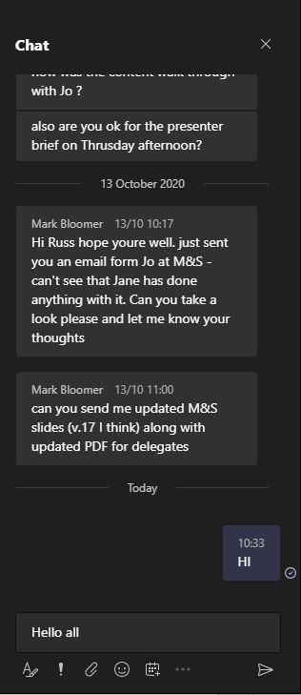

Using the chat box
click the chat box icon
type a message
Hello all…
tap the chat box icon
(it may be at the top of your device’s screen)
410452555

Slide 3
About us
WEALTH at work is a leading financial wellbeing, retirement and workplace savings specialist.
Established in 2005, we work with hundreds of organisations across both the private and public sector.
Our financial education services are delivered on a bespoke basis.
341377444

Slide 4
Financial education structure
Follow up call
You will be able to ask questions relating to your own circumstances.
Online Seminar
Next steps
Today’s online seminar will cover financial education.
We will identify your next steps and point you in the right direction.
27949402

Slide 5

What we’ll cover today
Income needs in retirement
The State Pension
Workplace pensions
Other savings and investments
Bringing it all together
Next steps

Slide 6
Income needs in retirement
127014555

Slide 7
Retirement could last a long time
Average life expectancy at age 65
88
85
1 in 4 chance of reaching age:
1 in 4 chance of reaching age:
94
92
Source: Office of National Statistics
691907972
Notes:
Updated Feb 2025
www.ons.gov.uk/peoplepopulationandcommunity/healthandsocialcare/healthandlifeexpectancies/articles/lifeexpectancycalculator/2019-06-07

Slide 8
Expenditure in retirement
Pensions UK have created a guide to the costs you may expect in retirement based on 3 different levels:
Examples
Minimum
Moderate
Comfortable
Single
£13,400pa
Single
£31,700pa
Single
£43,900pa
Couple
£21,600pa
Couple
£43,900pa
Couple
£60,600pa
3 year old car replaced every 7 years
3 year old car replaced every 5 years
No car
2 weeks in the Med and a long weekend in the UK every year
2 weeks in the Med and 3 long weekend breaks in the UK every year
A week in the UK every year
*information above is subject to change – please visit www.retirementlivingstandards.org.uk
47592471

Slide 9

Expenditure in retirement
Credit cards / Loans / Mortgage
Household / Utilities
Food & Clothing
Motoring / Travel
Hobbies
Leisure
Holiday
Notes:
Please acknowledge that individual circumstances may vary and that some categories (rent, travel, holidays) will vary between people

Slide 10
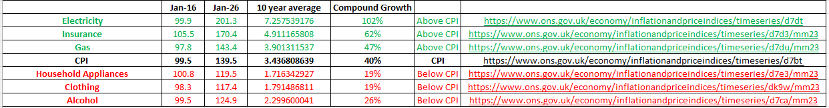
Inflation: average over 10 years
Insurance
4.9%pa
Household
Gas 3.9%pa
Electricity
7.3%pa
Above CPI
Consumer Price Index (CPI) = 3.4%pa
Below CPI
Household Appliances
1.7%
Clothing
1.8%
Alcohol
2.3%
Source: Office for National Statistics – January 2016 vs January 2026
999473106
Notes:
Zoom out for data

Slide 11
Inflation: over 10 years
The price of electricity has risen
102%
The price of insurance has risen
62%
The price of household gas has risen
47%
Insurance
4.9%pa
Household
Gas 3.9%pa
Electricity
7.3%pa
Source: Office for National Statistics – January 2016 vs January 2026
597485131
Notes:
Zoom out for data

Slide 12
Changing income needs
State Pension
Income Provision
Flexible Income Requirement
Income Provision
£
55
60
65
70
75
80
85
90
95
Age
727785169
Notes:
Presenter to mention: We will cover DC pension income options flexibility later

Slide 13

Rates of income tax
Personal Allowance
Basic
Rate Tax
Higher
Rate Tax
Additional
Rate Tax
on the first
£12,570*
on the next
£37,700
on the next
£74,870
on earnings above
£125,140
20%
40%
45%
>£12,570*
>£50,270
>£125,140
*The Personal Allowance reduces by £1 for every £2 of income above £100,000.
689165691
Notes:
Note to lecturer – Display in England, Wales & Northern Ireland Only

Slide 14
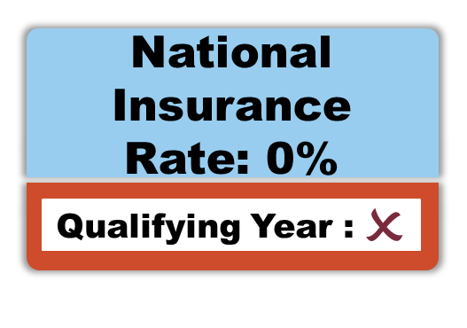
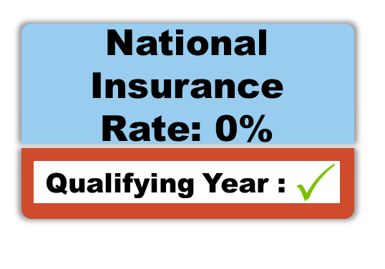
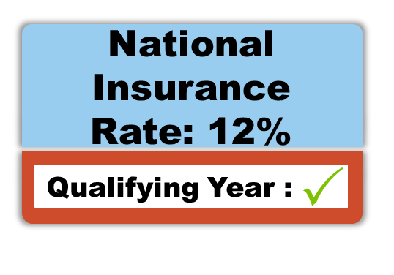

National Insurance
Lower Earnings Limit (LEL)
Primary Threshold
(PT)
Upper Earnings Limit (UEL)
8%
2%
£6,500 -
£12,570
£12,570 –
£50,270
£0 - £6,500
£50,270+
298948723

Slide 15
Can you afford to retire?
£50,000 annual salary
Costs pa:
  Income Tax
£6,986
  National Insurance
£2,794
Taxable salary after 0% salary sacrifice | £ 25,000.00
 | Amount Chargeable | Tax Paid PA | Tax Paid PM
Zero Tax | £ 12,570.00 | £ -
20% tax | £ 12,430.00 | £ 2,486.00 | £ 207.17
40% tax | £ - | £ - | £ -
 | TOTAL | £ 2,486.00 | £ 207.17
  Pension contributions*
£2,500
  Mortgage
£10,000
  Loans
£4,000
Remaining:
£23,720
£25,000 retirement income
Costs pa:
  Income Tax
£2,486
Remaining:
£22,514
*assumes pension contributions of 5% pa through a salary sacrifice arrangement
Notes:
Zoom out of slide for tax calculations

Slide 16
Where is the money coming from?
£
State Pension
02
01
Current workplace pension
04
Previous workplace pensions
03
Savings and investments
06
05
Cash from downsizing home
Part-time work
921733476

Slide 17
The State Pension
863776587

Slide 18
Your State Pension age
DoB from:
6 Apr 1978
DoB between:
6 Mar 1961 &
5 Apr 1977
gradually
increases
68
birthday
DoB between:
6 Oct 1954 &
5 Apr 1960
gradually
increases
67
birthday
66
birthday
Born before 6 Oct 1954? You’ve already reached State Pension age
www.gov.uk/state-pension-age
The Government intends to bring forward the State Pension age transition from 67 to 68 affecting those born between 6th April 1970 and 5th April 1978 - if adopted those affected will reach State Pension age between their 67th & 68th birthdays
560828722
Notes:
560828722
Note to lecturer: Please highlight the potential change in the state pension age to delegates:
What is the change?
The state pension age was intended to increase from 67 to 68 between 2044 & 2046. The Government has now announced a plan to bring this timetable forward, with the increase happening between 2037 & 2039.
Who does this affect?
Six million people born between 6th April 1970 and 5th April 1978, both men & women.
Is this definitely going to happen?
At present, this is merely the Government’s stated intention, and will need to be voted into law.

Slide 19

The new State Pension
    If you reach State Pension age after 5 April 2016 the new State Pension can provide income of:
You may receive less if:
      You have less than 35 years of National Insurance (NI) contributions, &/or
up to
per week
£241.30
      You have been contracted out of the Additional State Pension
Every year of NI contributions gained since 2016/17 to the year before you reach State Pension age will make the deduction less
up to
per year
£12,590.68
342688764
Notes:
Calculation of annual figure: (£241.30/7) x 365.25 = £12,590.68

Slide 20
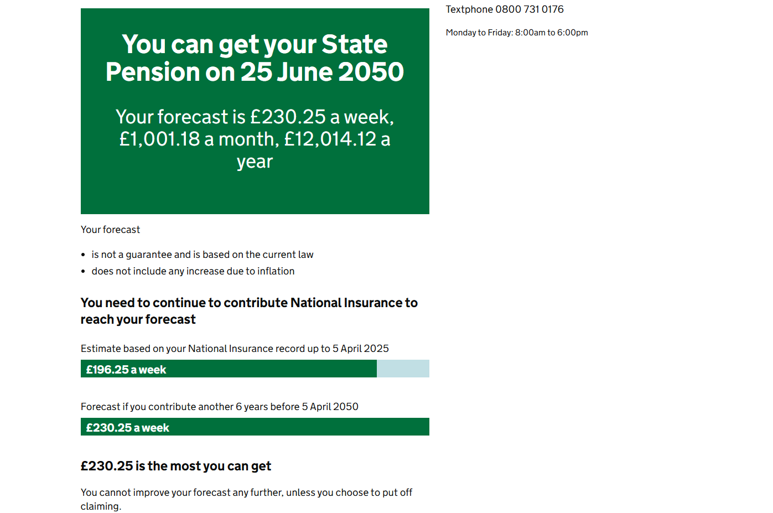
State Pension forecast
Your State Pension summary
You can get your State
Pension on 25 June 2036
www.gov.uk/check-state-pension
£175.20 a week
Your forecast is £241.30 a week,
£1,049.22 a month, £12,590.68 a year
Your forecast
is not a guarantee and is based on the current law
does not include any increase due to inflation
You need to continue to contribute National Insurance to reach your forecast
Estimate based on your National Insurance record up to 5 April 2026
£193.04 a week
Forecast if you contribute another 7 years before 5 April 2036
£241.30 a week
282334458
Notes:
The forecast shows you:
How much you could get
When you get it
How to increase it if you can
Calculation of annual figure: (£241.30/7) x 365.25 = £12,590.68
Calculation of monthly figure: (£241.30/7) x 365.25 = £12,590.68 / 12 = £1,049.22
Example shows someone with 25 years NI record
(£241.30 / 35) x 28 = £193.04

Slide 21
Workplace pensions
766259901

Slide 22


Defined benefit (DB) schemes
  Employer and employees contribute (tax-free up to HMRC limits)
  A secure pension income is built up
  Scheme rules determine when the pension normally starts
pension input
Jan
15
  It may be possible to start the pension income before or after this time
  A tax-free cash lump sum is usually also available
315718745

Slide 23



Defined contribution (DC) schemes
  Employer and employees contribute (tax-free*)
  Any investment growth is tax-free
  You can access your pension from age 55**
pension input
  Receive up to 25% tax-free
Receive a taxable lump sum or generate a taxable income with remaining pot
*subject to HMRC limits
**The minimum age for accessing your pension is expected to increase to age 57 from 6 April 2028. Pension savings in certain schemes may be protected from this change.
779311300

Slide 24
Your pension contributions
You Pay | LSEG Pays | Total
3% | 6% | 9%
4% | 8% | 12%
5% | 10% | 15%
  You can increase contributions beyond 5% however LSEG’s contributions will not increase further
  You can change contribution levels at any time on MyBenefits
  Contributions are defaulted to be paid via salary sacrifice
Notes:
The client has a few legacy DC contribution structures which may come up. Refer to HR for further info.

Slide 25
How your contributions may add up
Annual Salary £45,000 (basic rate taxpayer)
Employee Contribution = £2,250pa (5%)
Tax Saving = 20%
NI Saving = 8%
Personal Cost = £1,620pa
Employer Contribution = £4,500pa (10%)
TOTAL
£6,750
£4,500
£630
£2,250
Employer matching contribution (10%)
£1,620
Tax & NI savings
Employee contribution (5%)
*Percentage shows the increase in total contribution when compared to the personal cost.

Slide 26

Limits on tax efficiency
Annual Allowance (AA)
    The annual allowance is £60,000*
    This may be reduced if your total taxable income exceeds £200,000 or you flexibly withdraw taxable income from a DC scheme
    Carry forward may be available from up to the 3 previous tax years
    Limits on tax-free cash
    Lump Sum Allowance (LSA): The maximum tax-free cash is limited to 25% of the pension value, subject to a total cap of £268,275 (which is set to be frozen)
    Lump Sum and Death Benefits Allowance (LSDBA): The maximum amount of non-taxable lump sums that can be taken from a pension, set at £1,073,100.
    Those individuals who hold Life Time Allowance (LTA) protection will have allowances based on their protected LTA
If you think you may be affected, ask about this on your follow up call
*Tax relief is only available on contributions up to the greater of 100% of relevant earnings or £3,600
860866534
Notes:
Presenter note:
MPAA is £10,000
TAA is £10,000
Threshold Income: £200,000
Adjusted Income: £260,000
Benefits in excess of the new limits (LSA & LSDBA)

Slide 27



Defined contribution income options
DC retirement savings
Cash lump sums
Draw regular income
Annuity
You may need to transfer your benefits to an alternative arrangement to access your chosen income route
157059708

Slide 28
Cash lump sum
25%
Tax-free lump sum
75%
Taxable lump sum
The taxable lump sum is taxed in the year of receipt
This could lead to a significant tax charge
There is the option to receive a series of lump sums
475807093

Slide 29
Receiving a taxable cash lump sum
An individual who receives a £100,000 cash lump sum from a pension:
Tax-free Cash Lump sum
the first 25% of the pot
ZERO
£25,000
TAX
basic rate
Total tax charge of £17,432
Personal
Allowance
the next
ZERO
£12,570
TAX
basic rate
the next
20%
£7,540
Basic Rate
£37,700
tax
basic rate
40%
the next
£9,892
Higher Rate
£24,730
tax
This is an illustrative example only that assumes the individual has no other income in the tax year.
533937562

Slide 30
Phased cash lump sums
75%
Invested
Of this withdrawal is taxable
Remaining amount is invested and can be drawn in the future
25%
Of this withdrawal is tax-free
188038938

Slide 31
Flexi access drawdown
Up to 25%
Tax-free cash or opt to receive tax-free cash gradually
Invested
Flexible
Remaining amount is invested and can be drawn in the future as a taxable ‘income’
Make flexible withdrawals to create a taxable 'income’
Remember – the MPAA will apply if you receive taxable money flexibly from any DC pension pot.
664760966

Slide 32





Buying an annuity
Receive up to 25% as a tax-free lump sum
Options include
A guarantee period
Inflation linking
Spouse/partner income
Buy an annuity with the remainder
The income level is determined by your circumstances
Provides a secure income throughout your retirement
779206143

Slide 33
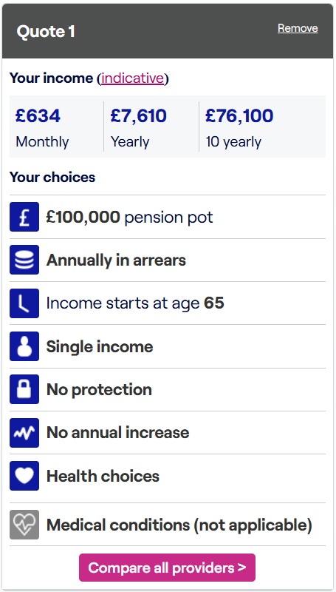

Example annuity rate
pot after receiving tax-free cash
age
annually
monthly
£100,000
65
£7,610
£634
Single income
No annual increases
No protection
Good health
Source: Money Helper – rates correct as at 23.01.2025
908264036
Notes:
6

Slide 34




Transferring from DB to DC
  WARNING - transferring out of a defined benefit (DB) scheme could damage your wealth!
WARNING!
FCA
FCA
£30,000
  FCA require adviser firms to start from the position that a transfer will not be suitable
  Regulated advice must be received before transferring benefits over £30,000
IRREVERSIBLE
ADVANTAGES & DISADVANTAGES
  A transfer is usually irreversible
  You should consider the advantages and disadvantages of a transfer before deciding whether or not to take advice
RISK
COST
  Certainty is replaced with risk
  The cost of advice must be disclosed at the outset
548276707
Notes:
Points for Presenters to highlight
Presenters to explain the concept of a DB to DC transfer and that a DB scheme can provide a transfer value to members. Delegates to be made aware that, by transferring benefits away from a DB scheme, members may find they are financially worse of in retirement than if they had left their benefit in their DB scheme
Members MUST receive regulated advice before making a transfer if the transfer value exceeds £30,000. Whilst there is no obligation for members to seek advice on smaller transfers, it may be in the best interest of members to do so.
There will be a cost to receiving transfer advice. Members should thee weigh up the advantages and disadvantages before proceeding with transfer advice
A regulated adviser will always disclose the costs of their service at the outset
DB schemes provide the certainty of a secure income for yourself and usually your partner/dependent in retirement. Transferring to a DC scheme can provide flexibility but the risks will be the responsibility of the pension member
Once a pension transfer is made, there is usually no way this can be reversed. Members should ct on this prior to making any decision
As the FCA require advisers to start from a position that a transfer will not be suitable, an adviser will need to be able to identify specific benefits of making a transfer in order to recommend a DB member transfers to a DC arrangement.

Slide 35
Financial scams – protect yourself
NO
THANKS
Reject unexpected offers and communications
Check who you’re dealing with
Financial services register: https://register.fca.org.uk/
or 0800 111 6768
Don’t be rushed or feel pressured
£
Get impartial information or advice before changing your pension arrangements
www.fca.org.uk/scamsmart
544701173

Slide 36
Inflation, savings and investments
743226699

Slide 37
Investment principles
Interest/dividends and long term gains are tax-free
Capital is completely safe
TAX
FREE
Environmental, Social & Governance
Core
Features
Very high growth/return
The cost of investing is low
Investment
is liquid
116216649

Slide 38
The relationship between risk and return
  Low
  High
Bonds
Gilts
Shares
Cryptocurrency
Commodities
Property
Cash
911901396
Benefits
Benefits
Benefits
Benefits
Benefits
Benefits
Benefits
Safe
Safe
Lower risk
Income
Growth
Inflation
Innovation
Easy access
Predictable
Regular income
Gearing
Dividends
Diverse
Decentralised
Stable
Stable
Low volatility
Asset backed
Ownership
Global demand
Technology
Risks
Risks
Risks
Risks
Risks
Risks
Risks
Poor returns
Poor returns
Default
Maintenance
Timing
Volatility
Hacking
Inflation
Inflation
Inflation
Tax
Volatility
Storage
Volatility
Exchange rate
Interest rates
Interest rates
Illiquid
Capital
Security
Regulation
Notes:
Task: Put these investments in order of risk and potential reward.
Give a brief overview of what these are:
Bonds & Gilts – One is an agreement with the UK government. The other is an agreement with a company. Essentially a type of loan that companies / gov take from investors. In return, the company promises to pay back the borrowed amount with interest at a set date in the future.
Shares – This is where you buy a small portion of a company and hope to make money if the company does well.
Cryptocurrency - A cryptocurrency is a digital currency, they’re largely unregulated and may or may not have anything to back them up. The less said about them the better.
Property: Can be investment in BTL / investment in a group of commercial properties via a collective investment. In this instance, lets assume BTL.
Commodities – We’re talking gold, sliver, oil, gas, that sort of thing
Cash – we’re talking cash in a bank or building society here. Not currency trading or anything like that.
Animation order: Low to high (There is an argument that commodities and shares could switch)
Currency
Gilts
Bonds
Property
Shares
Commodities
Cryptocurrency

Slide 39
Risk and returns: the real world
The value of £100 originally invested 31/12/2015 by 31/12/2025
FTSE All Share Total Return
Total Return Over Period 31/12/2015 – 31/12/2025
FTSE All Share TR ……………..
123.45%
IA Sterling Corporate Bond …...
30.81%
Cash*……………………..….…
18.86%
UK CPI …………………..
39.08%
CPI
Bonds
Cash
This chart shows past performance which is not a reliable guide to the future
Source: Financial Express & Bloomberg
*Cash is calculated using: FE FER Cash Proxy from 31/12/2015 to 31/12/2018 and the UK Bank of England Base rate from 31/12/2018 to 31/12/2025.
273593575

Slide 40
Personal taxation
437541320

Slide 41
Tax on your income
Your income is taxed in a specific order. The income you receive in work may be taxed differently to the income you receive in retirement.
Dividends
Savings
Interest
Personal Tax Allowance
Earnings
797933702

Slide 42
Tax on your income
Your income is taxed in a specific order. The income you receive in work may be taxed differently to the income you receive in retirement.
Dividends
Savings
Interest
Earnings
Personal Tax Allowance
Pensions
125063618

Slide 43
Tax on your income
Your income is taxed in a specific order. The income you receive in work may be taxed differently to the income you receive in retirement.
Dividends
Savings
Interest
Pensions
Personal Tax Allowance
State
Pension
200344839

Slide 44
Taxation of State Pension
  The State Pension is taxable, but it’s not deducted at source
PAYE Coding Notice
Tax code for the year 2026-27
Personal Allowance £12,570
Less your State Pension £12,536*
Net Allowance £34
Tax Code 3L
WEALTH at work colours
Check and see how your tax code is calculated by logging into your HMRC personal tax account:
www.gov.uk/personal-tax-account
* The State Pension is paid in arrears. In 2026/27, someone receiving the full new State Pension will get one week at the 2025/26 rate (£230.25) and 51 weeks at the 2026/27 rate (£241.30), giving a total of £12,536
244456923
Notes:
Note to lecturer – Display in England, NI & Wales Only
Your tax code will be reduced by the amount of State Pension you receive
Tax due on State Pension is effectively deducted from your occupational/private pension
Delegates may need to complete a self-assessment tax return

Slide 45



Personal savings allowance
£1,000
Basic rate
20%
£20,000
5% savings
rate
£500
Higher rate
40%
£10,000
£0
Additional rate
45%
  The Personal Savings Allowance is based on UK income tax rates and not Scottish income tax rates
237486090
Notes:
237486090

Slide 46
Dividend tax
39.35%
Dividend income within the additional rate band
33.75%
Dividend income within the higher rate band
10.75%
Dividend income within the basic rate band
£500
Tax-free dividend allowance
  The dividend allowance is based on UK income tax rates and not Scottish income tax rates
949307065
Notes:
949307065

Slide 47
Capital gains tax (CGT)
A tax on the profit when you sell (or ‘dispose of’) an asset that’s increased in value.
24%
£3,000
Gains above the basic rate tax band*
Annual exemption
Main exemptions
Gains within the basic rate tax band
Gains from
second properties
Main residence
Pensions & ISAs
18% basic rate
24% higher rate
Transfers
between spouse
/ civil partner
18%
429475516

Slide 48
Individual savings accounts (ISAs)
  An ISA protects your savings and investments from taxation
  Interest and dividends are tax-free
  Growth is free of Capital Gains Tax
  Lifetime ISA’s offer bonuses
  Standard ISA’s offer more flexibility
  2 most used types of ISA:
    Cash ISA
    Stocks & Shares ISA
Cash
ISA
Contribution Limit
£20,000
26/27 tax year
Bonds
Equities
605319790
Notes:
Give a brief overview of a lifetime Isa and what it is:
You must be under 40 to open a Lifetime ISA
Can only pay into it until you’re 50
Pay up to £4k a year – Government adds 25%
Can be used for first home or for retirement (from 60).
You can pay into more than one individual savings account in a tax year, including accounts of the same type, as long as you don’t exceed your £20,000 ISA allowance. This applies to Cash ISAs, Stocks and shares ISAs and Innovative Finance ISAs.
You can only have one type of LISA / JISA though.

Slide 49




Tax allowances summary
£12,570*
Salary & pension income
£1,000 / £500**
Savings
interest
Personal Allowance
Personal Savings Allowance
ISA
Contribution Limit
£20,000
current tax year
Up to
£17,070
tax-free
Plus ISAs
Capital Gains Tax Allowance
tax-free Dividend Allowance
£3,000
Realised Capital Gains
£500
Dividends
*Reduced for those with income over £100,000
**£1,000 for basic rate and £500 for higher rate taxpayers. Additional rate taxpayers do not have a Personal Savings Allowance
413725830

Slide 50
Bringing it all together
312781813

Slide 51

Bridging a pension gap
🎂
Wants to stop work at 60
🎯
Income target: £20,000 net/yr
💼
DB pension from 60: £7,750/yr
🏛
State Pension: £12,000/yr from 67
Shortfall of £250
Yearly income
Shortfall of £12,250 net / year
(SPA)
Age
🧩
Goal: Maintain £20,000 net/yr
209003150

Slide 52


How the £20,000 gap could be met
🔎
Available assets:
💷
DB income:
£7,750
ISA savings at 60:
£35,000
DC pot at 60:
£200,000
696154695

Slide 53





How the £20,000 gap could be met
💷
DB income:
£7,750
ISA savings at 60:
£35,000
DC pot at 60:
£200,000
£10,000/yr
💷
DC tax-free cash:
£2,000/yr
DC income:
£8,000/yr
£7,750/yr
£5,000/yr
Income from your pensions are taxable
Pension income is £15,750
£3,750 taxed at 20% = £750 paid in income tax
777784776

Slide 54
How the £20,000 gap could be met
💷
💷
DB income:
£7,750/yr
ISA savings:
£5,000/yr
DC tax-free cash:
£2,000/yr
DC income:
£8,000/yr
💷
£20,000
Income tax:
£750/yr
income each year between 60 & 67
✅
The £20,000 income requirement has been met
122390383

Slide 55
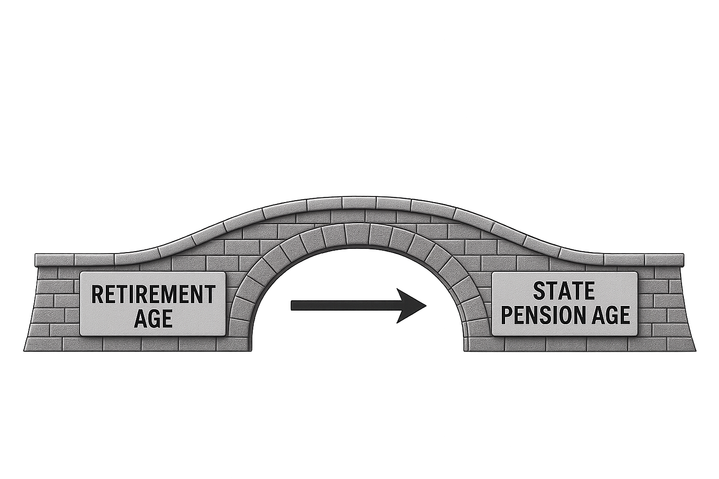
WEALTH at work colours
Bridging your pension gap
MAP OUT THE GAP
WITHDRAWAL ORDER
MANAGE RISK
1
2
3
How long do you need to bridge the gap?
Know when your income kicks in
Think about tax efficiency – use your allowances
Do you have more wealth in one type of account?
Build a cash buffer, if you are relying on investments
Regularly review your plan
563836014

Slide 56
Making the right decisions
How much income do I need?
1
When can I afford to retire?
2
What other savings, pensions and investments do I have?
3
Do I need more income or a higher lump sum?
4
Should I still make further pension savings now?
5
How do I get answers to my questions and concerns?
6
700617572
Notes:
2

Slide 57
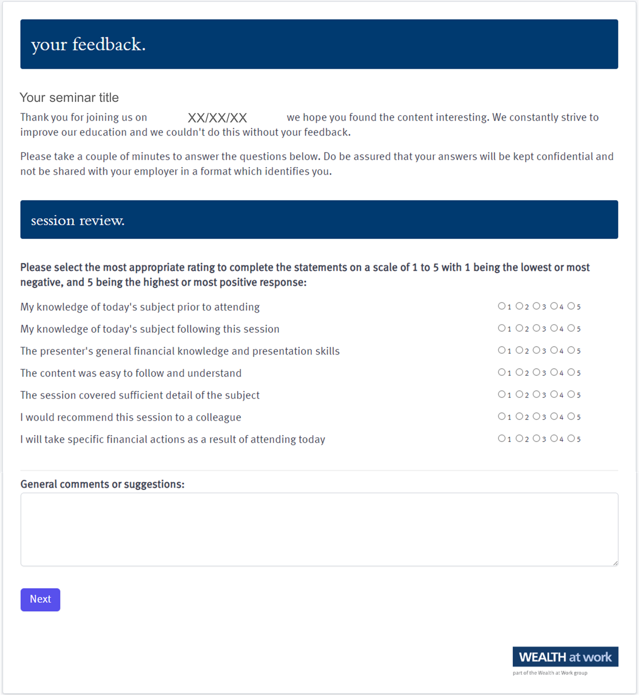
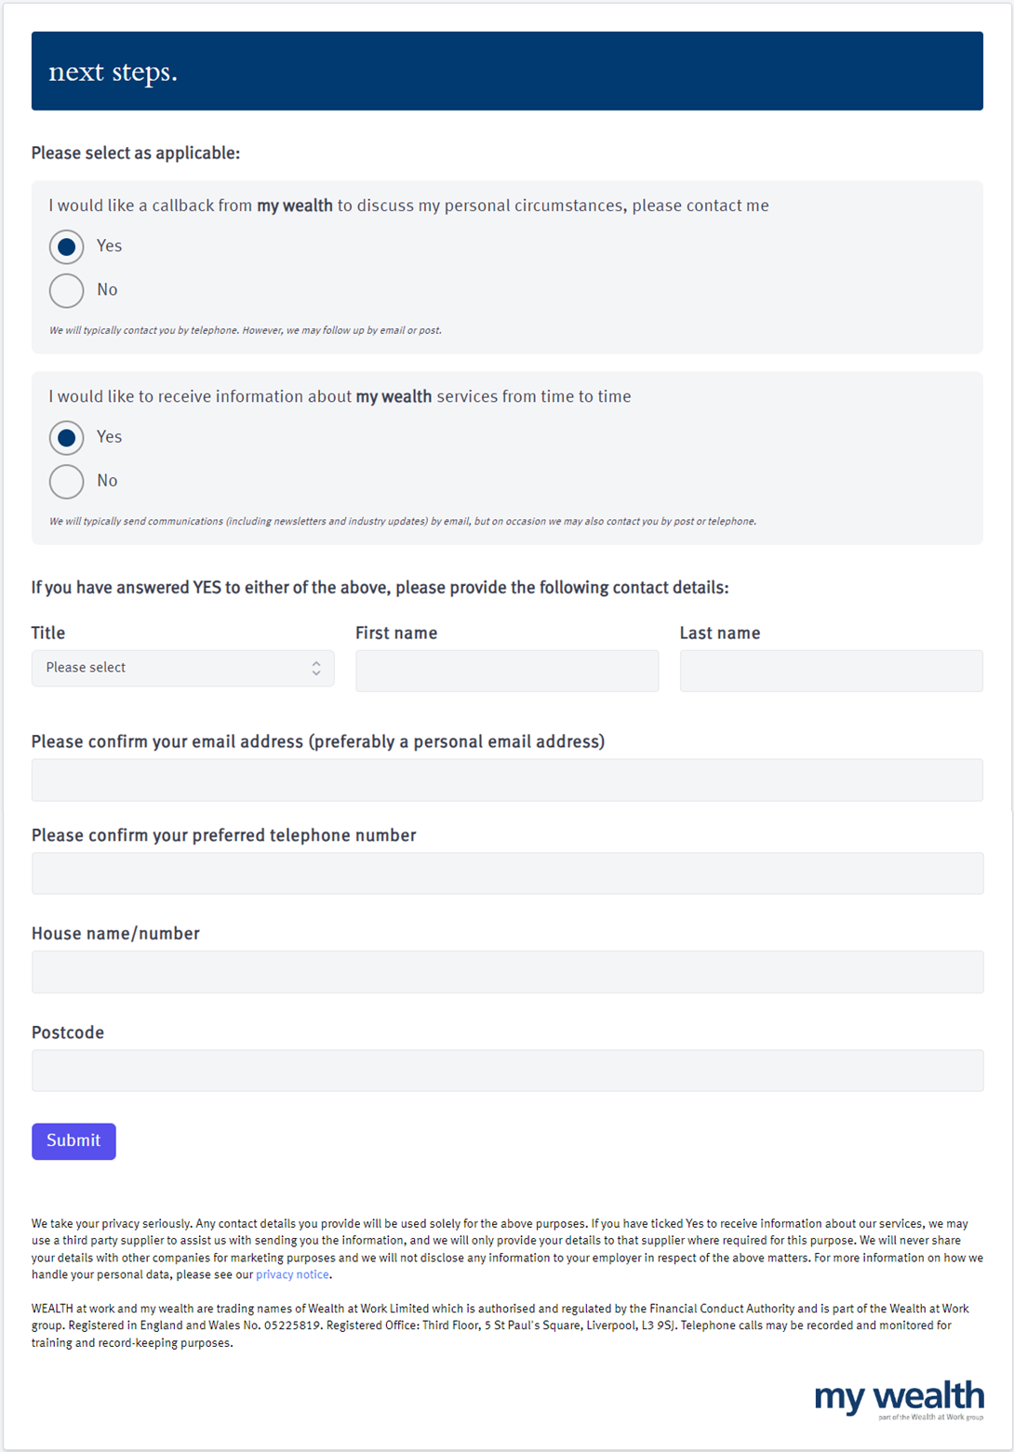
Your feedback
759533470

Slide 58
Next steps
211146986

Slide 59

Your feedback
Scan QR code
QR code to be pasted here if required
180650109

Slide 60
Next steps
393965084

Slide 61
Useful contacts
      LSEG Employee Assistance Programme - LifeWorks
01
        www.login.lifeworks.com
        |
        0800 169 1920
        username: lsegUK
        |
        password: lsegUK
02
      Money Helper pension calculator
        www.moneyhelper.org.uk/en/pensions-and-retirement/pensions-basics/use-our-pension-calculator
03
General tax and National Insurance information
        www.hmrc.gov.uk
  Pension Tracing Service
04
        www.gov.uk/find-pension-contact-details
05
Questions about your LSEG Pension Plan
        Email: pensions@lseg.com
  Obtain a State Pension Forecast
06
        www.gov.uk/check-state-pension

Slide 62
Seeking advice
    An adviser will assess your circumstances, objectives and risk profile and provide you with a personal recommendation to meet your objectives.
    All regulated firms are listed on the Financial Services Register, this provides confirmation that the firm is authorised, the specific services they are authorised to provide and details of the advisers who work for them.
    Financial Services Register link:
    https://register.fca.org.uk
252395834

Slide 63

Contact us
We provide a telephone helpline and a regulated investment advice service through my wealth - a trading name of Wealth at Work Limited which is part of the Wealth at Work group.
It helps individuals to understand their personal financial situation especially when selecting their retirement income options.
      Request a callback from the helpline via the feedback form to discuss your personal circumstances with my wealth and agree your next steps and receive regulated investment advice where required
      You can also telephone 0800 028 3200
141862785

Slide 64
Education caveat
All copyright or other intellectual property rights in the material constituting this presentation which has been provided by Wealth at Work Limited remains the property of the Wealth at Work group.
The content of this presentation is provided for illustrative purposes only and is not intended to be used for individual investment or financial planning and does not constitute financial advice.
Whilst every effort is made to ensure the accuracy of information contained in the presentation it cannot be guaranteed. In particular the rules relating to tax can frequently change.
Any references to tax or the operation of tax or tax reliefs are illustrative only and the tax treatment in respect of any individual depends upon the circumstances of each individual.
It is important to recognise that the value of investments related to the stock market (and any resulting benefits such as interest or dividends), can rise or fall and an investor may not get back the amount invested. Past performance data used is for illustrative purposes only and is not necessarily a guide to future performance.
Any hyperlinks or references to third parties or their websites are provided for information only and it does not mean that we endorse their products or services. We have no control over these and accept no legal responsibility for any content, material or information contained in them.
WEALTH at work and my wealth are trading names of Wealth at Work Limited which is authorised and regulated by the Financial Conduct Authority and part of the Wealth at Work group. Registered in England and Wales No. 05225819. Registered Office: Third floor, 5 St Paul’s Square, Liverpool L3 9SJ. Telephone calls may be recorded and monitored for training and record-keeping purposes.
881862975
Notes:
Back end caveat (WAW only)

Slide 65
Thank you
0800 028 3200
www.wealthatwork.co.uk/mywealth
156297902

