Slide 1
bonus sacrifice & pension awareness.
QC--905528038

Slide 2
about us.
We are a leading financial wellbeing and retirement specialist - helping those in the workplace to improve their financial future.
Established in 2005, we work with hundreds of organisations across both the private and public sector.
Our financial education services are delivered on a bespoke basis.
341377444

Slide 3

financial education structure.
Follow up call
You will be able to ask questions relating to your own circumstances.
Online Seminar
Next steps
Today’s online seminar will cover financial education.
We will identify your next steps and point you in the right direction.
27949402

Slide 4


what we’ll cover today.
The LSEG Pension Plan
  Bonus sacrifice
Limits to pension allowances
Investing your pension
  Target date funds (Lifetime Advantage Fund - LAF)
  Self select investments
Receiving your pension
Next steps

Slide 5
the LSEG Pension Plan.
Notes:
Please can the presenter note that there is information on the LSEG Pension Plan on ServiceNow which includes access to MyBenefits and through that Legal & General's Manage Your Account. This is single sign on.

Slide 6



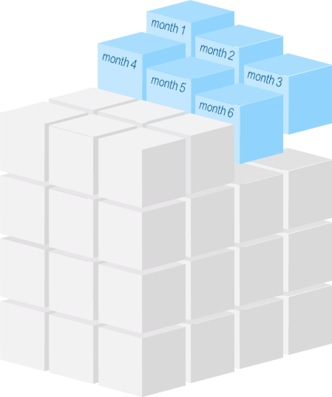
defined contribution (DC) schemes.
  Employer and employees contribute (tax-free*)
  Any investment growth is tax-free
  You can access your pension from age 55**
  Receive up to 25% tax-free
Receive a taxable lump sum or generate a taxable income with remaining pot
*subject to HMRC limits
**The minimum age for accessing your pension is expected to increase to age 57 from 6 April 2028. Pension savings in certain schemes may be protected from this change.
779311300

Slide 7
your pension contributions.
The new combined structure
You Pay | Employer Pays | Total
3% | 6% | 9%
4% | 8% | 12%
5% | 10% | 15%
  You can increase contributions beyond 5% however the company’s contributions will not increase further
  You can change contribution levels at any time on MyBenefits
  Contributions are defaulted to be paid via salary sacrifice

Slide 8

how your contributions may add up.
Annual Salary = £75,000 (higher rate tax payer)
Employee Contribution = £3,750pa (5%)
Tax Saving (40%) = £1,500pa
NI Saving (2%) = £75pa
Personal Cost = £2,175pa
LSEG Contribution = £7,500pa (10%)
TOTAL
£11,250
£7,500
LSEG contribution (10%)
£3,750
£1,575
Tax & NI savings
£2,175
Employee contribution (5%)
Salary sacrifice is the default contribution method

Slide 9
how your contributions may add up.
The below example is based on a 30 year old earning £75,000pa.
Pensionable salary: £75,000
|
Planned Retirement: Age 68
£785,950
£589,463
£471,570
£353,678
Total Contributions
3% + 6%
4% + 8%
5% + 10%
10% + 10%
Figures shown are for illustrative purposes only.
Notes:
Presenter to clearly outline that this is not related to compounding.

Slide 10
how your contributions may add up.
Annual Salary = £40,000 (basic rate tax payer)
Employee Contribution = £2,000pa (5%)
Tax Saving (20%) = £400pa
NI Saving (8%) = £160pa
Personal Cost = £1,440pa
LSEG Contribution = £4,000pa (10%)
TOTAL
£6,000
£4,000
LSEG contribution (10%)
£2,000
£540
Tax & NI savings
£1,440
Employee contribution (5%)
Salary sacrifice is the default contribution method
Notes:
LSEG feel this salary example is less likely to relevant to the delegates in this session. It is included on hide in case anyone asks about basic rate tax relief.

Slide 11
how your contributions may add up.
The below example is based on a 30 year old earning £40,000pa.
Pensionable salary: £40,000
|
Planned Retirement: Age 68
£419,174
£314,380
£251,504
£188,628
Total Contributions
3% + 6%
4% + 8%
5% + 10%
10% + 10%
Figures shown are for illustrative purposes only.
Notes:
LSEG feel this salary example is less likely to relevant to the delegates in this session. It is included on hide in case anyone asks about basic rate tax relief.

Slide 12

how your contributions may add up.
  What assumptions are used to estimate this future pension value?
  Contributions rates remain unchanged
  Annual pay increases by 2.5%pa
  Charges of 0.75%pa are taken from the pension pot
  The pension investments grow by 5% each year
  Inflation of 2.5% applies - the value of the pension pot shown in the example is in today's money
The assumptions used are from the Money Helper Pension Calculator. These have been used for illustrative purposes only.
Notes:
Lecturer to highlight that these are only assumptions and actual figures are likely to differ. The client has specifically asked us to highlight that the company pension charges are significantly lower than the ones listed above.
Delegates may hope to get pay increases/promotions later in their career which could have a significant impact on the value of their future pension pot.

Slide 13





bonus sacrifice to your pension.
01
Nominate a £ amount
If the bonus is less than this, 100% will be sacrificed
02
Nominate a fixed % of bonus
Bonus
sacrifice
options
03
Nominate a £ amount and fixed % of bonus
The higher of the two will be sacrificed
04
Specify that any amount above a £ amount should be sacrificed
Window for electing to sacrifice your LSEG bonus:
3 February 2025 – 14 February 2025 (inclusive)
Bonus announced: March
Notes:
Presenter to emphasise the message from LSEG that:
“there are no exceptions granted beyond the closing of the selection window at 5.30 pm on 14th February”
4 bonus sacrifice choices:
You can nominate a £ amount – if the bonus is less than this amount then 100% of bonus will be sacrificed
You can nominate a fixed % of bonus
You can choose the higher of a £ amount or a fixed % of bonus. The higher will be sacificed
You can elect to specify that any amount above a £ amount can be sacrificed e.g. “I request to sacrifice all bonus above £10,000” – helpful if you have an amount you want to ensure you take home
Election to sacrifice deadline – xxxxxxxxxxxx
Why you must elect before you know your bonus:
Bonus can only be announced after LSEG Annual Results on xxxxxx
It is paid in March payroll
To help, LSEG gives various options for sacrificing bonus to pension
If asked why are they referred to as legacy schemes, you can say the schemes are under review and they are looking at harmonising pension contributions for all. No further information is available at this point.

Slide 14
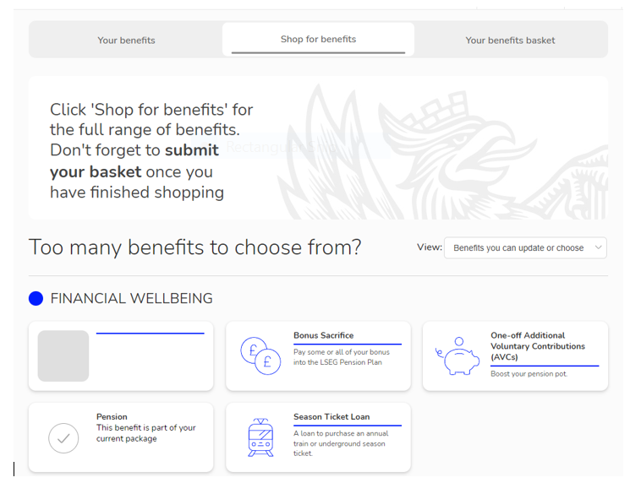
MyBenefits.
Notes:
The client would like us to breilfy talk through how the microsite works in relation to bonus sacrifice over the next 3 slides.

Slide 15
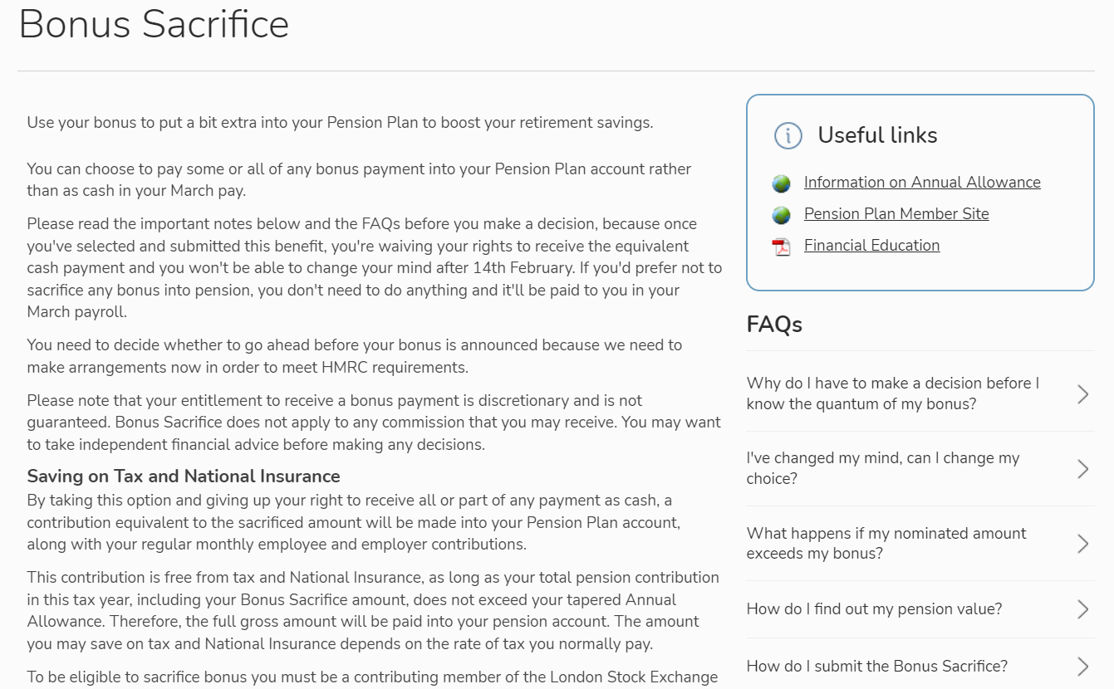
MyBenefits.

Slide 16
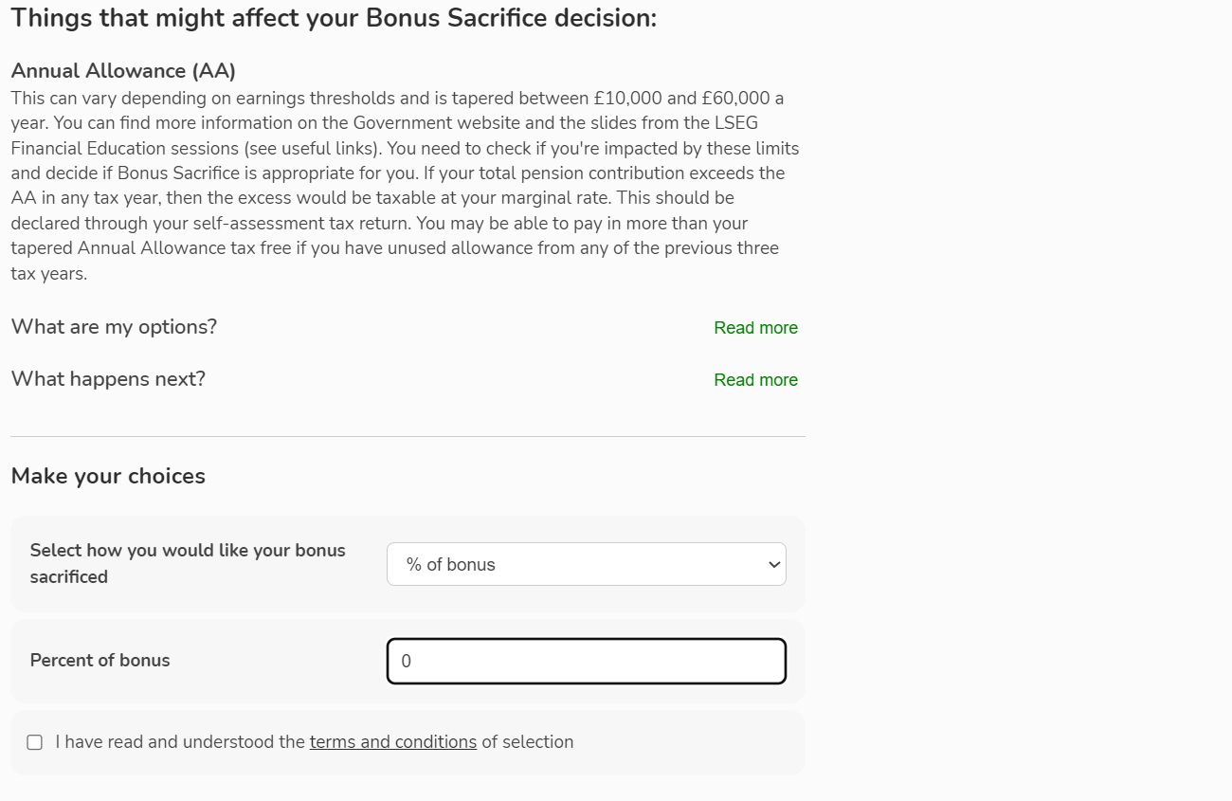
MyBenefits.

Slide 17
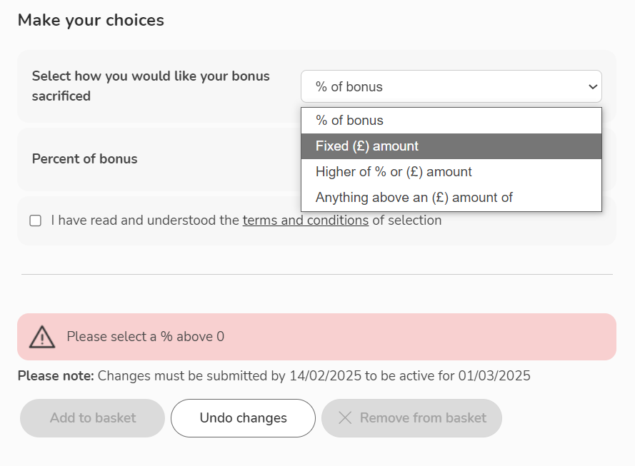
MyBenefits.

Slide 18

bonus sacrifice into your pension.
Bonus sacrifice example:
Chooses to sacrifice 50% of bonus to pension
£20,000
total bonus

Slide 19


bonus sacrifice into your pension.
£10,000
£10,000
sacrificed to pension
received through payroll
£20,000
total bonus

Slide 20


bonus sacrifice into your pension.
£10,000
£10,000
sacrificed to pension
received through payroll
£2,800 or £4,200
No Tax & No NI
lost to tax and NI (28% / 42%)
subject to HMRC limits
£10,000
paid into the pension
£7,200 or £5,800
received net of tax and NI

Slide 21


your bonus at retirement.
Using compound interest calculations you can estimate the future growth of your bonus in your pension.
Year | Paid in | Return | Value
1 | 10,000 | 0.05 | 10500
2 |  | 0.05 | 11025
3 |  | 0.05 | 11576.25
4 |  | 0.05 | 12155.06
5 |  | 0.05 | 12762.82
6 |  | 0.05 | 13400.96
7 |  | 0.05 | 14071
8 |  | 0.05 | 14774.55
9 |  | 0.05 | 15513.28
10 |  | 0.05 | 16288.95
11 |  | 0.05 | 17103.39
12 |  | 0.05 | 17958.56
13 |  | 0.05 | 18856.49
14 |  | 0.05 | 19799.32
15 |  | 0.05 | 20789.28
16 |  | 0.05 | 21828.75
17 |  | 0.05 | 22920.18
18 |  | 0.05 | 24066.19
19 |  | 0.05 | 25269.5
20 |  | 0.05 | 26532.98
£26,533
total
5%pa
Contributes
Investment return
£16,533
£10,000
growth
£10,000
invested
Age
48
53
58
63
68
For illustrative purposes only. Investment growth is not guaranteed. Ignores inflation and potential charges.

Slide 22
tax relief versus tax cost.
You will typically pay no tax or N.I. on your pension contributions*
However withdrawals at retirement are assessed for tax
The following example weighs up the tax relief and tax cost of contributing and receiving a lump sum
There are numerous other ways you may choose to access your pension
*Subject to HMRC limits

Slide 23
tax relief versus tax cost.
Based on an individual who has no available Personal Allowance in retirement and will pay basic rate tax on withdrawals.
A lump sum is drawn

Slide 24
tax relief versus tax cost.
Based on an individual who has no available Personal Allowance in retirement and will pay basic rate tax on withdrawals.
£10,000 withdrawal

Slide 25
tax relief versus tax cost.
Based on an individual who has no available Personal Allowance in retirement and will pay basic rate tax on withdrawals.
£10,000 withdrawal
£2,500 tax free cash (25%)

Slide 26
tax relief versus tax cost.
Based on an individual who has no available Personal Allowance in retirement and will pay basic rate tax on withdrawals.
£7,500 assessed for tax
£1,500
tax charge
Basic Rate Tax (20%)
£7,500 basic rate tax (20%)
£2,500 tax free cash (25%)

Slide 27
tax relief versus tax cost.
Based on an individual who has no available Personal Allowance in retirement and will pay basic rate tax on withdrawals.
£7,500 assessed for tax
£1,500
£8,500
15%
tax charge
Received net
effective tax
£2,500 tax free cash (25%)

Slide 28

tax saving vs saving cost.
Tax and NI saving
Pension Pot
Effective rate on withdrawal
Tax free growth
Basic rate
28%
Tax efficient growth
Basic rate
15%
Higher rate
42%
Tax free dividends
Higher rate
30%
Additional rate
47%
No IHT
Additional rate
33.75%
Notes:
Presenter to explain that the tax relief received on contributions into a pension may not be equal to the tax paid when drawing savings from a pension. For example, it is possible that a pension member may receive higher rate tax relief on contributions and pay basic rate tax when receiving a pension.
Equally we must highlight that the opposite could be true, particularly in cases where members are drawing large amounts from their pension in one tax year.

Slide 29
limits to pension allowances.

Slide 30



the annual allowance (AA).
  Applies to the combined value of all contributions in a tax year
  A £60,000 annual allowance usually applies but is reduced in certain circumstances
How it’s measured:
  DC schemes – the value of contributions paid in the tax year
  DB schemes – a formula is used and this figure is usually provided by the scheme administrator
  If you exceed your available AA you will have to pay a tax charge
527977218

Slide 31
carry forward.
Must normally earn more than £60,000 a year
1
You must have been a member of a UK registered pension
Carry forward unused annual allowance from up to the 3 previous tax years
5
2
You are limited by your earnings
4
3
Then any unused AA from the earliest year
  You must use the AA in the current tax year first
310423126
Notes:
310423126
You must have been a member of a UK registered pension scheme for each year to wish to use carry forward

Slide 32
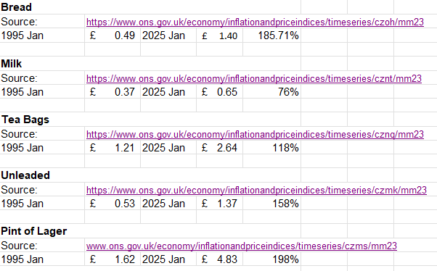





quiz – inflation: 1995 vs 2025.
1995
£1.21
1995
£0.49
1995
£0.37
1995
£0.53
1995
£1.62
118%
186%
76%
158%
198%
TEA
BAGS
(250g)
WHITE
BREAD
(sliced 800g)
PINT
OF
MILK
UNLEADED
PETROL
(per litre)
PINT
OF
LAGER
WEALTH at work colours
2025
£2.64
2025
£1.40
2025
£0.65
2025
£1.37
2025
£4.83
Source: Office for National Statistics
360606217
Notes:
7
Source: Office for National Statistics – January 1995 vs January 2025
OPTIONAL SLIDES
Zoom out for data

Slide 33

a lower annual allowance (AA).
If your total taxable income for the current tax year is:
You will normally be subject to the tapered AA of £10,000
£360,000
or more
You may be subject to a tapered AA – you’ll need to calculate your AA
£200,001 to £359,999
WEALTH at work colours
You will normally be subject to the standard AA of £60,000
£200,000
or less
Carry forward may be available from the 3 previous tax years
972769930
Notes:
972769930

Slide 34

limits on tax efficiency.
Annual Allowance (AA)
    The annual allowance is £60,000*
    This may be reduced if your total taxable income exceeds £200,000 or you flexibly withdraw taxable income from a DC scheme
    Carry forward may be available from up to the 3 previous tax years
    Limits on tax-free cash
    Lump Sum Allowance (LSA): The maximum tax-free cash is limited to 25% of the pension value, subject to a total cap of £268,275 (which is set to be frozen)
    Lump Sum and Death Benefits Allowance (LSDBA): The maximum amount of non-taxable lump sums that can be taken from a pension, set at £1,073,100.
    Those individuals who hold Life Time Allowance (LTA) protection will have allowances based on their protected LTA
If you think you may be affected, ask about this on your follow up call
*Tax relief is only available on contributions up to the greater of 100% of relevant earnings or £3,600
860866534
Notes:
Presenter note:
MPAA is £10,000
TAA is £10,000
Threshold Income: £200,000
Adjusted Income: £260,000
Benefits in excess of the new limits (LSA & LSDBA)

Slide 35





combining your past pensions.
    You can transfer most other pensions into the LSEG Pension Plan
Shall I Transfer?
Contact L&G
Transfer Process
Funds Received
      It can be a complicated decision; you may wish or be required to take regulated financial advice
  You will need to provide L&G with details of the pension you would like to transfer
  L&G will contact the pension provider and arrange the transfer
  The transfer proceeds will be credited to your LSEG Pension Plan
Legal & General
Contact Details
0345 070 2063
employerdedicatedteam@landg.com
Notes:
From April 2022 this also applied to members of the Refinitiv plan.

Slide 36
investing your pension.

Slide 37
the default pension investment.
The default investment fund is the Lifetime Advantage Fund which uses a target dated fund approach
– The Legal & General Generation 3 fund range
L&G PMC 2040 – 2045 Lifetime Advantage Fund 3
Target
retirement
date
2035
2036
2037
2038
2039
2040
2041
2042
2043
2044
2045
L&G PMC 2035-2040 Lifetime Advantage Fund 3
Notes:
.The new default investment it a target dated fund. Most pension scheme members don’t have a clear idea about when they intend to retire. To combat this, each fund targets a different five-year period. For example, if you think you’re likely to start taking your money from your pension pot in 2042, you would select the The Legal & General Generation 3 fund 2040-2045

Slide 38
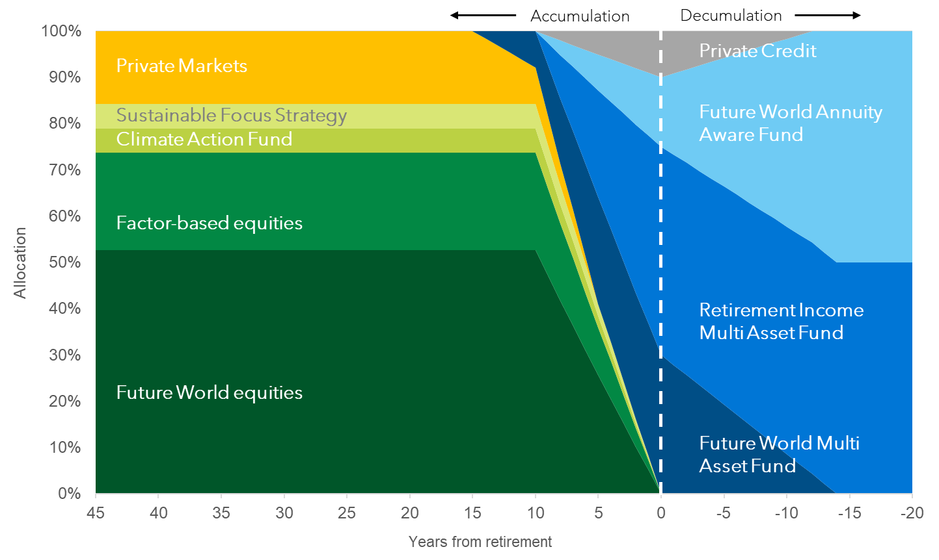
how target date funds are invested.
Asset allocation
50+
40
30
20
10
0
20+
Years before retirement
After retirement
Source: Legal & General.
Asset allocation is used as an example only and will vary according to fund choice.
Notes:
The fund may be actively or passively managed.
There are four investment phases; ‘growth’, ‘steady growth’, ‘preparing for retirement’ and ‘retirement’, depending on how close investors are to retirement. Over time, as investors move through the four phases, the proportion of riskier investments, such as equities is decreased and the proportion of less risky investments, such as government and corporate bonds is increased.
Further information for presenter: https://www.legalandgeneral.com/retirement/pensions/workplace-pensions/funds/target-date-funds/

Slide 39

choosing your own funds.
May be suitable if you are looking for greater investment flexibility
Choose how much to allocate to different types of investments
Manage your own risk exposure as you approach retirement
Manually adjust your investments in line with your retirement income plan

Slide 40
receiving your pension.

Slide 41


defined contribution income options.
DC retirement savings
Cash lump sums
Draw regular income
Annuity
You may need to transfer your benefits to an alternative arrangement to access your chosen income route
157059708

Slide 42
cash lump sum.
25%
Tax-free lump sum
75%
Taxable lump sum
The taxable lump sum is taxed in the year of receipt
This could lead to a significant tax charge
There is the option to receive a series of lump sums
475807093

Slide 43
flexi access drawdown.
Up to 25%
Tax-free cash or opt to receive tax-free cash gradually
Invested
Flexible
Remaining amount is invested and can be drawn in the future as a taxable ‘income’
Make flexible withdrawals to create a taxable 'income’
Remember – the MPAA will apply if you receive taxable money flexibly from any DC pension pot.
664760966

Slide 44





buying an annuity.
Receive up to 25% as a tax-free lump sum
Options include
A guarantee period
Inflation linking
Spouse/partner income
Buy an annuity with the remainder
The income level is determined by your circumstances
Provides a secure income throughout your retirement
779206143

Slide 45
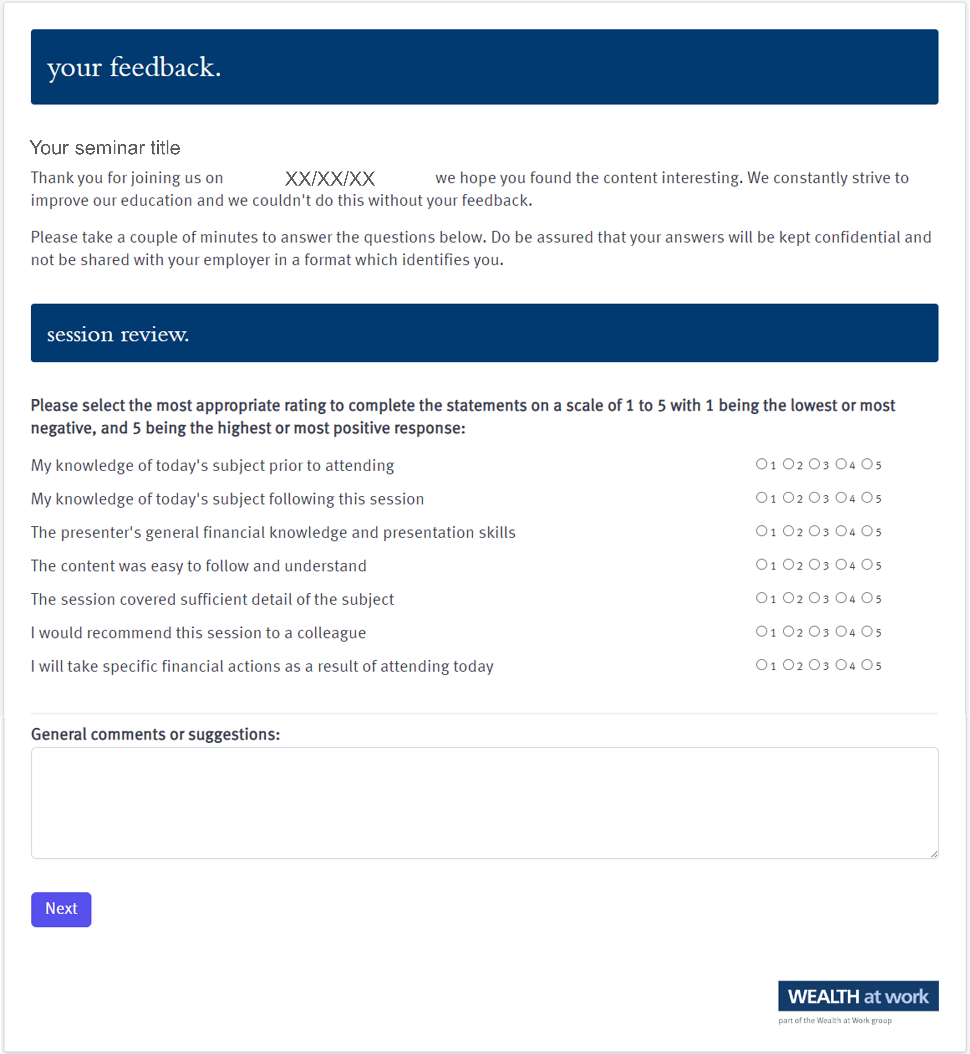
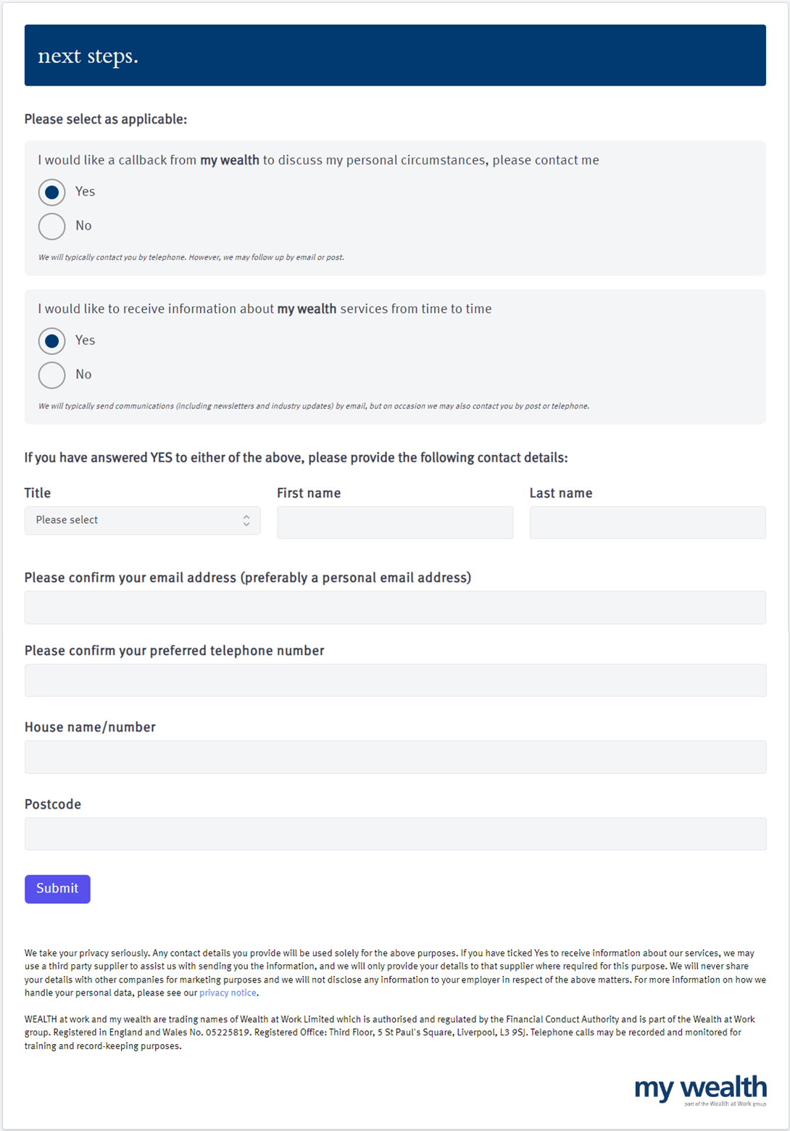
your feedback.
759533470

Slide 46
next steps.
211146986

Slide 47
next steps.

Slide 48
useful contacts.
      Lifeworks
01
        Login.lifeworks.com
        |
        0800 169 7072
        Username &
        password: lsegUK
02
      Money Helper pension calculator
        www.moneyhelper.org.uk/en/pensions-and-retirement/pensions-basics/pension-calculator
03
General tax and National Insurance information
        www.hmrc.gov.uk
  Pension Tracing Service
04
        www.gov.uk/find-pension-contact-details
05
Questions about your LSEG Pension Plan
        Email: pensions@lseg.com
  Obtain a State Pension Forecast
06
        www.gov.uk/check-state-pension

Slide 49
seeking advice.
    An adviser will assess your circumstances, objectives and risk profile and provide you with a personal recommendation to meet your objectives.
    All regulated firms are listed on the Financial Services Register, this provides confirmation that the firm is authorised, the specific services they are authorised to provide and details of the advisers who work for them.
    Financial Services Register link:
    https://register.fca.org.uk
252395834

Slide 50

contact us.
We provide a telephone helpline and a regulated investment advice service through my wealth - a trading name of Wealth at Work Limited which is part of the Wealth at Work group.
It helps individuals to understand their personal financial situation especially when selecting their retirement income options.
      Request a callback from the helpline via the feedback form to discuss your personal circumstances with my wealth and agree your next steps and receive regulated investment advice where required
      You can also telephone 0800 028 3200
141862785

Slide 51
education caveat.
All copyright or other intellectual property rights in the material constituting this presentation which has been provided by Wealth at Work Limited remains the property of the Wealth at Work group.
The content of this presentation is provided for illustrative purposes only and is not intended to be used for individual investment or financial planning and does not constitute financial advice.
Whilst every effort is made to ensure the accuracy of information contained in the presentation it cannot be guaranteed. In particular the rules relating to tax can frequently change.
Any references to tax or the operation of tax or tax reliefs are illustrative only and the tax treatment in respect of any individual depends upon the circumstances of each individual.
It is important to recognise that the value of investments related to the stock market (and any resulting benefits such as interest or dividends), can rise or fall and an investor may not get back the amount invested. Past performance data used is for illustrative purposes only and is not necessarily a guide to future performance.
Any hyperlinks or references to third parties or their websites are provided for information only and it does not mean that we endorse their products or services. We have no control over these and accept no legal responsibility for any content, material or information contained in them.
WEALTH at work and my wealth are trading names of Wealth at Work Limited which is authorised and regulated by the Financial Conduct Authority and part of the Wealth at Work group. Registered in England and Wales No. 05225819. Registered Office: Third floor, 5 St Paul’s Square, Liverpool L3 9SJ. Telephone calls may be recorded and monitored for training and record-keeping purposes.
881862975
Notes:
Back end caveat (WAW only)

Slide 52
thank you.
0800 028 3200
www.wealthatwork.co.uk/mywealth
156297902

