Slide 1
An advanced guide to estate planning
QC--277463477

Slide 2


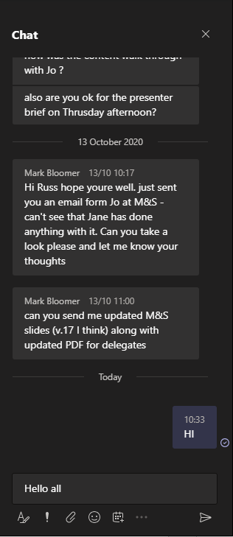

Using the chat box
click the chat box icon
type a message
Hello all…
tap the chat box icon
(it may be at the top of your device’s screen)
410452555

Slide 3
About us
We are a leading financial wellbeing and retirement specialist - helping those in the workplace to improve their financial future.
Established in 2005, we work with hundreds of organisations across both the private and public sector.
Our financial education services are delivered on a bespoke basis.
341377444

Slide 4

Financial education structure
Follow up call
You will be able to ask questions relating to your own circumstances.
Online Seminar
Next steps
Today’s online seminar will cover financial education.
We will identify your next steps and point you in the right direction.
27949402

Slide 5
Agenda
  Inheritance tax
  Making gifts during your lifetime
  intestacy rules and Will writing
  Trusts
  Further Information
Notes:
Please note: If attendees have attended part 1, they will be familiar with the introduction to the session.

Slide 6
Estate planning
495410273

Slide 7


Inheritance tax (IHT)
  HMRC apply IHT to your worldwide assets if you are a long-term resident of the UK
  Long-term residents are those UK-resident for over 10 of the last 20 tax years
  You may still count as a long-term resident for up to 10 years after leaving the UK
81349940
Notes:
0

Slide 8





Inheritance tax (IHT)
Residence Nil Rate Band
Transfer unused portion
100,000
100,000
100,000
Nil Rate Band
IHT
Charge
£325,000
£175,000
up to £500k
40%
Applied to any part of an estate that is chargeable to IHT
Only applied to a home that is left to a direct descendant
A couple could potentially pass on up to £1m before IHT becomes due*
*A couple in this context is a spouse or civil partner
741423466
Notes:
IHT is a tax charge applied to an individual’s estate, usually at the point they die

Slide 9
Inheritance tax (IHT) - example
The estate is worth £515,000 after IHT
The estate
£10,000
40% IHT charge
£25,000
Excess subject to IHT
£15,000
Net excess
£450,000
Total nil rate band limit
£175,000
£50,000
Residence nil rate band
£25,000
£325,000
Total £525,000
Nil rate band
The estate is being passed to a direct descendant
927393826
Notes:
A person’s estate is made up of everything they own at the point they die
Highlight that non exempt gifts made in 7 years prior to death are included in the estate.

Slide 10

Taper threshold (TT)
For estates valued at over £2,000,000 a taper may apply to the RNRB.
  RNRB is reduced by £1 for every £2 an estate exceeds the taper threshold.
  There will be no RNRB if the estate exceeds £2.35m or £2.7m including available partner's unused allowance.*
Maria’s Example:
  Estate valued at £2,100,000 including a home worth £500,000
  Maria has inherited her husband’s full NRB + RNRB from his death
  Maria dies leaving the full estate to their children
£650,000
NRB
£350,000
RNRB
£1,000,000
£950,000
£300,000
Adjusted RNRB
*Based on current RNRB of £175,000
531335124
Notes:
4
TT applies to the value of the estate after liabilities, but before taking into account any exemptions or reliefs.
Maria dies in the current tax year with £2.1m estate including a £500,000 home. All left her children
Maria’s default RNRB is £175,000 + £175,000 (from her dead husband) = £350,000
As the Estate is valued at £100,000 over £2,000,000 so the Taper threshold applies
The reduction will be £50,000 (£100,000 x 0.5)
Adjusted RNRB = £350,000 less £50,000 = £300,000
Maria’s estate qualifies for a RNRB of £300,000

Slide 11



Downsizing addition
An individual may still qualify for the RNRB in cases where they have sold their home or moved to a less valuable home.
To qualify, all these conditions must apply:
The person sold, gave away or downsized to a less valuable home on or after 08.07.2015
  The former home would have qualified for the RNRB if they’d kept it until they died
Their direct descendants inherit at least some of the estate
482546167
Notes:
7
Source: https://www.gov.uk/guidance/how-downsizing-selling-or-gifting-a-home-affects-the-additional-inheritance-tax-threshold
There are 5 steps to working out how much RNRB has been lost.
Work out the RNRB that would have been available when the former home was sold or given away or when the move happened. This figure is made up of the maximum RNRB due at that date (or £100,000 if it was before 6 April 2017) and any transferred RNRB available when the person dies.
Divide the value of the former home at the date of the move or when it was sold or given away by the figure in step 1, and multiply the result by 100 to get a percentage. If the value of the former home is greater than the figure in step 1 the percentage will be limited to 100%. If the value of the home sold is less than the figure in step 1, the percentage will be between 0% and 100%.
If there’s a home in the estate, divide the value of the home by the RNRB that would be available at the date the person dies (including any transferred RNRB). Multiply the result by 100 to get a percentage (again this percentage cannot be more than 100%). If there’s no home in the estate at the time the person dies this percentage will be 0%.
Deduct the percentage in step 3 from the percentage in step 2.
Multiply the RNRB that would be available at the time the person died by the figure from step 4. This gives the amount of the lost RNRB.

Slide 12
Making gifts during your lifetime
268806947

Slide 13


Your estate
In addition to the nil rate bands, there are a number of other gifts that can be made free from IHT. These include gifts to:
A spouse or civil partner
+
Gifts that are free from IHT regardless of who the recipient is:
  The proceeds of a Life Assurance policy held in trust
  Discretionary payments from a pension on death to any nominated beneficiary
Political parties in the UK
Any registered charity
From 6 April 2027, unspent DC pension pots and lump sum death benefits from a DB plan left to non-spouse/civil partner beneficiaries will be subject to Inheritance Tax.
281704780
Notes:
0

Slide 14




Gifts during your lifetime
There are certain gifts that can be made during your lifetime that are immediately exempt from any Inheritance Tax charge. These include:
An annual exemption of £3,000 (carry forward over 1 year is permitted)
Exempt
Small gifts up to the value of £250 per person
From
IHT
Regular gifts or payments that are part of your normal expenditure out of income
Gifts to a spouse or civil partner
605933157
Notes:
7
Note to Presenter. Below is a definition of the word ‘normal’ provided the HMRC in the context of gift out of normal expenditure.
Lifetime transfers: conditions for normal out of income exemption: normal expenditure
The dictionary definition of ‘normal’ includes standard, regular, typical, habitual or usual. For the purpose of this exemption, ‘normal’ means normal for the transferor and not for the average person. In most cases, it will be clear whether or not there is a pattern of giving, but it is not always that simple.
It is possible that a number of gifts made by one person may not qualify. It is also possible for a single gift to qualify if it is or is intended to be the first of a pattern and there is evidence of this. You will need to analyse all the facts in cases of doubt to see if a pattern can be found (IHTM14242).
Factors to take into account in looking at any pattern of gifts include the frequency and amounts, the nature of the gifts, the identity of the donees and the reasons for the gifts (IHTM14243).
Next page

Slide 15

Potentially exempt transfers
  Other gifts made whilst alive may become exempt after a period of time has passed.
Outright Gift
Failed PET
7 Years
  The donor must give up all interest in the gift
  The donor must survive 7 years from the date the gift was made
  After 7 years the gift is exempt from IHT
191952385
Notes:
5

Slide 16





Potentially exempt transfers
2021
2028
Sally makes a cash gift of £300,000
Survival date for the gift to be excluded from her estate
2021
2022
2023
2024
2025
2026
2027
2028
2025
Sally dies - leaving an additional £200,000 but no house
530449813
Notes:
3
Example - Sally decides to make a cash gift to her children of £300,000.
Sally dies 5 years from the date the gift was made
As she died within 7 years of making the gift, it is assessed for IHT
Sally does not own a home but has a remaining estate of £200,000 in addition to the gift
Sally dies 5 years from the date the gift was made
As she died within 7 years of making the gift, it is assessed for IHT
Sally does not own a home but has a remaining estate of £200,000 in addition to the gift

Slide 17
Potentially exempt transfers
  The gift forms part of the nil rate band
  The remaining estate is then added
  IHT applies to £175,000*
  40% of £175,000 = £70,000
£500K
Total
£175k
chargeable to IHT
£200K
£325K
additional
nil rate band
£300K
gift
*Example assumes a home does not form part of her estate.
988102315
Notes:
5
Presenter to make delegates aware that no Taper applies in this example. This is because Taper applies to any IHT charge, not the gift itself. As the gift fell entirely within the nil rate band, there is no charge to Taper.

Slide 18
Potentially exempt transfers
If a Potentially Exempt Transfer was made within 7 years of death, taper relief may apply:
  Gifts made before death will use up the nil rate band first
  Taper relief applies where the total value of gifts exceeds the nil rate band
Time since death | Tax paid
Less than 3 years | 40%
3 to 4 years | 32%
4 to 5 years | 24%
5 to 6 years | 16%
6 to 7 years | 8%
7 or more years | 0%
124173915
Notes:
5

Slide 19
Intestacy rules and Will writing

Slide 20




Writing a will
A solicitor will write a Will that reflects your wishes or intentions
Only consider writing a Will yourself if you’re confident that it reflects your wishes or intentions
Keep your Will up to date
Divorce automatically removes any entitlement to the ex-spouse*
A Will is automatically revoked on marriage*
Regularly review your nomination forms for life assurance and pensions
*Unless your Will specifically states otherwise
673281448
Notes:
FOR USE IN ENGLAND, WALES & NORTHERN IRELAND ONLY

Slide 21







Intestacy rules – England & Wales
If you were to die without a valid will, intestacy rules would apply. The rules that apply depend upon your personal circumstances.
Married / Civil Partner?
Children?
Children?
Spouse / Civil Partner - £322,000 +
½ the remainder
Children - Everything
Children - the rest
Parents, siblings, grandparents, aunts/uncles or crown takes all
Spouse / Civil Partner - everything
296502304
Notes:
4

Slide 22
Applying for probate
Probate is the legal right to deal with an individual’s estate when they die.
If the person left a Will
You can apply for probate if you’re named as the executor
You will get a ‘grant of probate’
If the person did not leave a Will
The administrator deals with the estate
A spouse, civil partner or child can apply to be the administrator
You’ll receive ‘letters of administration’
572381585

Slide 23

Applying for probate
  If tax is due, at least some of it is normally payable before probate is granted
  The executor can claim the tax back from the estate or the beneficiaries
Probate application fees
£273
No fee
If the value of the estate is £5,000 or over
If the estate is under £5,000
For more information and to apply for probate:
www.gov.uk/applying-for-probate/apply-for-probate
An executor can apply for probate or pay a solicitor to apply on their behalf
790400493

Slide 24
Trusts

Slide 25

Trusts
There are 3 groups of people involved in setting up a trust:
The Settlor
The Trustee
The Beneficiaries
Puts assets into the trust
Holds legal title to the assets in the trust
The people who benefit from the trust
Trust wording sets out how to manage and distribute the assets
846821457

Slide 26


Trusts
Two of the main reasons for setting up a trust are:
To keep control in some way until an event happens
As part of a tax planning exercise
842141914

Slide 27
Trusts
Other examples why an individual may look to set up a trust include:
When someone is too young to manage their own finances
When someone cannot manage their own finances because they are incapacitated
To administer assets for charitable purposes
To pass on assets when you die (a ‘will trust’)
It is not advisable to try and set up any trusts without expert advice from a solicitor and/or tax adviser.
630246704

Slide 28
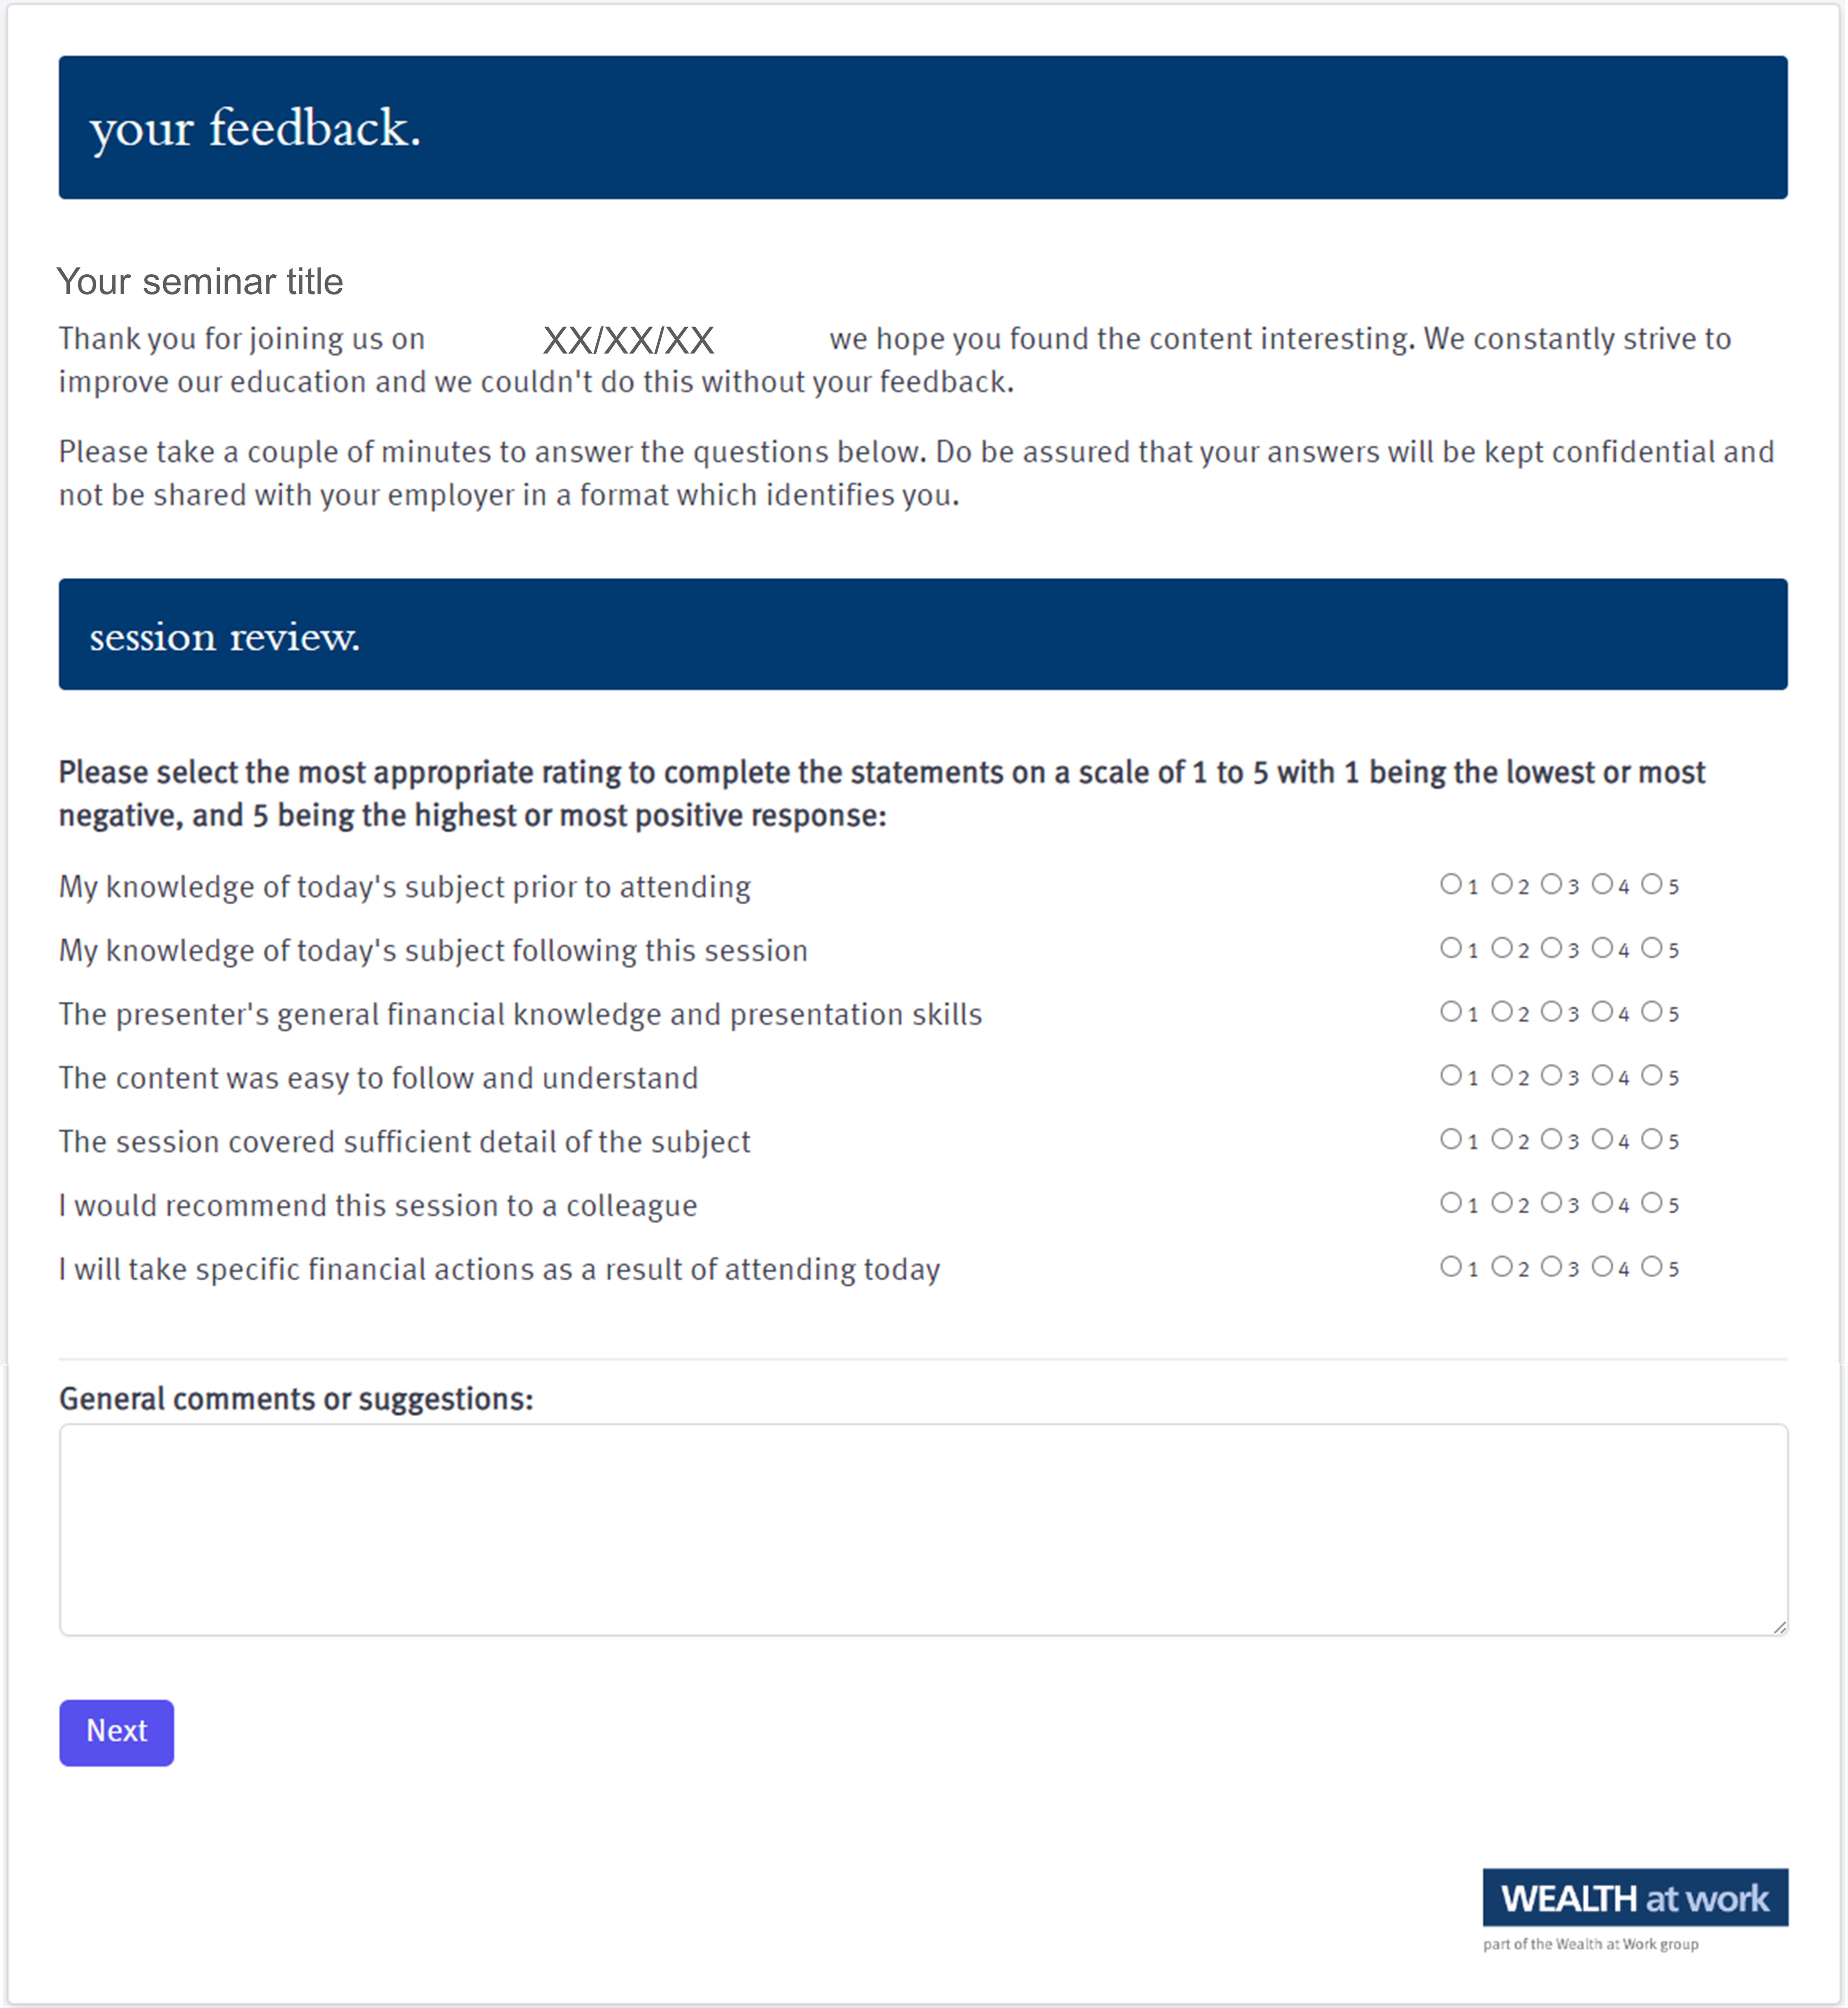
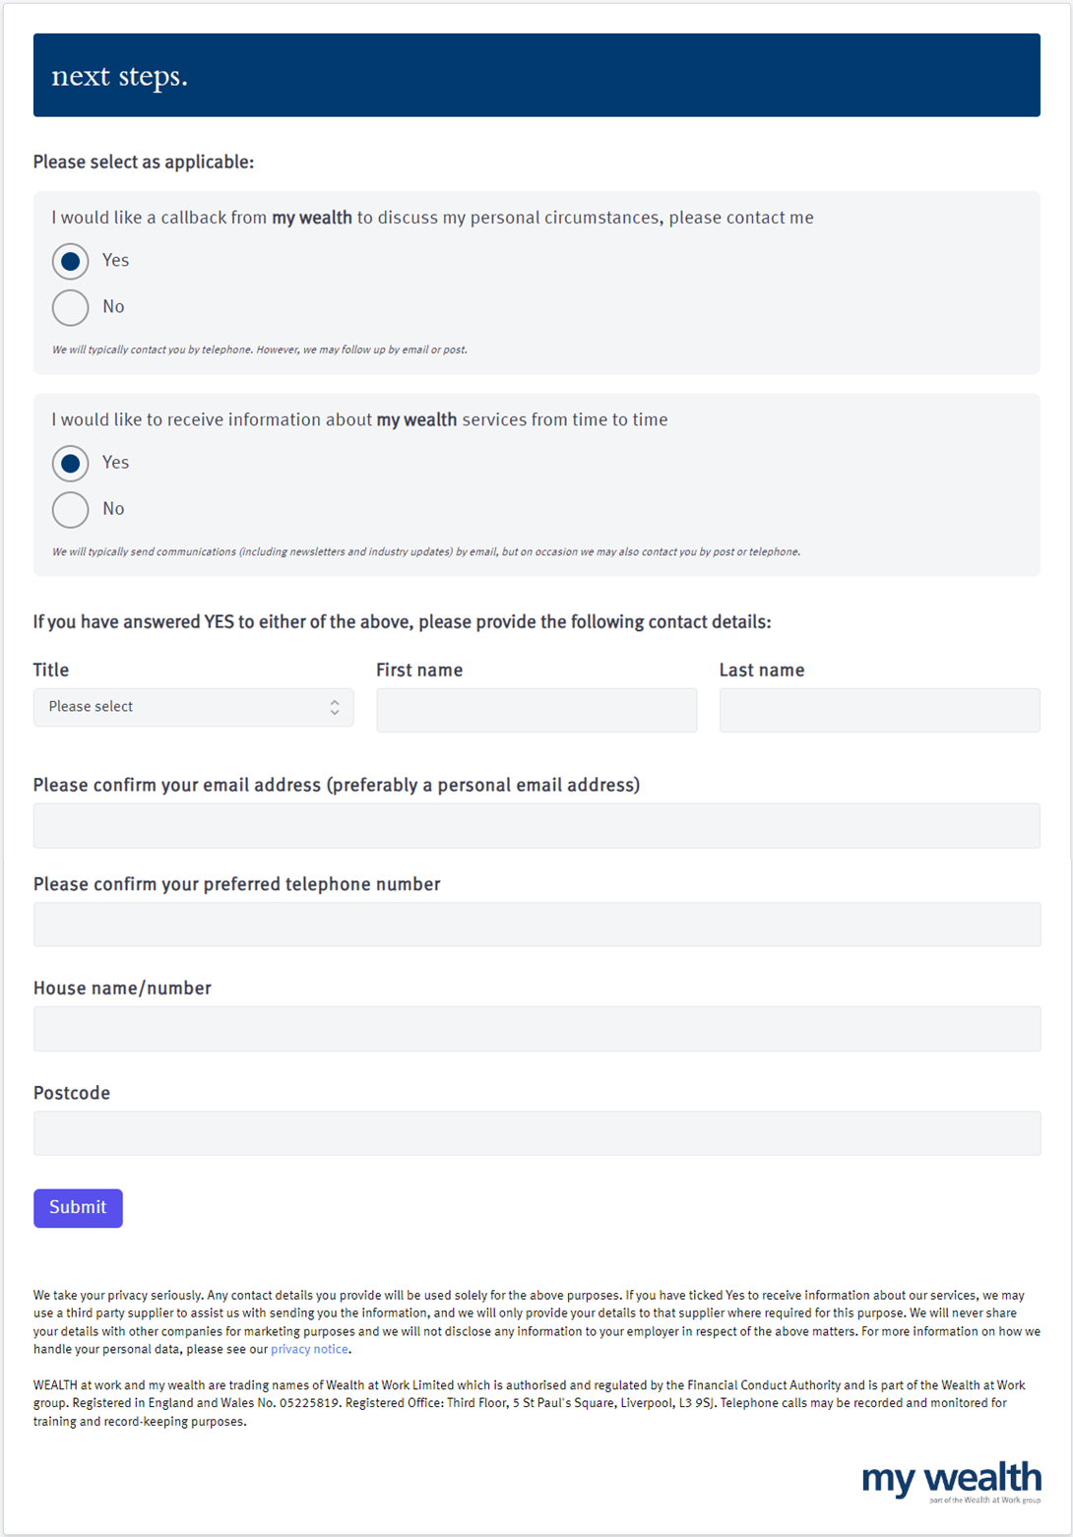
Your feedback
759533470

Slide 29
Next steps
211146986

Slide 30
Next steps
393965084

Slide 31
Useful contacts
01
      Free Wills Month
        freewillsmonth.org.uk/
02
      Citizens advice – Help with dealing with an estate
citizensadvice.org.uk/family/death-and-wills/
      Residence Nil rate band – further information
03
        gov.uk/guidance/inheritance-tax-residence-nil-rate-band
Intestacy rules
04
        gov.uk/inherits-someone-dies-without-will
  Power of Attorney – further information
05
        moneyhelper.org.uk/en/family-and-care/long-term-care/setting-up-a-power-of-attorney-in-england-and-wales
  Workplace nomination forms
06
        visit scheme websites
Notes:
FOR USE IN ENGLAND AND WALES ONLY

Slide 32
Seeking advice
    An adviser will assess your circumstances, objectives and risk profile and provide you with a personal recommendation to meet your objectives.
    All regulated firms are listed on the Financial Services Register, this provides confirmation that the firm is authorised, the specific services they are authorised to provide and details of the advisers who work for them.
    Financial Services Register link:
    https://register.fca.org.uk
252395834

Slide 33

Contact us
We provide a telephone helpline and a regulated investment advice service through my wealth - a trading name of Wealth at Work Limited which is part of the Wealth at Work group.
It helps individuals to understand their personal financial situation especially when selecting their retirement income options.
      Request a callback from the helpline via the feedback form to discuss your personal circumstances with my wealth and agree your next steps and receive regulated investment advice where required
      You can also telephone 0800 028 3200
141862785

Slide 34
Education caveat
All copyright or other intellectual property rights in the material constituting this presentation which has been provided by Wealth at Work Limited remains the property of the Wealth at Work group.
The content of this presentation is provided for illustrative purposes only and is not intended to be used for individual investment or financial planning and does not constitute financial advice.
Whilst every effort is made to ensure the accuracy of information contained in the presentation it cannot be guaranteed. In particular the rules relating to tax can frequently change.
Any references to tax or the operation of tax or tax reliefs are illustrative only and the tax treatment in respect of any individual depends upon the circumstances of each individual.
It is important to recognise that the value of investments related to the stock market (and any resulting benefits such as interest or dividends), can rise or fall and an investor may not get back the amount invested. Past performance data used is for illustrative purposes only and is not necessarily a guide to future performance.
Any hyperlinks or references to third parties or their websites are provided for information only and it does not mean that we endorse their products or services. We have no control over these and accept no legal responsibility for any content, material or information contained in them.
WEALTH at work and my wealth are trading names of Wealth at Work Limited which is authorised and regulated by the Financial Conduct Authority and part of the Wealth at Work group. Registered in England and Wales No. 05225819. Registered Office: Third floor, 5 St Paul’s Square, Liverpool L3 9SJ. Telephone calls may be recorded and monitored for training and record-keeping purposes.
881862975
Notes:
Back end caveat (WAW only)

Slide 35
Thank you
0800 028 3200
www.wealthatwork.co.uk/mywealth
156297902

