Slide 1
Summer finances
Focusing on your Financial Future
QC--845020836

Slide 2
About us
WEALTH at work is a leading financial wellbeing, retirement and workplace savings specialist.
Established in 2005, we work with hundreds of organisations across both the private and public sector.
Our financial education services are delivered on a bespoke basis.
341377444

Slide 3
Financial education structure
Follow up call
You will be able to ask questions relating to your own circumstances.
Online Seminar
Next steps
Today’s online seminar will cover financial education.
We will identify your next steps and point you in the right direction.
27949402

Slide 4
Agenda
Why summer stretches budgets
Budgeting for summer activities
Dealing with childcare during school summer holidays
Smart spending on holidays and travel
Ensuring your holiday is protected
Borrowing pitfalls and debt traps
Next steps

Slide 5
Why summer stretches budgets

Slide 6
Why we spend more
School Holidays
Christmas
Travel
Winter holidays
Festivals
Weddings
Days out
Notes:
1. More Socialising and Travel
Summer brings holidays, festivals, weddings, and days out
People tend to spend more on:
Transport (fuel, trains, flights)
Accommodation and holidays
Eating out, pubs, and events
This increase in discretionary spending makes overall living costs feel higher
2. Peak Pricing (Supply & Demand)
Many industries raise prices due to higher demand in summer
Hotels, flights, and holiday rentals are typically more expensive during school holidays
Childcare costs can rise when kids are off school
This is classic seasonal pricing pressure
3. Food and Drink Spending Shifts
While some fresh produce is cheaper in summer, people often:
Buy more premium or convenience foods (BBQs, picnics, drinks)
Eat out more frequently
Social gatherings can push grocery and hospitality spending up
4. Energy Bills Aren’t Always Lower
Heating costs drop, but savings can be offset by:
Increased electricity use (fans, appliances, more time at home during holidays)
Fixed tariffs or averaging payments, which keep bills steady year-round
So costs don’t drop as much as expected
5. Higher Transport Costs
More travel = more:
Fuel usage (petrol prices often rise with demand)
Train fares (especially at peak times)
Road trips and commuting changes can increase expenses
6. Seasonal Purchases
People often spend on:
Summer clothing
Outdoor furniture or gardening supplies
Home improvements
These are not regular expenses but add to the seasonal spike
7. Events and Occasions
Summer is peak time for:
Weddings
Festivals
Family celebrations
Gifts, outfits, travel, and accommodation all add to household costs

Slide 7
Christmas
Why we spend more
Winter holidays
Step 1
What have you got planned?
School Holidays
Days out
Festivals
Travel
Weddings
Step 2
How much is it likely to cost?
Consider all costs: Travel, food, entertainment, entrance fees etc
Step 3
How are you going to pay for it?
Regular income
Existing savings
Advanced budgeting
Credit
Notes:
Once you know your plans, its not a surprise so how are you going to plan ahead for it?
What activities are you doing?
Do you need extra money for that?
Do you need to take time off? Will that impact your income?
Don’t bury your head in the sand. “Having a budget in place before the holidays start can help you to plan out what you can, and can’t, afford to spend this summer, “This should include all the essentials, such as activities, food and transport.”

Slide 8
Budgeting for summer activities
Notes:
We know there are likely to be spikes in our spending during the year – but how can we plan for these?

Slide 9
Ideas for budgeting
There are many ways of budgeting, to ensure success, it’s about finding the right method for you.
50/30/20
Zero
Based
Cash
stuffing
50% - essentials
Allocate your monthly budget for different expenses into categories
30% - your future
Put every penny to work
20% - wants
Notes:
Here are some tried and tested budgeting techniques, what works best for you?
The 50-30-20 budgeting rule sets 50 per cent of your monthly income aside for your needs, 30 per cent for your wants, and 20 per cent for your savings. We’ve adapted it to fit in with our slides.
More info: https://www.nerdwallet.com/article/finance/nerdwallet-budget-calculator#:~:text=How%20the%2050%2F30%2F20,for%20savings%20and%20debt%20repayment.
Zero-based budgeting is a technique developed in the 1960s that forces you to analyse and justify all of your expenses.
https://www.theguardian.com/money/2024/apr/20/every-penny-has-a-purpose-the-rise-of-zero-based-budgeting
And as the name suggests, cash stuffing has you relying on hard cash and envelopes (although virtual options now also exist within most banking apps).
https://www.money.co.uk/savings-accounts/what-is-cash-stuffing-and-how-does-it-work

Slide 10
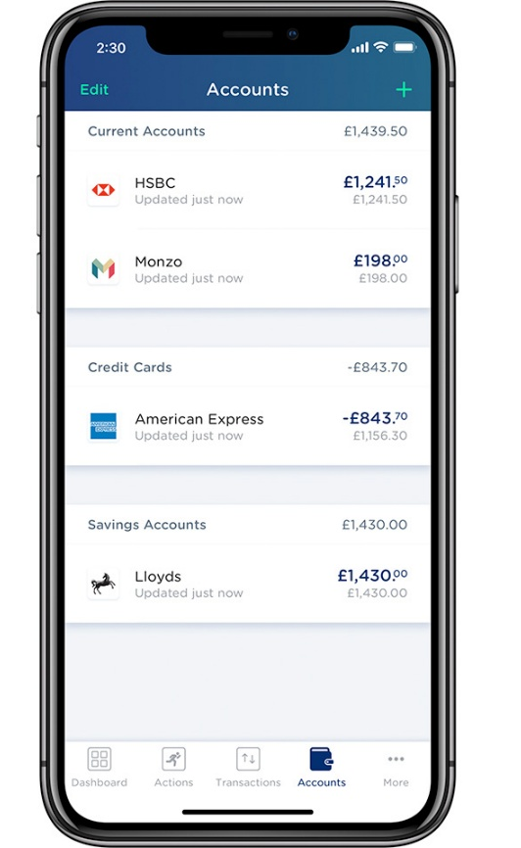
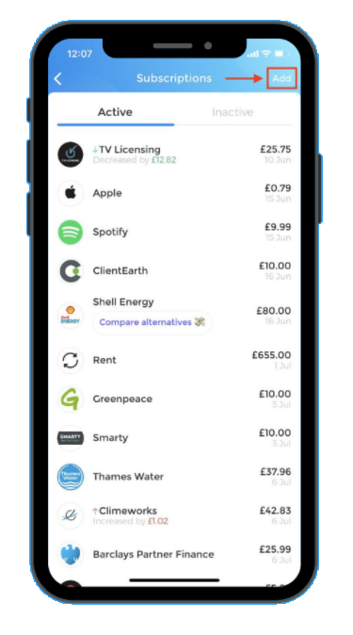
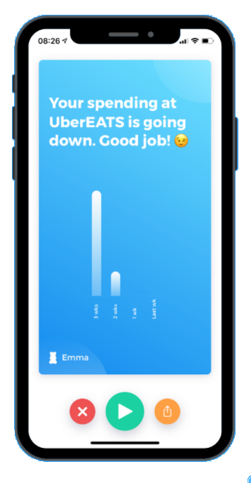
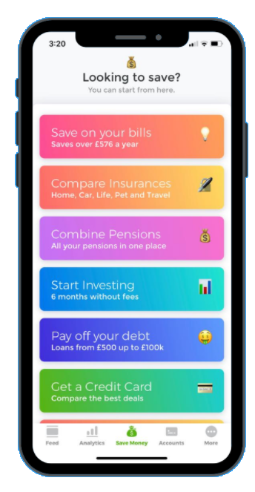
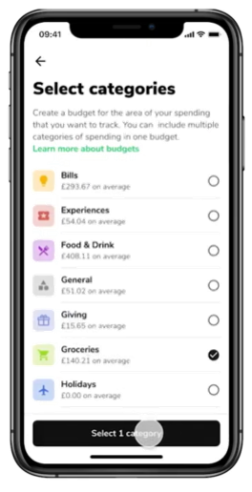
Use technology to identify spending habits
Technology can make it easier to identify spending trends.
Many banking apps also now offer smart insights, which allow you see exactly where your money is going – from how much of your weekly spend is tied up in direct debits and bills, to spotting patterns in your spending.
Notes:
These tools can make it easier to manage your day-to-day finances and plan ahead, especially for bigger events, like the summer holidays, when you know you’ll be spending more.

Slide 11
Budgeting for peak spending seasons
Regular spend
Spent monthly, throughout the year
Emergency fund
Use to avoid debt or dipping into savings
Long term savings
Only for long term (+5 years) goals
Earnings
Used to supplement regular income when spending spikes
Summer budget
Used to supplement regular income when spending spikes
Winter holidays
Notes:
Every time you get paid:
You divide your income into pots immediately
Each pot is ring-fenced for its purpose
You only spend from that pot
If a pot is empty, spending stops (or you consciously move money)
1. Identify – out of the ordinary spends
2. Capture seasonal savings
3. Utilise the reserve when needed.

Slide 12
Summer spending priorities
Essentials
Optional
Potential hazards
Needs first
• Rent, bills and groceries
• Work travel / commuting
• Childcare or school holiday cover
• Summer clothing replacements
• Basic toiletries and medicines
Nice to have
• Day trips and picnics
• BBQs, eating out and coffees
• Streaming, hobbies and small treats
• Festival or event tickets
• Home and garden extras
Plan for surprises
• Higher utility bills in heatwaves
• Holiday overspend and travel disruption
• Kids' entertainment costs over the school break
• Last-minute gifts and social plans
Prioritise by due date, then ring-fence a weekly amount.
Set a cap and only spend after essentials are covered.
Keep a buffer for these before committing to optional plans
Notes:
Explain the structure of these columns (essential, future and wants) and why we’ve put them in this order.
(Break out rooms) Work in your group to Fill each column with categories. We have some examples here, but yours could look very different. There is no right or wrong here, the idea is to work as a team and talk through your expenses and where you think they fit.
Following on from this, we’ll give an example of how this could look and explain why we’ve put certain categories into certain column. We’ll also talk about budgeting methods to achieve this.

Slide 13
Summer holidays for parents
Notes:
During term time, many families rely on school to provide structure, meals, and support with childcare. School holidays remove that safety net, often resulting in a rise in household expenditure. Daily meals at home, entertainment for children, and additional travel or transport all come into play.
It’s understandable why parents worry about the financial cost of school holidays. Nearly half of parents reported that the cost of summer childcare along with shopping list of things to buy before children go back to school will put them in financial difficulty.

Slide 14

The cost of school holidays
Household bills
Clothing
Food
Travel
Entertainment
Days out
Holiday
Notes:
Household bills – Gas usage may go down (due to hot weather) but electricity may go up if you’re spending more time at home.
Clothing – Data suggest we buy more clothes in the summer, especially around holidays or changes in weather. There is also the expense of new school uniform and accessories in September.
Food – It’s likely you’ll now be cooking 3 meals a day plus snacks, whereas in school you may get subsidised or free meals.
Daily travel - is likely to go up as you’re doing more with the kids or dropping them off places

Slide 15
Adapting to increased costs
Research has found that the parents spend more during the school holiday period, splurging, on average, an extra £500 over the six weeks.
77%
40%
31%
Notes:
Research from Lloyds has found that the majority of parents (77%) spend more during the school holiday period, splurging, on average, an extra £500 over the six weeks.
To adapt to this increase in spending, many parents have had to make some changes, replacing takeaways with home-cooked meals (40%), working extra hours (40%) and even delaying personal appointments, like haircuts (31%).
Research: https://www.lloydsbankinggroup.com/media/press-releases/2025/lloyds-bank-2025/summer-budgeting.html

Slide 16
Childcare during School holidays
A
OPTIONS TO BRIDGE GAP
Take annual leave or unpaid parental leave
Holiday clubs
Family & other parents
Reduce working hours
July
September
Notes:
1. Holiday Clubs
What they are
Organised childcare programmes (e.g. sports camps, activity clubs, school-run schemes)
Usually run during school holidays for children aged 4–14
Advantages
Reliable and structured care during working hours
Offers social interaction with other children
Often includes activities, trips, and skill-building
Helps maintain a routine similar to school
Disadvantages
Can be expensive, especially for multiple children or full summer coverage
Limited availability—places may fill quickly
Fixed hours may not align perfectly with working schedules
Considerations
Book early to secure places
Check availability of tax-free childcare or vouchers to reduce costs
Consider part-time use
2. Family and Other Parents
What it involves
Sharing childcare responsibility with:
Grandparents or extended family
Friends, neighbours, or other parents (informal childcare swaps)
Advantages
Often low-cost or free
Children are cared for in a familiar and comfortable environment
Flexible arrangements can be created informally
Builds community support networks
Disadvantages
Availability may be limited or inconsistent
Can feel like a burden on family members over long periods
Informal arrangements may lack structure for young children
Considerations
Agree clear expectations (days, hours, responsibilities)
Combine with other childcare methods to avoid over-reliance
Ensure fairness when sharing with other parents
3. Taking Annual Leave or Unpaid Parental Leave
What it involves
Parents take time off work to provide childcare themselves
Could be:
Paid annual leave (holiday entitlement)
Unpaid parental leave (if eligible)
Advantages
Enables direct parent-child time during holidays
No childcare costs during time off
Flexible—can be spread across the summer or used for key weeks
Disadvantages
Reduces time available for rest or other holidays
Loss of income if unpaid leave is used
May not cover the full holiday period (6+ weeks)
Considerations
Plan leave early with employer
Combine with other options to stretch leave days
Check eligibility for unpaid parental leave (UK employees can take up to 18 weeks per child in total)
4. Reducing Working Hours
What it involves
Temporarily reducing hours (e.g. part-time work, flexible working, remote work)
Advantages
Provides more consistent childcare coverage across the whole summer
May reduce need for paid childcare
Can support better work-life balance
Disadvantages
Reduced income during the period
May impact workload, responsibilities, or career progression
Not always possible depending on the job role
Considerations
Request flexible working arrangements in advance
Explore options such as:
Compressed hours
Job sharing
Hybrid working
Consider financial impact and budget accordingly
Key Takeaway
Most families don’t rely on just one method — they combine several approaches, for example:
Holiday clubs (part-time) + grandparents
Annual leave for key weeks + childcare swaps
Reduced hours + occasional paid childcare
The goal is to balance:
Cost
Flexibility
Child wellbeing
Work commitments

Slide 17

Tax-free childcare
Benefits
Receive a £2 “top up” for every £8 you pay into your childcare account until your child is 12*
Limits
£2k
Top up capped at £500 per quarter
£8k
or £2,000 per year
Eligibility
You and your partner must be earning at least minimum wage
You or your partner cannot be in receipt of certain benefits
£500
You or your partner cannot earn over £100,000
£2k
Further information
Government top up
gov.uk/tax-free-childcare
Personal contribution
*If you’re working, you may be able to get up to £4,000 a year to help pay for childcare for a disabled child until age 17.
644354846
Notes:
644354846
Approved childcare could include: childminders, nurseries and nannies, after school clubs and play schemes.

Slide 18
Unpaid parental leave
As a parent, you’re entitled to take Up to 18 weeks unpaid leave per child, which must be taken before the child’s 18th birthday.
Allowance
Your rights
Up to 18 weeks total per child, which must be taken before the child’s 18th birthday.
Your rights such as holidays and the right to return to your job, are fully protected during your time off.
Annual allocation
Notice period
You are normally limited to taking a maximum of 4 weeks of parental leave per child in any 12-month period.
You must give your employer at least 21 days' notice before you intend to take the leave.
Blocks
Blocks
Leave must generally be taken in blocks of whole weeks
Leave can not be denied but can be postponed.
Notes:
Key Entitlements
Up to 18 weeks total per child, which must be taken before the child’s 18th birthday.
You are normally limited to taking a maximum of 4 weeks of parental leave per child in any 12-month period.
Leave must generally be taken in blocks of whole weeks (unless the child is disabled, where individual days are permitted)
Your Rights
Your employment rights, such as holidays and the right to return to your job, are fully protected during your time off.
Notice Period: You must give your employer at least 21 days' notice before you intend to take the leave.
While your employer cannot deny you the leave, they can postpone it by up to 6 months if your absence would cause significant disruption to the business.
Review further guidance on gov.uk

Slide 19
Free school meals – during the summer
Holiday Activity and Food (HAF) programme
If your child is eligible for free school meals, you may be able to take part in the Holiday Activity and Food (HAF) programme.
What is it?
This is run by your local council and entitles your child to a meal and access to holiday activities.
How to apply
Check how you'll need to apply by contacting your local council.
Notes:
How this works and what you get depends on where you live in the UK, but it can include free meals, free activities and even free cash to help with your childcare costs.
The HAF programme funding is primarily for school aged children from reception to year 11 (inclusive) who receive benefits related FSMs. However, local authorities have discretion to use up to 15% of their funding to provide free or subsidised holiday club places for children who are not in receipt of benefits related FSMs but who the local authority believe could benefit from HAF.
Benefits related FSMs are available to pupils if their parents are in receipt of one of the qualifying benefits and have a claim verified by their school or local authority.
Access to HAF is not automatic, you must apply each holiday.

Slide 20
Smart spending on holidays and travel

Slide 21
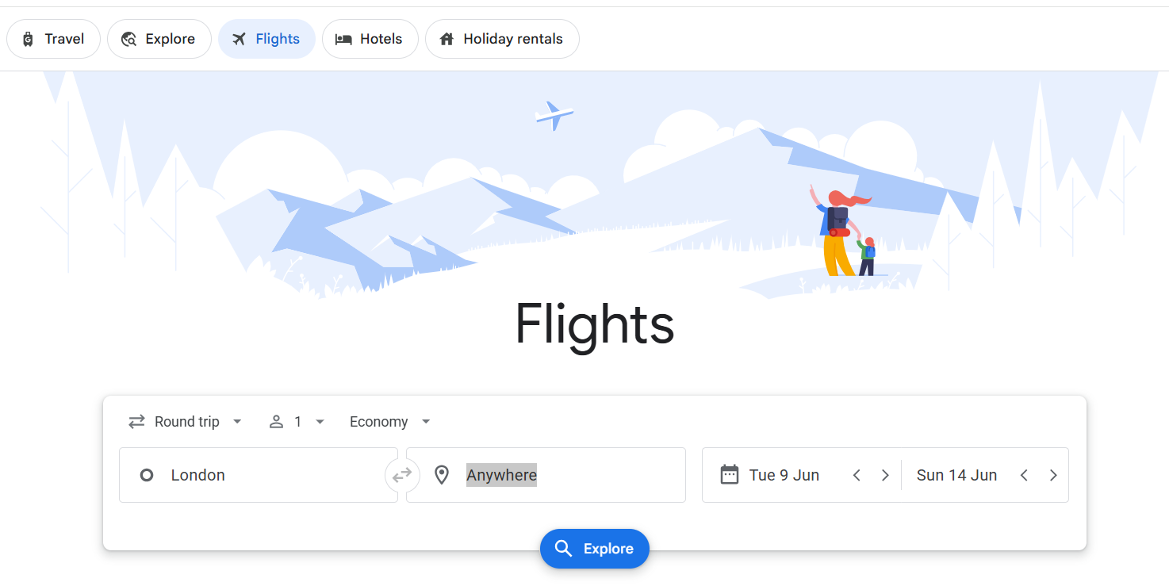
Finding a good deal on your holiday booking
There are a variety of search tools online to help you find the cheapest flight prices for your holiday.
Search across multiple airlines and routes in one place
Enter your destination and dates to find the cheapest flights available
Explore different destinations and dates to find the best deals if you’re open to options
Search: Google Flights and select the ‘Flights’ tab

Slide 22
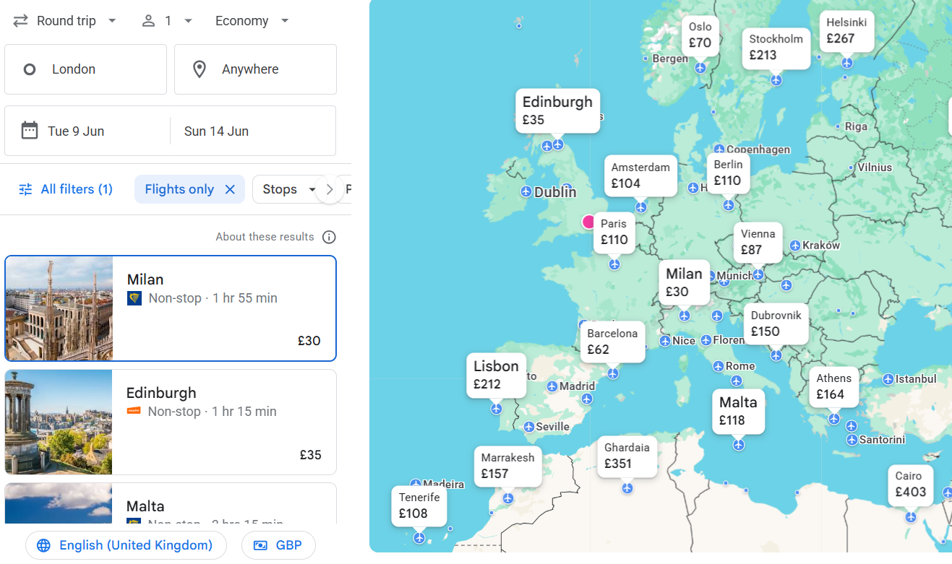
Finding a good deal on your holiday booking
Choose your dates and select ‘anywhere’ if you’re flexible on location

Slide 23
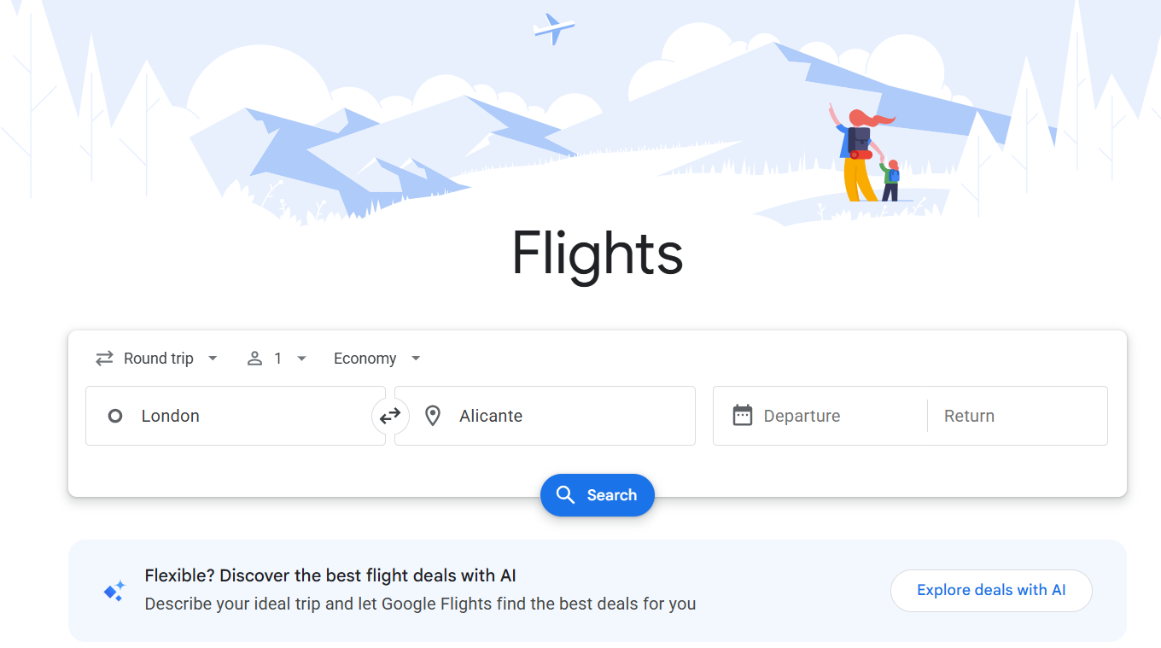
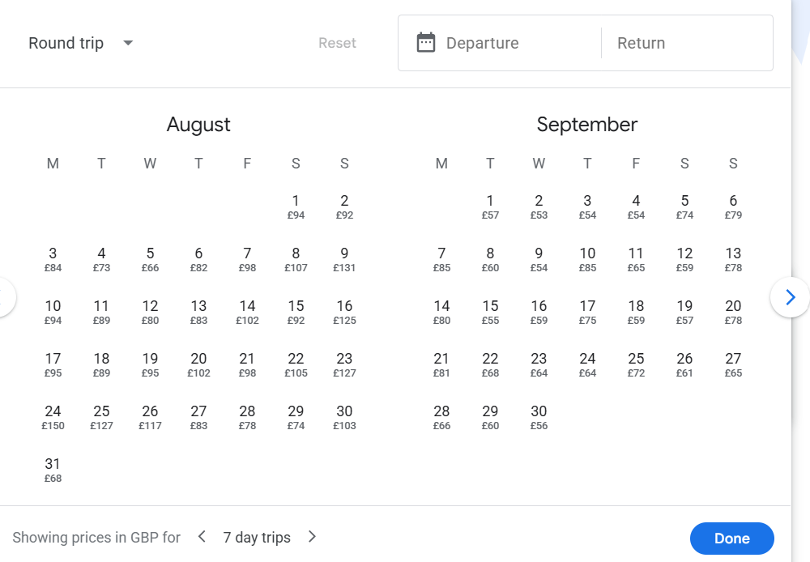
Finding a good deal on your holiday booking
Or, choose your location and search for cheap dates
Choose your flight route
Search for prices on various dates

Slide 24
Finding a good deal on your holiday booking
Or, choose your location and search for cheap dates
Search for prices on various dates
+78%
Timing of your trip can make huge different
(change this as required)
if choosing the last week of August
Prices are for a round trip (change this as required)
Google finder, sky scanner, jet2
Cash back – quidco etc

Slide 25

Avoiding the summer holiday price hikes
Scotland
Late June –
Mid August
Prices can hike up to 213%* when in school holidays
gov.uk/school-term-holiday-dates
Wales
England
Late July - September
Late July - September
*Source: Which
Notes:
You may be able to get a significant discount on foreign holidays if you fly out of an airport in a different country. Check gov website for term dates around the country.
England
Starts: Late July (usually 3rd–4th week of July)
Ends: Early September (around first week of September)
Length: About 6 weeks
Dates can vary slightly between local councils
Wales
Starts: Late July (similar to England, often a few days earlier or later)
Ends: Early September (first week of September)
Length: About 6 weeks
Usually closely aligned with England, though may vary by a week or two
Scotland
Each local authority sets its own term dates and holidays
Starts: Late June (usually around last week of June)
Ends: Mid-August (around mid-August, e.g. 14–18 August)
Length: About 6–7 weeks
Key difference: Starts and finishes earlier than the rest of the UK
Source: https://www.which.co.uk/news/article/why-the-summer-holiday-flight-rip-off-is-worse-than-ever-aOoMh6p9UxOF

Slide 26
Other useful search sites
There are a range of useful search sites beyond google, typically with similar search tools and some of their own unique benefits.
Skyscanner: Similar functionality to Google Flights — search “everywhere” www.skyscanner.net
Kayak: Useful filters and price tracking tools www.kayak.co.uk
Momondo: Finds less obvious (often cheaper) routes www.momondo.co.uk
Expedia: Good for bundling flights + hotels www.expedia.co.uk
Hopper: predicts prices and recommends when to book www.hopper.com
Google Flights: Fast comparison and price tracking www.google.com/flights

Slide 27
Holiday hacks
Book summer early
Use half terms for shorter, cheaper breaks
Go early in the holiday week
Check attraction opening times
Use incognito and Compare mobile vs laptop
Plan your Christmas early too
Notes:
1. Late July and August are peak weeks for family travel and attractions. Prices for theme parks, holiday parks, and popular days out can jump significantly once the school holidays officially begin. Booking 6-8 weeks ahead makes a real difference.
2. February, May, and October half terms are often overlooked compared to the big summer push. They’re perfect for a one-night stay, a day at a local attraction, or a spontaneous road trip, usually without the full summer price tag.
3. The first Monday of any school holiday is almost always the busiest day at popular attractions. Families rush out on day one. If you can go Tuesday to Thursday, queues and crowds are noticeably better.
4. Some venues run reduced hours or special holiday programmes during school breaks. Worth a quick check on their website rather than showing up and finding limited access.
5. Using Ingocnito mode on your browser can stop sites from increasing the price if you return to book later. Retailers often advertiste discount for booking via an app or mobile but this isn’t always the case, so check on mobile browser, app and laptop if available.
5. Plan your Christmas early too The best Christmas activities and holidaysbook up fast, especially popular light trails and grotto experiences. If you’re planning something special for the Christmas holiday window, don’t leave it until December.

Slide 28
Estimating your spending costs before you travel
A study based on ONS data estimates the cost of an overseas holidays iare
Average 9‑night holiday abroad = £1,312 per person
Includes flight costs at…………………………………………………………............
£232
Covers accommodation, food, drinks and activities at………….……………..
£1,080
Average daily spend per person is £1,080 / 9 night………………………..……..
£120
Around half of the daily spend goes on food, drink and activities at…………
£60
You’ll need to multiply these cost for a family and consider if you have any factor in any high-cost activities
Notes:
https://www.promopro.co.uk/blog/how-much-do-brits-really-spend-on-summer-holidays

Slide 29
Planning your costs before you travel
Creating an estimated budget plan before you go can help ensure your costs stay on track
Costs to include in your budget plan may include:
Travel to & from the airport (taxi, train, parking)
Transfers at your destination (taxis, shuttles)
Meals out (breakfast, lunch, dinner)
Activities, excursions and entertainment
Airport spending (food, drinks, last‑minute purchases)
Getting around (car hire, fuel, local transport)
Drinks, snacks and coffees
Extras (shopping, tips, unexpected costs)
It’s not normally one big cost — it’s lots of small daily decisions that add up

Slide 30
How will you access your money on holiday?
Method | Potential benefit | Potential drawback
Credit card | Protection, good for big costs | Risk of overspending, fees/interest
Debit card | Simple, straight from account | Fees, weaker protection
Prepaid travel card | Helps budget, fixed rate | Fees, less flexible
Cash before travel | Known rate, easy for small spend | Loss risk, need to estimate the amount
Cash abroad | Convenient access to cash | ATM fees, bad rates possible
You can often load credit cards, debit cards and prepaid travel cards to digital wallets (Apple Pay, Google Pay) for added convenience.

Slide 31
Using a credit card abroad
A credit card can be a cost-efficient way to spend abroad, provided you check the terms and ensure the debt is cleared on time.
Potential benefits
Potential drawbacks
Widely accepted and convenient
Strong purchase protection
Some cards have no FX fees
Competitive exchange rates
Ideal for larger purchases
No need to carry large amounts of cash
May charge 2–3% FX fees
Exchange rate not fixed at purchase
Must be enabled for overseas use
Easy to overspend on credit
Interest if not repaid in full
Cash withdrawals incur fees + interest

Slide 32
Using a debit card abroad
A debit card can provide convenient access to money, without the need to carry large amount of cash.
Potential benefits
Potential drawbacks
Simple and familiar to use
Direct spending from your account
Widely accepted
Easy to track spending
Useful for cash withdrawals
ATM fees usually lower than credit cards
Foreign transaction fees may apply
Exchange rates can be less competitive
ATM withdrawal charges still apply
Less protection than credit cards
Risk if card is lost or stolen
Spending reduces your account balance immediately

Slide 33
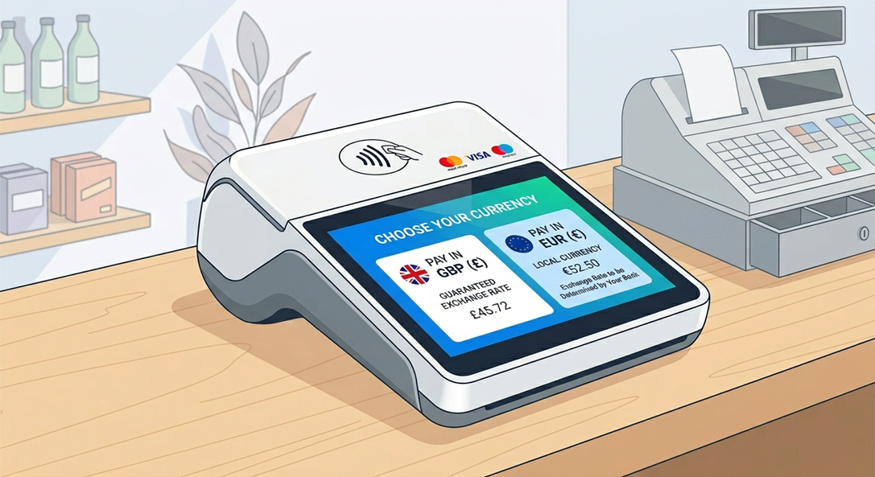
Paying in GBP or local currency
When paying with either credit card or debit card, you may be given the option to pay in GBP (£) or the local currency.
Why choosing to ‘pay in GBP’ may cost more
Usually gives a worse exchange rate
Retailer sets the rate — not your bank
Often includes a markup
Can cost more overall per transaction
You may still face additional card fees on top

Slide 34
Ensuring your holiday is protected

Slide 35
Ensuring your holiday is protected
Before booking a package holiday, you should check if it has ATOL protection
Protects you if a travel company ceases trading before or during your trip
Ensures you either get a refund or are brought home if stranded abroad
Look for the ATOL logo and a valid licence number
1
2
3
4
5
6
Covers package holidays that include flights
Check your booking includes an ATOL certificate
Not all bookings are covered — flights booked directly with an airline are not normally covered

Slide 36

Buy your travel insurance early
You should consider taking out travel insurance for any holiday booking, and preferably as early as possible.
Covers you if you need to cancel before travelling
If you become ill or injured before taking out insurance, you may not be covered for it
Protection starts from booking, not departure

Slide 37
What should your policy cover?
Look for a policy that includes cover for:
01
03
02
04
Emergency medical treatment abroad
Lost or delayed luggage
Cancellation and curtailment
Travel delays and disruptions
Medical cover could be the most important component as costs can be very high.

Slide 38
What to check before you buy
Destination covered (Europe vs worldwide)
Whether it’s more cost effective to buy annual cover or a single trip policy
Cover limits and excess levels
Cover for pre‑existing medical conditions you declare
Activities included (e.g. skiing, water sports, motorbike / scooters)
The cheapest policy isn’t necessarily the best.

Slide 39
Common mistakes to avoid
01
Relying on bank account insurance without checking coverage
02
Not declaring medical conditions
03
Choosing cover limits that are too low
04
Buying insurance just before travel
Claims may be rejected due to simple mistakes on what your policy covers

Slide 40

Making use of your LSEG benefits
Personal Travel Insurance
Provides coverage for any trip that includes an overnight stay or a flight, whether in the UK or abroad.
Emergency backup care
Provides practical support to help manage family responsibilities, particularly during unexpected situations.
Disclaimer: My Offers (the service), provided by Next Jump, an independent third party.
Notes:
Travel Insurance
The Personal Travel Insurance policy provides coverage for any trip that includes an overnight stay or a flight, whether in the UK or abroad. It offers financial protection with up to £5,000 for trip abandonment and up to £1,000 for missed departures, helping to reduce the impact of unexpected disruptions. The policy also covers participation in over 200 sports, including higher-risk activities such as motor biking. Employees can choose worldwide cover, add winter sports protection, and extend the policy to partners and children. Trips are covered for up to 60 days, though business travel covered by a separate company policy is excluded.
Emergency Back-up Care (Bright Horizons Care Advantage)
The Bright Horizons Care Advantage Programme provides practical support to help manage family responsibilities, particularly during unexpected situations. A key feature is access to emergency back-up care for children and adult dependants, with up to 15 days available per employee each year. This care can be arranged up to one month in advance, giving flexibility when usual arrangements fall through. The programme also resets annually in March, ensuring ongoing access to support.
Additional Family Support Services
In addition to emergency care, the Care Advantage Programme helps employees find long-term childcare and adult care solutions. This includes access to exclusive discounts at participating nurseries and holiday clubs across the UK, making regular care more affordable. Employees also benefit from preferred access to Bright Horizons nurseries and online resources that simplify the search for suitable care options, helping to balance work and family life more effectively.

Slide 41
Travel pitfalls and debt traps

Slide 42
Borrowing
Credit cards, BNPL and overdrafts can all be used to fund a holiday — but may lead to debt
Avoid bringing debt back from your holiday
The cost isn’t reduced — it’s just delayed
Interest and fees can increase the total cost of your holiday
You may need to repay borrowing while also funding holiday spending
It’s easy to lose track of what you’ve spent across different methods
£
Have a clear repayment plan — ideally within any interest‑free period
Short‑term spending can quickly become long‑term debt

Slide 43
Think beyond the flight price
07
Peak vs off‑peak timing can shift costs between flights, hotels and activities
06
Transfers (airport to hotel) can vary significantly in cost
05
Airlines often charge extras for bags, seat selection and add‑ons
04
Early/late flights can add extra costs (taxis, airport food, overnight stays)
03
Car hire and transport costs may be higher during “cheap flight” periods
02
01
Check accommodation costs — a low flight price can hide an expensive destination
A cheaper departure airport may mean higher travel costs (e.g. train, parking, hotels)
Make a big impact with professional slides, charts, infographics and more.

Slide 44
“We’ll worry about it later”
Small extras feel harmless at the time
Costs build up because decisions are made in the moment, not planned
It’s easy to think “I’ll deal with it when I’m back”
Spending becomes more about experience and emotion than budget
Holidays feel like a one‑off treat, so spending rules get relaxed
The impact is often only felt after the holiday ends

Slide 45
Your holiday checklist
Set a realistic budget and estimate the total cost of your trip
Plan ahead for childcare, school holiday costs and family spending needs
Include all spending — travel, meals, activities and extras
Check the full cost of your holiday, not just the flight price
Plan how you’ll access your money abroad (cards, cash, backup options)
Understand fees and exchange rates — pay in local currency where possible
Avoid relying on borrowing without a clear repayment plan
Take out travel insurance as soon as you book
Check your policy includes medical cover and appropriate limits
Confirm your booking has ATOL protection (if applicable)

Slide 46
Next steps

Slide 47
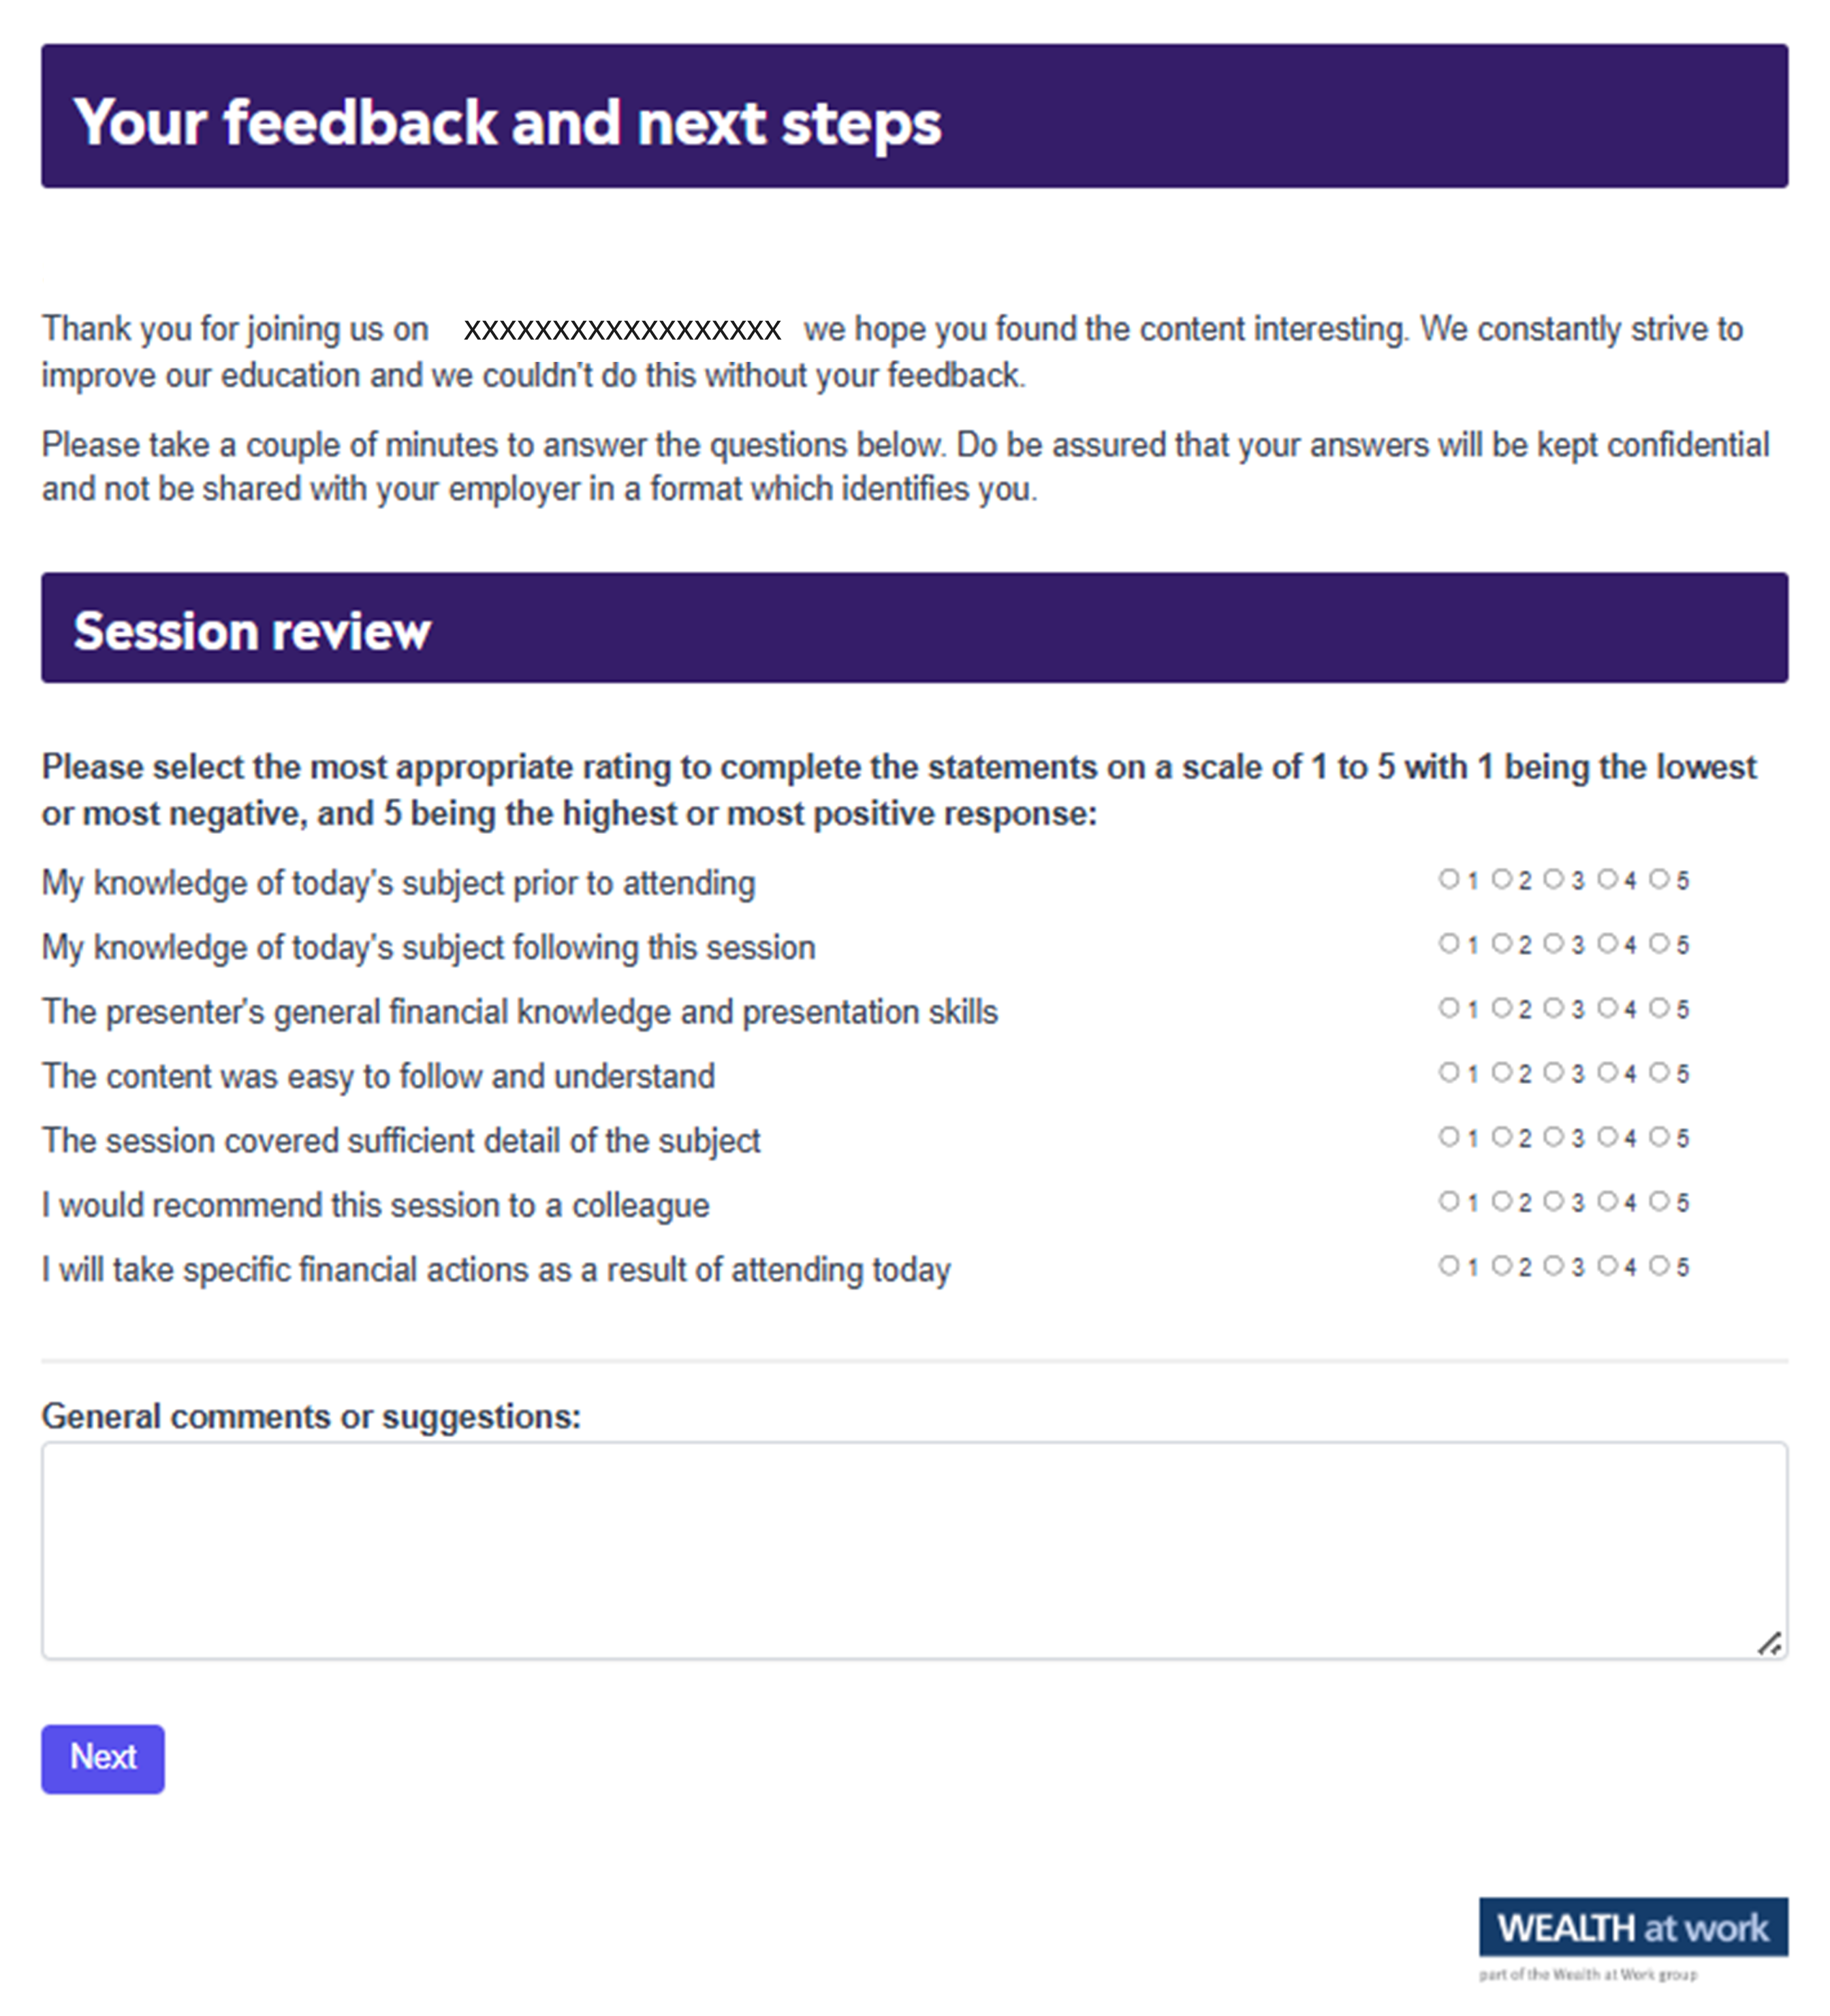
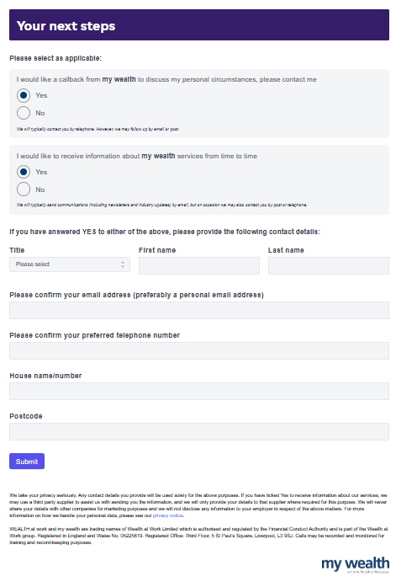
Your feedback
We value your feedback!
Please take a moment to complete
the session review.
759533470
Notes:
Page 1. Unique feedback form for general use.

Slide 48

Next steps
Next steps
To take the next steps, speak to a personal financial coach at my wealth
Option 1: Request a callback from my wealth to discuss your personal circumstances.
Option 2: Receive information about my wealth services.
211146986
Notes:
Page 2. Unique feedback form for general use.

Slide 49

Your feedback
Scan QR code
QR code to be pasted here if required
180650109

Slide 50
Next steps
393965084

Slide 51
Useful contacts
MoneyHelper
01
www.moneyhelper.org.uk/en/everyday-money/budgeting
GOV.UK travel advice
02
        www.gov.uk/foreign-travel-advice
GOV.UK Tax-Free Childcare
03
www.gov.uk/tax-free-childcare
NHS Healthcare Abroad
04
        www.nhs.uk/using-the-nhs/healthcare-abroad/
ABTA – support if something goes wrong
05
www.abta.com/help-and-complaints

Slide 52
Seeking advice
    An adviser will assess your circumstances, objectives and risk profile and provide you with a personal recommendation to meet your objectives.
    All regulated firms are listed on the Financial Services Register, this provides confirmation that the firm is authorised, the specific services they are authorised to provide and details of the advisers who work for them.
    Financial Services Register link:
    https://register.fca.org.uk
252395834

Slide 53
Contact us
We provide a telephone helpline and a regulated investment advice service through my wealth - a trading name of Wealth at Work Limited which is part of the Wealth at Work group.
It helps individuals to understand their personal financial situation especially when selecting their retirement income options.
      Request a callback from the helpline via the feedback form to discuss your personal circumstances with my wealth and agree your next steps and receive regulated investment advice where required
      You can also telephone 0800 028 3200
141862785

Slide 54
Education caveat
All copyright or other intellectual property rights in the material constituting this presentation which has been provided by Wealth at Work Limited remains the property of the Wealth at Work group.
The content of this presentation is provided for illustrative purposes only and is not intended to be used for individual investment or financial planning and does not constitute financial advice.
Whilst every effort is made to ensure the accuracy of information contained in the presentation it cannot be guaranteed. In particular the rules relating to tax can frequently change.
Any references to tax or the operation of tax or tax reliefs are illustrative only and the tax treatment in respect of any individual depends upon the circumstances of each individual.
It is important to recognise that the value of investments related to the stock market (and any resulting benefits such as interest or dividends), can rise or fall and an investor may not get back the amount invested. Past performance data used is for illustrative purposes only and is not necessarily a guide to future performance.
Any hyperlinks or references to third parties or their websites are provided for information only and it does not mean that we endorse their products or services. We have no control over these and accept no legal responsibility for any content, material or information contained in them.
WEALTH at work and my wealth are trading names of Wealth at Work Limited which is authorised and regulated by the Financial Conduct Authority and part of the Wealth at Work group. Registered in England and Wales No. 05225819. Registered Office: Third floor, 5 St Paul’s Square, Liverpool L3 9SJ. Telephone calls may be recorded and monitored for training and record-keeping purposes.
881862975
Notes:
Back end caveat (WAW only)

Slide 55
Thank you
0800 028 3200
www.wealthatwork.co.uk/mywealth
156297902

