Slide 1
Welcome to: family finances
QC--379656177

Slide 2


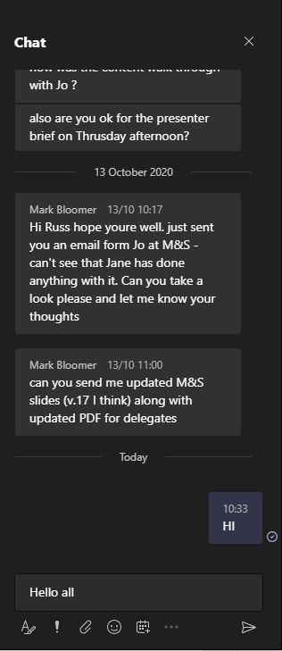

Using the chat box
click the chat box icon
type a message
Hello all…
tap the chat box icon
(it may be at the top of your device’s screen)
410452555

Slide 3
About us
WEALTH at work is a leading financial wellbeing, retirement and workplace savings specialist.
Established in 2005, we work with hundreds of organisations across both the private and public sector.
Our financial education services are delivered on a bespoke basis.
341377444

Slide 4
Financial education structure
Follow up call
You will be able to ask questions relating to your own circumstances.
Online Seminar
Next steps
Today’s online seminar will cover financial education.
We will identify your next steps and point you in the right direction.
27949402

Slide 5

Agenda
Creating a budget plan
Raising a young family
  How your costs may change
  Managing your finances
  Saving for your child’s future
Caring for an adult
  Long term and elder care
  Saving for your financial future
  Next steps

Slide 6
Creating a budget plan

Slide 7
Budgeting – 4 steps
Take action
Surplus or deficit?
List all your expenses
Calculate your income
Search: ‘MoneyHelper Budget Planner’
636988732
Notes:
2
Calculate all possible sources of income including, partners income, benefits, dividends, second income (rental?)
Get bank statements & credit card bills to find a full list of expenses. Make sure you include any debts that are due soon
Have you got a surplus or deficit?
Take action – If you have a deficit it could be a good idea to look at your spending. If you have a surplus make sure your money in is the right areas and all debt incurring interest is paid off.

Slide 8








Your assets and costs
Get valuations for savings and investments you have a consider how your costs may change in the coming years.
  Pension
  Mortgage
  Savings
  Other debt
Costs include:
Assets
include:
  ISA
  University fees
  Property
  Childcare
  Investments
  Insurance & utility bills
Notes:
6

Slide 9
Raising a young family – how your costs may change

Slide 10
Consider how your costs will change
Children starting nursery and/or school
reduced childcare costs?
Activities / entertainment
school trips, holidays, games?
Baby clothes, nappies etc.
fall to zero?
School uniform, clothes, food
how are these likely to change in the future?
Hobbies
?
Putting money aside for their future
?

Slide 11
The cost of raising a child
Under 5
Home adaptations
Childcare
Clothing
School age
School
activities
Hobbies
Tech
Average cost of raising a child up to the age of 18
£185,413
18+
Further
education
Moving
home
Ongoing financial support
Notes:
Compliance note: figures used from LV & Money Helper.

Slide 12

Tax-free childcare
Benefits
Receive a £2 “top up” for every £8 you pay into your childcare account until your child is 12*
Limits
£2k
Top up capped at £500 per quarter
£8k
or £2,000 per year
Eligibility
You and your partner must be earning at least minimum wage
You or your partner cannot be in receipt of certain benefits
£500
You or your partner cannot earn over £100,000
£2k
Further information
Government top up
gov.uk/tax-free-childcare
Personal contribution
*If you’re working, you may be able to get up to £4,000 a year to help pay for childcare for a disabled child until age 17.
644354846
Notes:
644354846
Approved childcare could include: childminders, nurseries and nannies, after school clubs and play schemes.

Slide 13
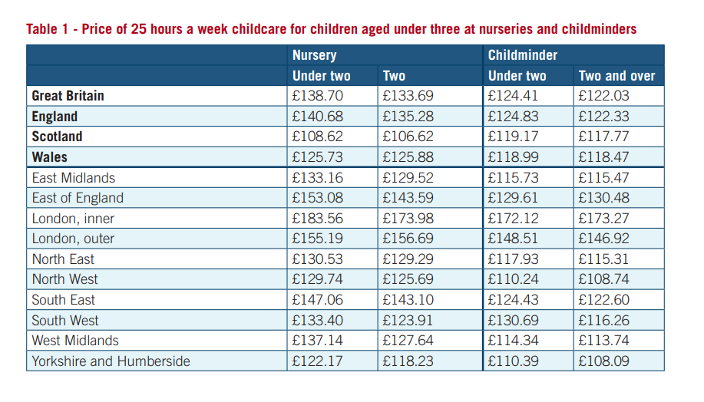
Returning to work considerations
  Understand how much childcare will cost you
Weighing up childcare costs and reduced working hours
  Calculate your income after tax on your reduced earnings
  Understand what work &/or government benefits you may be entitled to claim
  Consider your family’s overall financial picture
Average childcare costs in inner London
Registered childminder, 25 hours for a child under 2 = £172 per week
Day nursery, 25 hours for a child under 2 = £184 per week
Source: Family and Childcare Trust – Childcare Survey
Notes:
Figures taken from a 2022 study
https://www.familyandchildcaretrust.org/sites/default/files/Coram%20Childcare%20Survey%202022.pdf

Slide 14
Managing finances with a young family

Slide 15
Flexible working arrangements
Flexible Workweek
Job Sharing
Work from a different location
Change: hours, days, start/end times
Two part-time employees sharing a full-time job
On a partial or full week basis
Not every job or person is suited to a flexible working arrangement (FWA)
You should speak to your manager if you would like to be considered for a flexible working arrangement
For further information you should approach your line manager in the first instance

Slide 16
Reduced hours - tax considerations
Ensure you understand the impact on your net income.
FULL TIME
REDUCED HOURS
Days worked……….
5 days
Days worked……….
4 days
Full time gross salary….
£50,000
Reduced gross salary….
£40,000
Monthly net salary…..
£3,293
Monthly net salary…..
£2,693
£50,000pa
£40,000pa
=
20%
reduction
£3,293pm
£2,693pm
=
18%
reduction
Use HMRC’s Income Tax and National Insurance calculator to estimate your tax:
www.gov.uk/estimate-income-tax

Slide 17



Child benefit
£27.05 per week
for your first child
£17.90 per child each week for further children
Earn over £60,000?
Earn over £80,000?
Still Claim
Repay 1% of child benefit for every £200 you or your partner earns over £60,000
You will repay all your child benefit as income tax
You can still opt to receive entitlements but not payments
If you don’t claim you may miss out on:
National Insurance credits for your State Pension
Your child being automatically issued with a National Insurance number before their 16th birthday
436182552
Notes:
436182552
https://www.gov.uk/government/publications/changes-to-the-high-income-child-benefit-charge/information-on-changes-to-the-high-incomechild-benefit-charge#:~:text=As%20announced%20at%20Spring%20Budget,60%2C000%20from%206%20April%202024.&text=For%20instance%2C%20you'll%20be,income%20that%20exceeds%20%C2%A360%2C000.

Slide 18
Saving for your child’s future

Slide 19
Spending horizon
Long term
University fees & house deposit
Equities
Medium term
Property
Education & extra curricular activities
Bonds
Fixed term savings
Short Term
Home adaptations & baby costs
Easy access savings
Current account
819793480
Notes:
Presenter note: Only hold money in a current count if you have a good interest rate.

Slide 20
Savings in your child’s name
Bank/Building Society Accounts
Cash savings accounts
Interest may be tax free if it falls within the child’s personal allowance
‘£100 rule for parents’
Savings given to a child by a parent or step-parent are taxed at the parent’s marginal tax rate if it generates more than £100 a year in interest
– does not apply to grandparents, other family or friends
Subject to the rules of the account, children over 7 can operate their own savings account

Slide 21
Junior ISA (JISA)
  A tax efficient long term savings vehicle for your child
  An ISA protects your savings from taxation
  Available as cash ISA or stocks and shares ISA
  Open from birth - access from age 18
  Child Trust Fund accounts can transfer to a JISA
Cash
ISA
Contribution Limit
£9,000
current tax year
Bonds
Equities
400293322

Slide 22
Long term care
728840750
Notes:
728840750

Slide 23

How much you pay depends on..
The value of your savings, assets and income
The level of help you need
What funding you might be entitled to
Your health
Free NHS Continuing Healthcare
You may qualify if you have mostly healthcare needs rather than social needs
There’s no clear-cut list of health conditions or illnesses that qualify
The assessment is strict - most people do not qualify
To apply, ask your GP or social worker for a NHS Continuing Healthcare assessment
WEALTH at work colours
163474269
Notes:
163474269
Note to presenter:
NHS FUNDED CARE ASSESSMENT:
What is covered?
Normal NHS healthcare – for example, from your GP, health visitor or in hospital – is free.
But NHS continuing healthcare covers extra costs, such as help with washing or dressing, or paying for specialist therapy.
It might also include accommodation if your care is provided in a care home, or support for carers if you’re being looked after at home.
Step 1 – The initial screening
First, you’ll have an initial screening to see if you qualify for funding.
It’s usually carried out in hospital or at home by a nurse, doctor, social worker or other healthcare professional.
They’ll assess your general health and care needs with a simple checklist. It will cover:
mobility
breathing
continence
communication
nutrition – food and drink
skin – including wounds and ulcers
psychological and emotional needs
altered states of consciousness
symptom control through drug therapies and medication
cognition – everyday understanding of what’s going on around you
other significant care needs.
If your health, or the health of someone you care for, is getting worse quickly – ask about a fast track assessment to bypass the initial screening.
Step 2 – The assessment
Even though the assessment process can be complex, most people and families who’ve been through it say the benefits are worth it.
If the initial screening shows you might be able to get free NHS continuing healthcare, you’ll need to have another assessment.
It will be carried out by a team of two or more health and social-care professionals who are involved in your care.
The team will use a Decision Support Tool which is more detailed than the checklist above. They will assess the possibility of ultimate eligibility and will decide if you should be red to the next stage.
They’ll mark each of your care needs as no need, low, moderate, high, severe or priority.

Slide 24
Local council funded care
STEP 1 – CARE NEEDS ASSESSMENT
STEP 2 – FINANCIAL ASSESSMENT
A social worker carries out the assessment
Care isn’t normally free
Needs are checked against nationally agreed criteria
There’s a means tested financial assessment
The council has a duty to provide &/or arrange the care services
This will show you how much you will need to contribute
473142282
Notes:
473142282
For use in England, Scotland & Wales
Getting a local council care needs assessment
Before they can help, your local council must carry out a care needs assessment. It’s free and it’s your legal right to have one.
You shouldn’t be ed an assessment because the local council thinks your needs aren’t great enough or that you won’t qualify for financial help.
The local council will identify your care needs and check that they meet a nationally agreed set of criteria.
If you qualify for help, they have a legal duty to provide or arrange the services you need.
They’ll then carry out a financial assessment to work out if you should pay towards any services you need.
Financial assessment and eligibility
If you qualify for help, your local council will carry out a financial assessment.
This is called a ‘means test’. It helps to work out how much you should pay towards the cost of your care.

Slide 25
Financial assessment – looks at:
YOUR REGULAR
INCOME
YOUR
CAPITAL
  State Pension & benefits
  Savings & Premium Bonds
  Private & occupational pensions
  Investments
  Rental income
  Your home & other property
If you have income as part of a couple, then only your share will be taken into account
  Jointly held assets are generally split equally
714573089
Notes:
714573089

Slide 26
Financial assessment – your home
Any of the following still live there:
    a spouse, partner or civil partner
    a close relative who is over 60 or older or receives disability benefit
    a child you’re legally responsible to support
WEALTH at work colours
You move into care on a temporary basis
You will be receiving care in your own home
£
Your home will be excluded if:
288002785
Notes:
288002785

Slide 27
Deprivation of assets
  Deliberately decreasing your assets to reduce the amount you are charged towards care
£
WEALTH at work colours
Evidence
  Your local council (HSC in Northern Ireland) must show that you have intentionally reduced your assets
£
  Third parties who received the assets could be liable to repay the local council (or HSC)
Source: Department of Health – Care & Support Statutory Guidance
441896711
Notes:
441896711

Slide 28
Capital limits: England
Fully Funded
Partially Funded
You will need to contribute £1 for every £250 of capital above £14,250
Self Funded
Capital of less than:
£14,250
Capital between:
£14,250 - £23,250
Capital of more than:
£23,250
You may still be expected to contribute from your income
Limits apply to residential care and care at home
224808411
Notes:
224808411
Note to lecturer – Display in England

Slide 29
Paying for care costs
Equity release
Can you claim any benefits?
Access money tied up in your property
Downsizing or renting out your home
Search: ‘Age UK benefits calculator’
It may be more cost effective than equity release
DWP
£
Immediate needs annuity
Selling things you own
Provides a regular income in exchange for a lump sum - income is tax-free if paid directly to care provider
Such as art, antiques or collectibles
633080641
Notes:
633080641
Note to lecturer:
Please mention transaction costs may affect the viability of downsizing your home.
Claim the benefits you’re entitled to
Attendance Allowance is money for people aged 65 or over who have care needs.
It could include help outside the home. It does not matter if no one actually gives this help, as long as you can show you need it.
You can have any type of disability or illness, including sight or hearing impairments, or mental health issues such as dementia.
To claim Attendance Allowance you must have needed help with your care needs for at least 6 months. (If you’re terminally ill you can make a claim straight away.)
Attendance Allowance is not means-tested so your income and savings are not taken into account when assessing if you qualify for the benefit.
It is paid tax-free - Claiming Attendance Allowance won’t reduce any other income you receive.
Depending on the situation other benefits may be available. Benefit calculators are available at the following charities websites:
Entitled to (www.entitledto.co.uk)
Turn2us (www.turn2us.org.uk)
Equity release – consider overall cost
When it comes to long-term-care planning, equity release schemes can be useful, but only if you’re looking to fund care in your own home and you do not qualify for local authority support.
However, if you think you’ll soon need to move out into residential care, then equity release probably won’t be suitable.
That’s because equity release arrangements require you to repay the loan in full if you move permanently into a care home.

Slide 30
Are you entitled to any benefits?
There are a range of benefits from the government you may be entitled to.
Carer’s allowance
Child benefit
Warm home discount scheme
Childcare grants
Entitled To
Housing benefit
Free school meals
Universal Credit and Job Seekers Allowance (JSA)
Parents learning allowance
Anything received from JSA is deducted from any Universal Credit you may receive. If your partner works, you can apply for New Style JSA, as your partner’s work does not affect your entitlement.
731459337
Notes:
731459337
15 minute calculator on - entitledto.co.uk
https://www.gov.uk/benefits-calculators

Slide 31

Further information on care
MoneyHelper
www.moneyhelper.org.uk/en/family-and-care/long-term-care
Age UK
England: www.ageuk.org.uk
Scotland: www.ageuk.org.uk/scotland
WEALTH at work colours
Wales: www.ageuk.org.uk/cymru
Northern Ireland: www.ageuk.org.uk/northern-ireland
447291012
Notes:
447291012

Slide 32
Saving for your financial future

Slide 33
Saving for your future
Whether you have a young family or are providing long term elder care, it is important you keep on top of your own finances.
Benefits including your pension are protected whilst you are on parental / shared parental leave
Review your workplace pension values, current contributions and planned retirement date
State Pension credits will also be built up if you are on parental leave or receiving certain benefits as a carer

Slide 34
Creating an emergency fund
If you are in a position to put money aside, take these steps to create an emergency fund:
901328035
Notes:
5

Slide 35
Creating an emergency fund
If you are in a position to put money aside, take these steps to create an emergency fund:
Add up your essential monthly expenditure
331168423
Notes:
3

Slide 36
Creating an emergency fund
If you are in a position to put money aside, take these steps to create an emergency fund:
Add up your essential monthly expenditure
Aim to save 3-6 months worth of this calculation
17963225
Notes:
5

Slide 37
Creating an emergency fund
If you are in a position to put money aside, take these steps to create an emergency fund:
Add up your essential monthly expenditure
Hold this money in an instant access account
Aim to save 3-6 months worth of this calculation
959845085
Notes:
5

Slide 38
Individual Savings Accounts (ISAs)
  An ISA protects your savings and investments from taxation
  Interest and dividends are tax-free
  Growth is free of Capital Gains Tax
Cash
Bonds
ISA
Contribution Limit
£20,000
current tax year
Equities
605319790
Notes:
You can pay into more than one individual savings account in a tax year, including accounts of the same type, as long as you don’t exceed your £20,000 ISA allowance. This applies to Cash ISAs, Stocks and shares ISAs and Innovative Finance ISAs.

Slide 39
Risk and returns: the real world
The value of £100 originally invested 31/12/2015 by 31/12/2025
FTSE All Share Total Return
Total Return Over Period 31/12/2015 – 31/12/2025
FTSE All Share TR ……………..
123.45%
IA Sterling Corporate Bond …...
30.81%
Cash*……………………..….…
18.86%
UK CPI …………………..
39.08%
CPI
Bonds
Cash
This chart shows past performance which is not a reliable guide to the future
Source: Financial Express & Bloomberg
*Cash is calculated using: FE FER Cash Proxy from 31/12/2015 to 31/12/2018 and the UK Bank of England Base rate from 31/12/2018 to 31/12/2025.
273593575

Slide 40


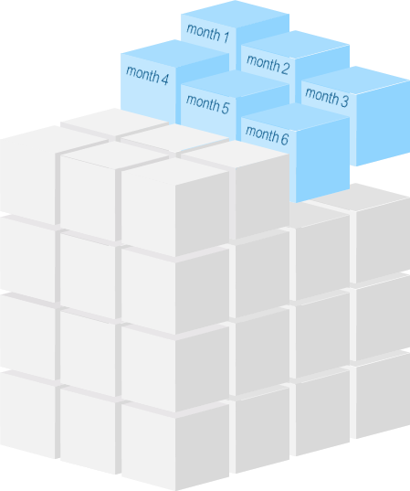
Defined contribution (DC) schemes
  Employer and employees contribute (tax-free*)
  Any investment growth is tax-free
  You can access your pension from age 55**
pension input
  Receive up to 25% tax-free
Receive a taxable lump sum or generate a taxable income with remaining pot
*subject to HMRC limits
**The minimum age for accessing your pension is expected to increase to age 57 from 6 April 2028. Pension savings in certain schemes may be protected from this change.
779311300

Slide 41
Your pension contributions
You Pay | LSEG Pays | Total
3% | 6% | 9%
4% | 8% | 12%
5% | 10% | 15%
  You can increase contributions beyond 5% however LSEG’s contributions will not increase further
  You can change contribution levels at any time on MyBenefits
  Contributions are defaulted to be paid via salary sacrifice
Notes:
The client has a few legacy DC contribution structures which may come up. Refer to HR for further info.

Slide 42
How your contributions may add up
Annual Salary £45,000 (basic rate taxpayer)
Employee Contribution = £2,250pa (5%)
Tax Saving = 20%
NI Saving = 8%
Personal Cost = £1,620pa
Employer Contribution = £4,500pa (10%)
TOTAL
£6,750
£4,500
£630
£2,250
Employer matching contribution (10%)
£1,620
Tax & NI savings
Employee contribution (5%)
*Percentage shows the increase in total contribution when compared to the personal cost.

Slide 43

The new State Pension
    You’ll only receive the full amount of the State Pension (£241.30pw 2026/27) if you’ve paid, or been credited with 35 years’ National Insurance (NI)
  The credits are automatically added to your NI record
  Keep track of your NI Record and view your State Pension forecast
  You’ll receive NI credits if you claim Child Benefit until your youngest child is 12
www.gov.uk/check-state-pension

Slide 44
National Insurance credits
There are number of benefits you or someone you care for might receive that will provide NI credits towards State Pension entitlement.
Statutory Sick Pay
Maternity Allowance
Incapacity Benefit/ Employment and Support Allowance
Unemployability Supplement or Allowance
Universal credit

Slide 45
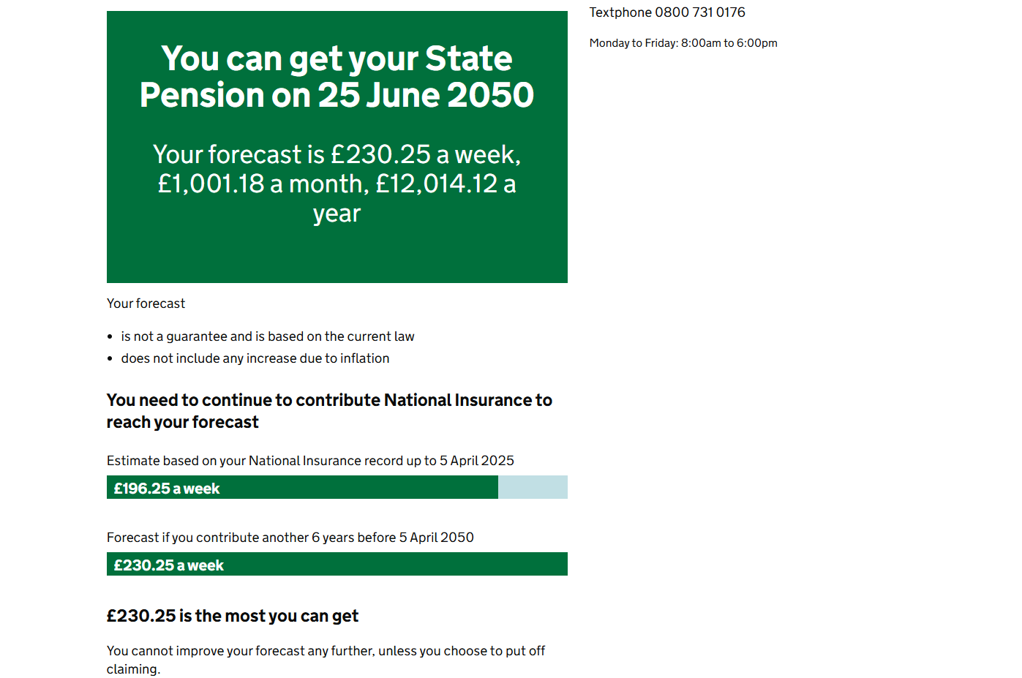
State Pension forecast
Your State Pension summary
You can get your State
Pension on 25 June 2036
www.gov.uk/check-state-pension
£175.20 a week
Your forecast is £241.30 a week,
£1,049.22 a month, £12,590.68 a year
Your forecast
is not a guarantee and is based on the current law
does not include any increase due to inflation
You need to continue to contribute National Insurance to reach your forecast
Estimate based on your National Insurance record up to 5 April 2026
£193.04 a week
Forecast if you contribute another 7 years before 5 April 2036
£241.30 a week
282334458
Notes:
The forecast shows you:
How much you could get
When you get it
How to increase it if you can
Calculation of annual figure: (£241.30/7) x 365.25 = £12,590.68
Calculation of monthly figure: (£241.30/7) x 365.25 = £12,590.68 / 12 = £1,049.22
Example shows someone with 25 years NI record
(£241.30 / 35) x 28 = £193.04

Slide 46
Summary
Review your income & expenditure
Calculate the costs you are incurring as a carer
Review where your current savings & investments are being held
Consider what benefits you could be entitled to

Slide 47
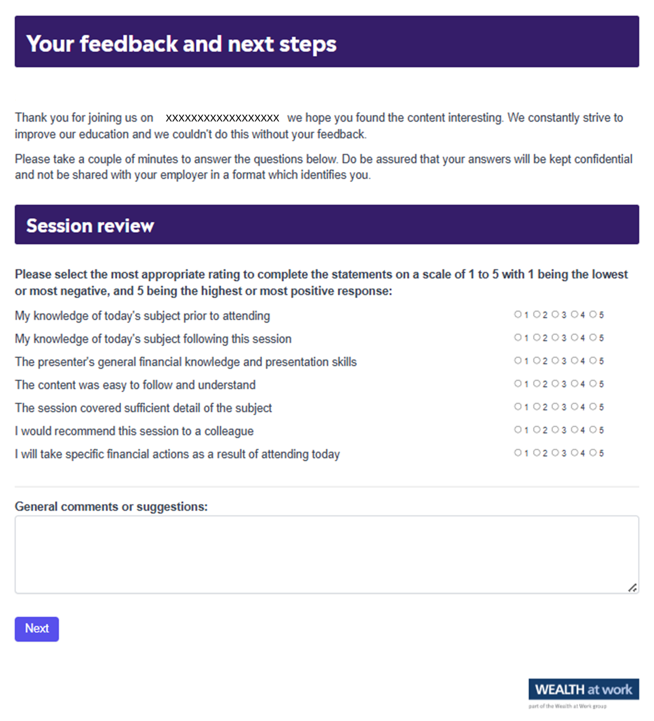
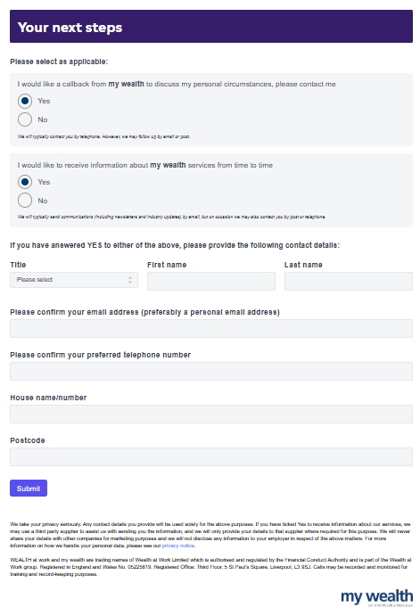
Your feedback
We value your feedback!
Please take a moment to complete
the session review.
759533470
Notes:
Page 1. Unique feedback form for general use.

Slide 48

Next steps
Next steps
To take the next steps, speak to a personal financial coach at my wealth
Option 1: Request a callback from my wealth to discuss your personal circumstances.
Option 2: Receive information about my wealth services.
211146986
Notes:
Page 2. Unique feedback form for general use.

Slide 49

Your feedback
Scan QR code
QR code to be pasted here if required
180650109

Slide 50
Next steps

Slide 51
Useful contacts & resources
01
      Money Helper pension calculator
        www.moneyhelper.org.uk/en/pensions-and-retirement/pensions-basics/pension-calculator
02
      State Pension forecast
        www.gov.uk/check-state-pension
03
General tax and National Insurance information
        www.hmrc.gov.uk
04
  Statutory maternity pay and leave
  Statutory paternity pay and leave
        www.gov.uk/maternity-pay-leave
        www.gov.uk/paternity-pay-leave
05
  Entitled To
        www.entitledto.co.uk

Slide 52
Seeking advice
    An adviser will assess your circumstances, objectives and risk profile and provide you with a personal recommendation to meet your objectives.
    All regulated firms are listed on the Financial Services Register, this provides confirmation that the firm is authorised, the specific services they are authorised to provide and details of the advisers who work for them.
    Financial Services Register link:
    https://register.fca.org.uk
252395834

Slide 53
Contact us
We provide a telephone helpline and a regulated investment advice service through my wealth - a trading name of Wealth at Work Limited which is part of the Wealth at Work group.
It helps individuals to understand their personal financial situation especially when selecting their retirement income options.
      Request a callback from the helpline via the feedback form to discuss your personal circumstances with my wealth and agree your next steps and receive regulated investment advice where required
      You can also telephone 0800 028 3200
141862785

Slide 54
Education caveat
All copyright or other intellectual property rights in the material constituting this presentation which has been provided by Wealth at Work Limited remains the property of the Wealth at Work group.
The content of this presentation is provided for illustrative purposes only and is not intended to be used for individual investment or financial planning and does not constitute financial advice.
Whilst every effort is made to ensure the accuracy of information contained in the presentation it cannot be guaranteed. In particular the rules relating to tax can frequently change.
Any references to tax or the operation of tax or tax reliefs are illustrative only and the tax treatment in respect of any individual depends upon the circumstances of each individual.
It is important to recognise that the value of investments related to the stock market (and any resulting benefits such as interest or dividends), can rise or fall and an investor may not get back the amount invested. Past performance data used is for illustrative purposes only and is not necessarily a guide to future performance.
Any hyperlinks or references to third parties or their websites are provided for information only and it does not mean that we endorse their products or services. We have no control over these and accept no legal responsibility for any content, material or information contained in them.
WEALTH at work , my wealth, my wealth private and my wealth invest are trading names of Wealth at Work Limited which is authorised and regulated by the Financial Conduct Authority and part of the Wealth at Work group. Registered in England and Wales No. 05225819. Registered Office: Third floor, 5 St Paul’s Square, Liverpool L3 9SJ. Telephone calls may be recorded and monitored for training and record-keeping purposes.
881862975
Notes:
Back end caveat (WAW only)

Slide 55
Thank you
0800 028 3200
www.wealthatwork.co.uk/mywealth
156297902

